Slide 1
Training course: Surviving digital
Module 2 – How to set up your own contributory research project?
www.survivingdigital.eu

Slide 2
Introduction
Objectives
Skills addressed and learning outcomes
Theoretical knowledge
Techniques
Case studies and Activities
Tips and hints

Slide 3
Introduction
In the past years, there has been increased focus on the negative effects excessive screens exposure might have on the development of young children. Scientific studies have shown correlations between screen time and attention, sleep quality, obesity, and emotional dysregulation, while many European countries and health organisations have issued official recommendations regarding screen time and best digital practices.
While we know more about the effects of the overexposure, we are still far from coming up with an efficient way of fighting against this problem. The proof? The number of hours children spent in front of screens is on this rise. The problem? Today, local authorities and health care agencies will often communicate general advice on recommended screen time and ways of practicing screens, without considering the situation of the parents in question. For screens as for other social problems, “centralized policies and programs generated by “experts”, as E Stringer writes, ‘have limited success in resolving […] problems” (2007).
In this module, we look at how to launch a process for coming up with strategies against overexposure adapted for a particular local context. Working from the principles of action research, it will give professionals the tools to instigate work with parents, researchers and other professionals, and position themselves sensibly to ensure a fruitful and sustainable collaborative action.

Slide 4
Objectives
The module will take professionals through the main steps to get started on a contributory research project on overexposure to screens of children.
It will introduce them to the theory behind action research and outline the main differences between traditional action research and the form of action research that we call contributory research.
The theory will be supported by a case study that will demonstrate how such research might look in practice.
Finally, it will propose three concrete exercises that will help a group of actors getting started with their own action against screens.
Identifying Contributory Research Opportunities will guide professionals in identifying specific areas within the context of children's screen time where contributory research can make a meaningful impact.
Emphasize the importance of community involvement and collaboration in contributory research initiatives.
Outline the key differences between contributory research and traditional action research methodologies.
Highlight the importance of diverse perspectives in contributing to a holistic understanding of the issue.

Slide 5
Skills adressed
01
Planning
02
Collaboration
03
Creativity
04
Teamwork and interpersonal relation
05
Empathy

Slide 6
What are the learning outcomes?
The learning outcomes in this context include the acquisition of new information, the development of research skills, improvements in collaborative and analytical skills, the stimulation of critical thinking, the promotion of innovation and creativity, active involvement in the learning process and the attribution of a sense of empowerment and autonomy as participants become active agents in the construction of knowledge and solutions.
Therefore, it will be necessary to: Understand the basic principles of action research and contributory research.
Decide on the necessary stakeholders for the research project
Define the agenda, position and role of the researcher.
Identify the characteristics of your territory and be able to adapt your approach accordingly.
Experience a sense of empowerment and autonomy as active agents in the creation of knowledge and the development of solutions, fostering a mindset of lifelong learning and continuous improvement.
Experience a sense of empowerment and autonomy as active agents in the creation of knowledge and the development of solutions, fostering a mindset of lifelong learning and continuous improvement.

Slide 7
Theoretical knowledge
Action research, a dynamic approach to inquiry and change, is characterized by its inherent goal of facilitating tangible and meaningful transformations within specific contexts. Rooted in a commitment to fostering positive societal change, action research is a participatory and collaborative process that seeks to bridge theory and practice, engaging stakeholders as active agents in shaping their own realities. This methodology emphasizes the intertwining of reflection and action, aiming to address challenges through an iterative and adaptive process of learning, implementation, and reassessment.
The process of action research unfolds through a series of interconnected stages, often involving cycles of planning, acting, observing, and reflecting. These cycles enable practitioners to continuously refine their understanding of the issue at hand, adapt strategies based on real-time feedback, and collaborate closely with stakeholders to develop context-specific solutions. In this way, action research transcends traditional research paradigms by fostering a symbiotic relationship between researchers and the researched, prioritizing co-creation of knowledge, and ensuring that the outcomes are not just academically significant but also practically impactful. Through its iterative nature and participatory ethos, action research stands as a powerful tool for enacting positive change within communities and organizations.
The role of the researcher in action research significantly diverges from that in a traditional research process. Unlike the detached and observer-centric stance often adopted in traditional research, the action researcher engages as an active participant, collaborator, and facilitator within the research context. In action research, the researcher's role is characterized by their direct involvement in the issue at hand, working closely with stakeholders to co-create knowledge and implement interventions. In this sense, all implicated partners in the process can rightly be considered a researcher.

Slide 8
The difference between Action Research and Contributory Research
Contributory research is action research with a particular focus on the different issues concerning technologies. It emphasises the valorisation of different types of knowledge, whether theoretical, practical, or lived knowledge. It means that a group of contributory research will always be constituted of researchers, professionals, and inhabitants, who contribute to the research process on equal terms.
The goal of contributory research is to come up with virtuous practices of digital technologies, which leads to the growth of participants’ knowledge instead of degrading these. The process of contributory research is in itself considered one of the ‘outcomes’, as it capacitates people on the issue in question in a way that allow them to undertake meaningful actions. Parent-Child Musical Journeys: Within the Explora'Son program, Ricochet Sonore offers parent-child musical journeys that incorporate elements of storytelling, immersive soundscapes, and visual imagery. Families participate in sessions where they learn about different cultures and musical traditions, engaging in activities such as listening, explanation, singing, and dancing.
Action research and contributory research are two distinct approaches to research that differ in their goals, methods, and overall purposes. action research is primarily concerned with practical problem-solving in real-world contexts through collaboration with practitioners, while contributory research aims to contribute to the theoretical understanding of a specific discipline or field.

Slide 9
Case study 1: Improvements in neonatal care
The action research focused on implementing Experience-Based Co-Design (EBCD) to enhance neonatal care processes. EBCD involved collaboration between healthcare professionals and patients to improve care through capturing experiences, understanding them, making improvements, and measuring outcomes. It aimed to address healthcare problems of varying complexity, classified as simple, complicated, and complex according to Glouberman and Zimmerman. The project highlighted that involving patients as "quality detectives" unveiled unnoticed problem areas, leading to significant improvements in simple issues and emphasizing the importance of patient involvement in addressing complex challenges.
The research revealed differences between staff and patient experiences, showcasing patients' unique insights. Collaborative efforts resulted in improvements in communication, breastfeeding advice, and collaboration with primary care staff. The EBCD approach facilitated learning for both healthcare professionals and patients, enhancing process understanding and collaboration. Problem categorization aided targeted interventions. In summary, EBCD's patient-centered approach demonstrated its effectiveness in tackling diverse healthcare issues, fostering collaboration, and improving overall care quality.
Gustavsson, S. M. K. (2014). Improvements in neonatal care; using experience-based co-design. International Journal of Health Care Quality Assurance, 27(5), 427–438. https://doi.org/10.1108/IJHCQA-02-2013-0016

Slide 10
1° Activity: Identifying the Critical Reference Group
The goal of this exercise is to help the healthcare professionals identify and map the relevant stakeholders who should be part of the action research process on the topic of overexposure to screens in young children. They will learn how to involve a diverse set of knowledge and expertise to address the issue comprehensively.
Materials Needed: Flipchart paper, markers, sticky notes, pens
Instructions
Begin by explaining the concept of a critical reference group and its importance in action research.
Provide participants with flipchart paper, markers, sticky notes, and pens.
Ask participants to individually brainstorm and write down potential stakeholders who could contribute valuable insights to the research on overexposure to screens in young children.
After brainstorming, have each participant share their ideas and place their sticky notes on a central board or wall.
As a group, discuss and categorize the stakeholders into different areas of expertise or knowledge.
Facilitate a conversation about how to approach and contact these stakeholders, considering potential common connections that could help facilitate meetings.
Encourage participants to consider the various perspectives these stakeholders might bring to the research process and how their involvement could contribute to a holistic understanding of the issue. Identify at least one type of knowledge or skill set particular to each of the identified stakeholders.

Slide 11
2° Activity: Defining Research Position and Stance
The aim of this activity is to guide participants in reflecting on their own position and stance as researchers to ensure a respectful and non-threatening engagement with the communities they intend to work with.
Materials Needed: Whiteboard, markers, projector (for online sessions)
Instructions
Introduce the importance of being self-aware as researchers and explain the terms 'agenda,' 'stance,' and 'position' in the context of action research.
Facilitate a group discussion where participants reflect on their objectives (agenda) for conducting the research, how they present themselves (stance), and their relation to the existing communities they plan to collaborate with (position).
Encourage participants to jot down their thoughts on a whiteboard or a shared online document.
Facilitate a discussion on the challenges and benefits of maintaining a balanced position and respectful stance. Let each participant present what they consider to be the main challenge in their engagement with communities: where is their experience and perspective likely to differ from local partners? How do they respond to the unequal power relation that is likely to arise when a researchers goes ’on the ground’? How will these insights influence the way they present themselves and approach people? Let other participants comment on the strategies evoked. Are there any ‘blind spots’ the participant has overlooked?
Based on the group discussions, let participants refine their agenda, stance, and position on the shared document.

Slide 12
3° Activity: Addressing Local Challenges and Advantages
This activity helps participants consider the unique challenges and advantages posed by the local territory to the action research process. They will brainstorm ways to tackle challenges and leverage advantages in conjunction with the stakeholder involvement and their own research position.
Materials Needed: Flipchart paper, markers, sticky notes, pens
Encourage participants to discuss the specific challenges they anticipate encountering during the action research process in their local area. How might the socio-economic and cultural position of the implicated population bear on the research process?
Facilitate a brainstorming session on the flipchart paper to list down these challenges.
After identifying challenges, guide the group in a discussion on potential strategies to overcome or mitigate these challenges.
Shift the focus to advantages that the local context may offer to support the action research process. What types of knowledge and activities do you hope to valorise through your work?
Similarly, brainstorm strategies to harness these advantages effectively.
Encourage participants to re-evaluate the stakeholders they identified earlier and consider how they can align their research position and stance with the local challenges and advantages.

Slide 13
Tips and hints for professionals
01
It is important that the trainer has some knowledge of the principles and process of Action Research to be able to guide professionals during the exercises.
02
We recommend that they familiarise themselves with one of the handbooks accessible on Action Research.
03
The book Action Research Third Edition by Ernest Stringer is written with a non-specialist audience in mind, which means that it is accessible even for those with no prior experience working on or with participatory research methods.
04
Allow participants to formulate their own strategies concerning their position before elaborating on the different concerns to take into consideration when engaging with communities.
05
It is an effective way of highlighting and collectively deconstructing some of the missteps that could be taken during the initial contact with future collaborators.

Slide 14
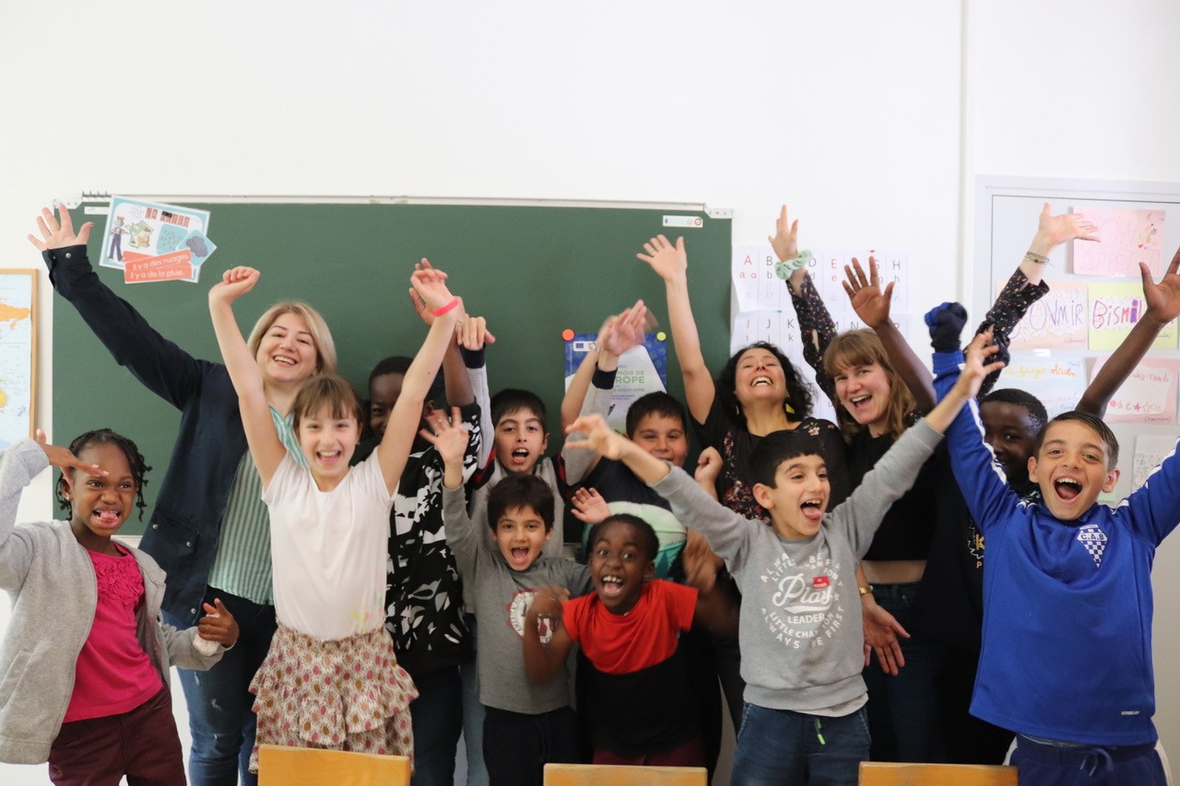
End of module
Thank you for reading this module, and we hope you enjoyed it and learned some useful information. This module is part of the Surviving Digital Training Course, you can find the rest of the modules on our website. Be sure to keep up to date on the project by following us on our social media channels!
www.survivingdigital.eu

