Slide 1
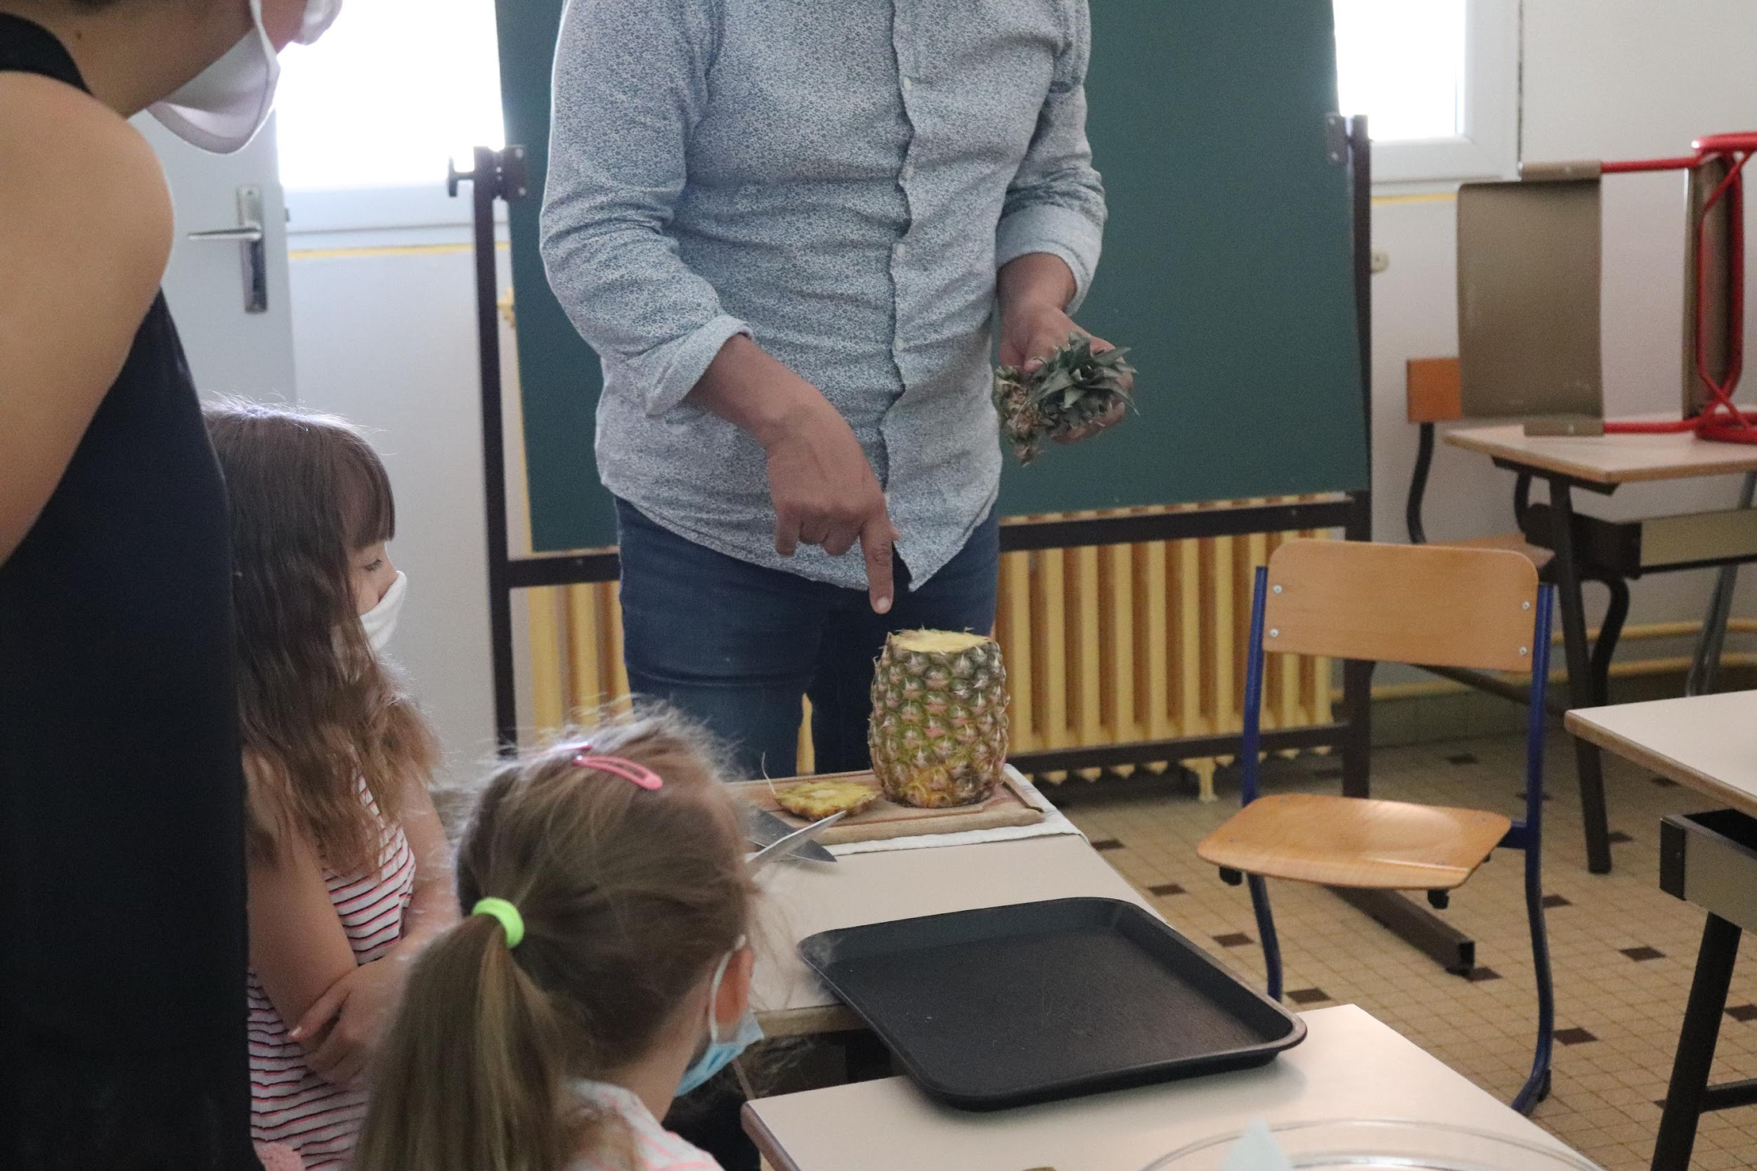
Training course: Surviving digital
Module 5 – Cook and relate
www.survivingdigital.eu

Slide 2
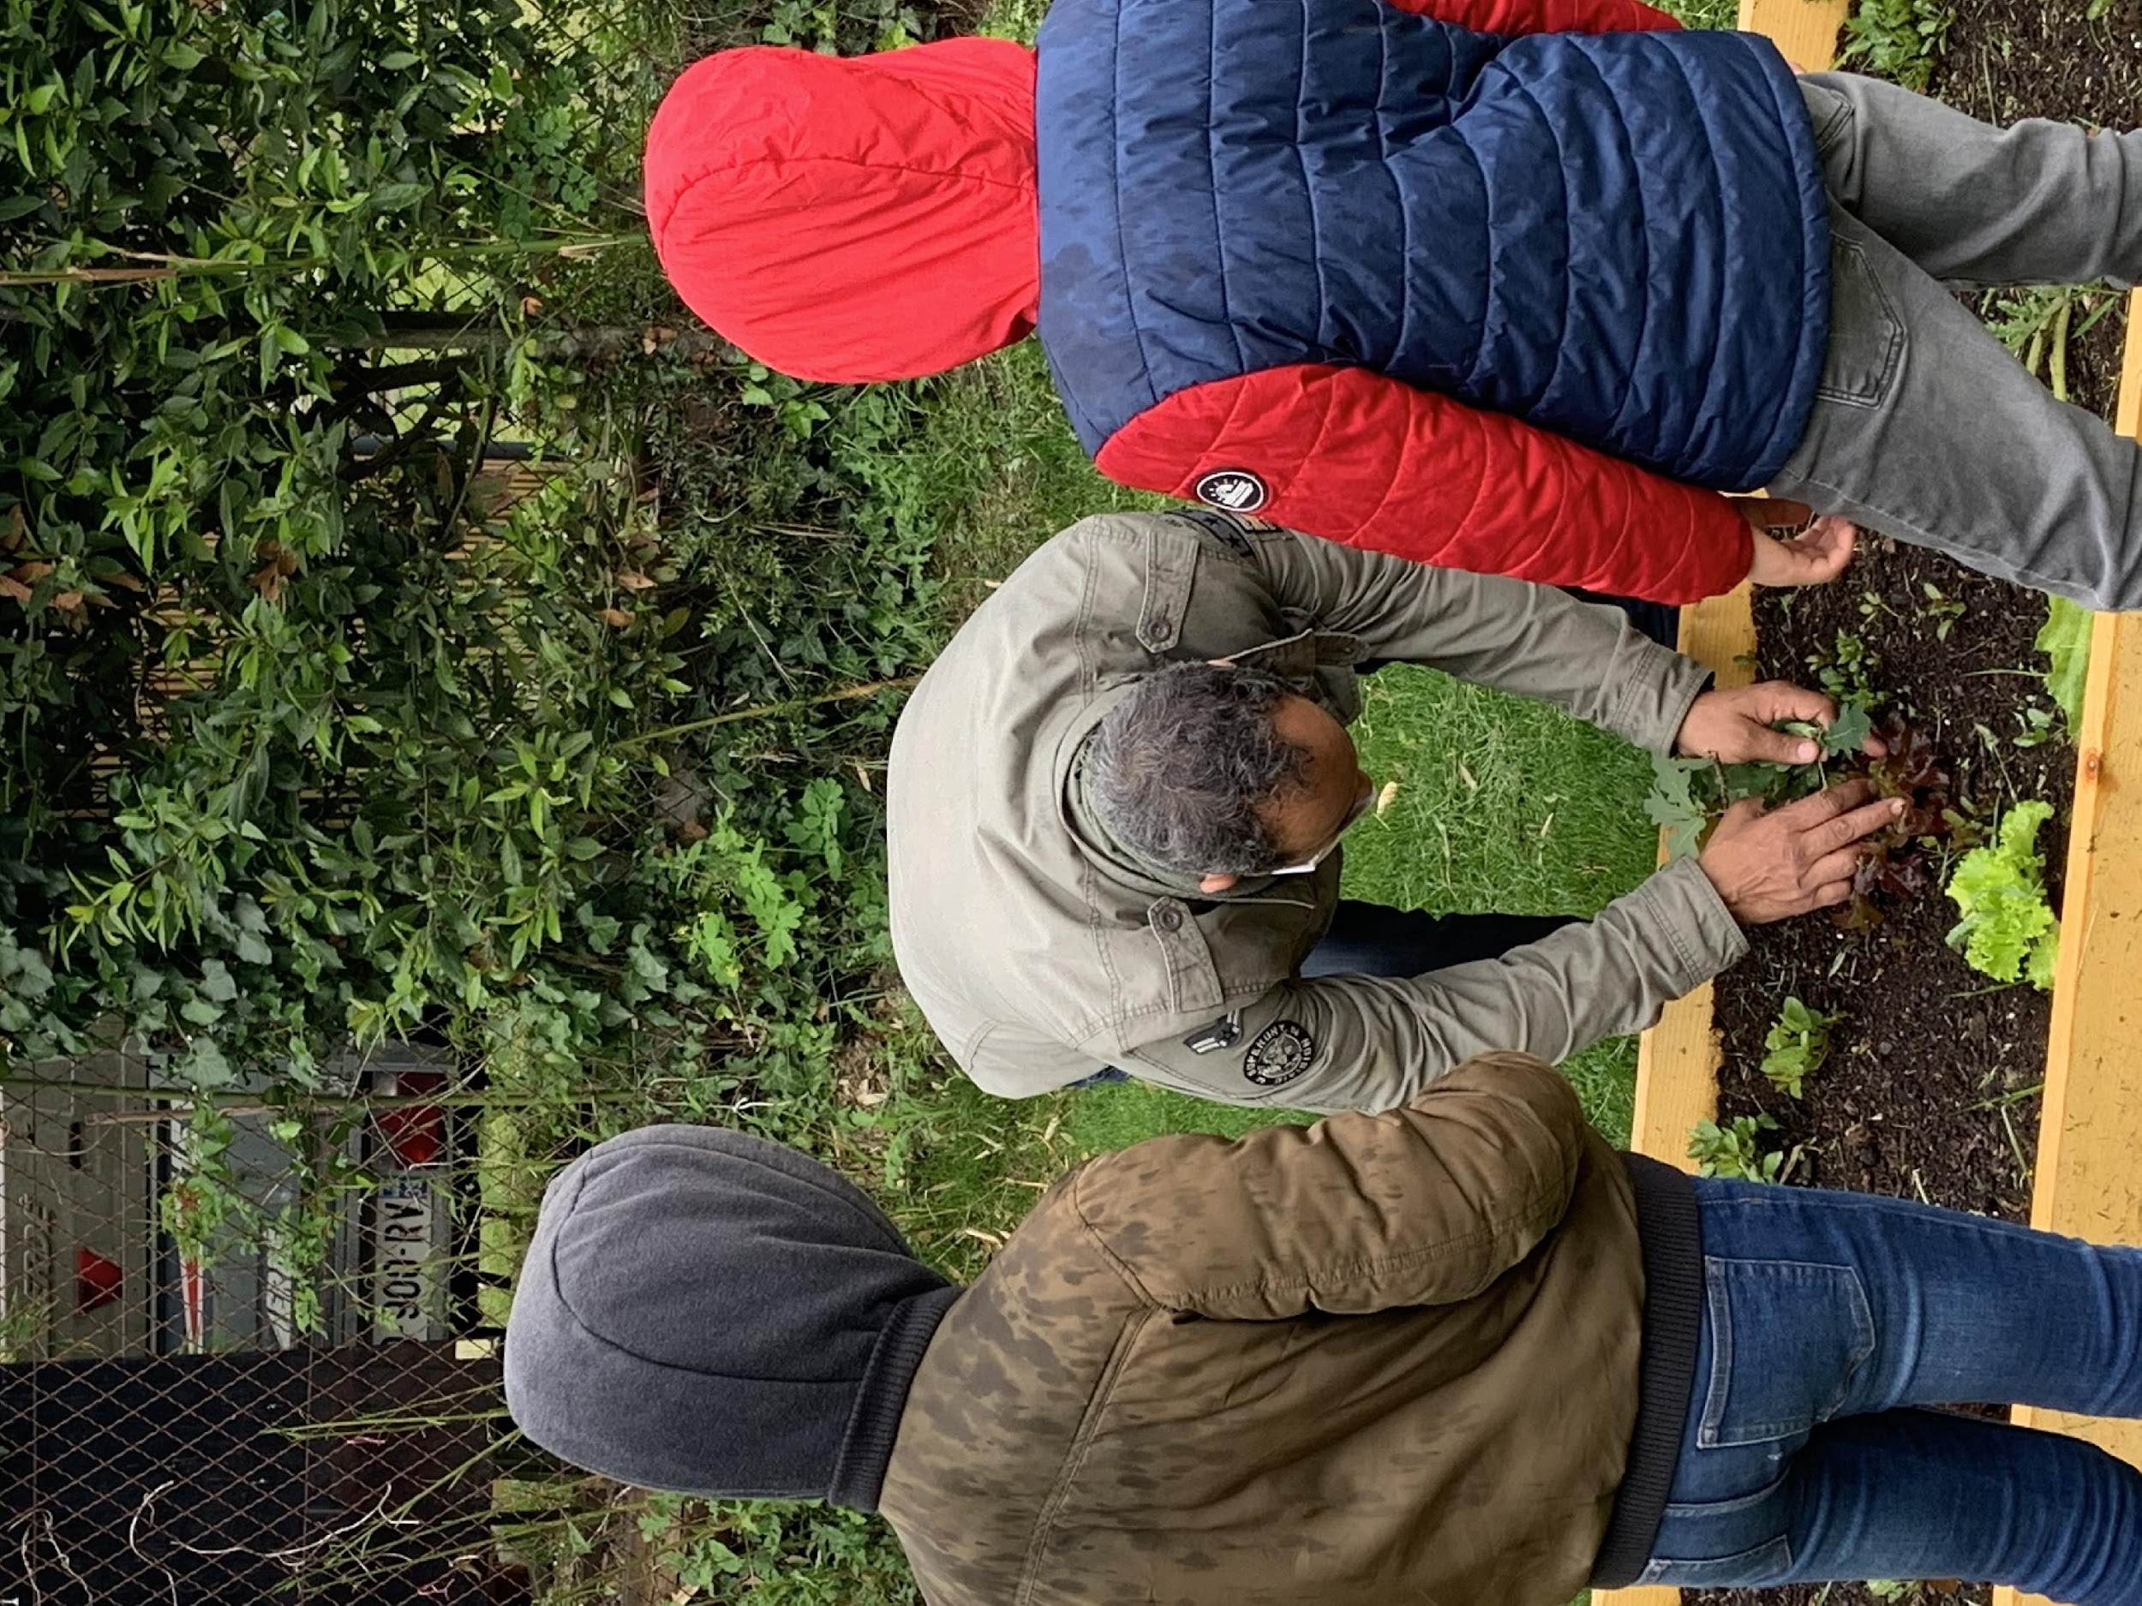
Introduction
Objectives
Skills addressed and learning outcomes
Theoretical knowledge
Techniques
Case studies and Activities
Tips and hints

Slide 3
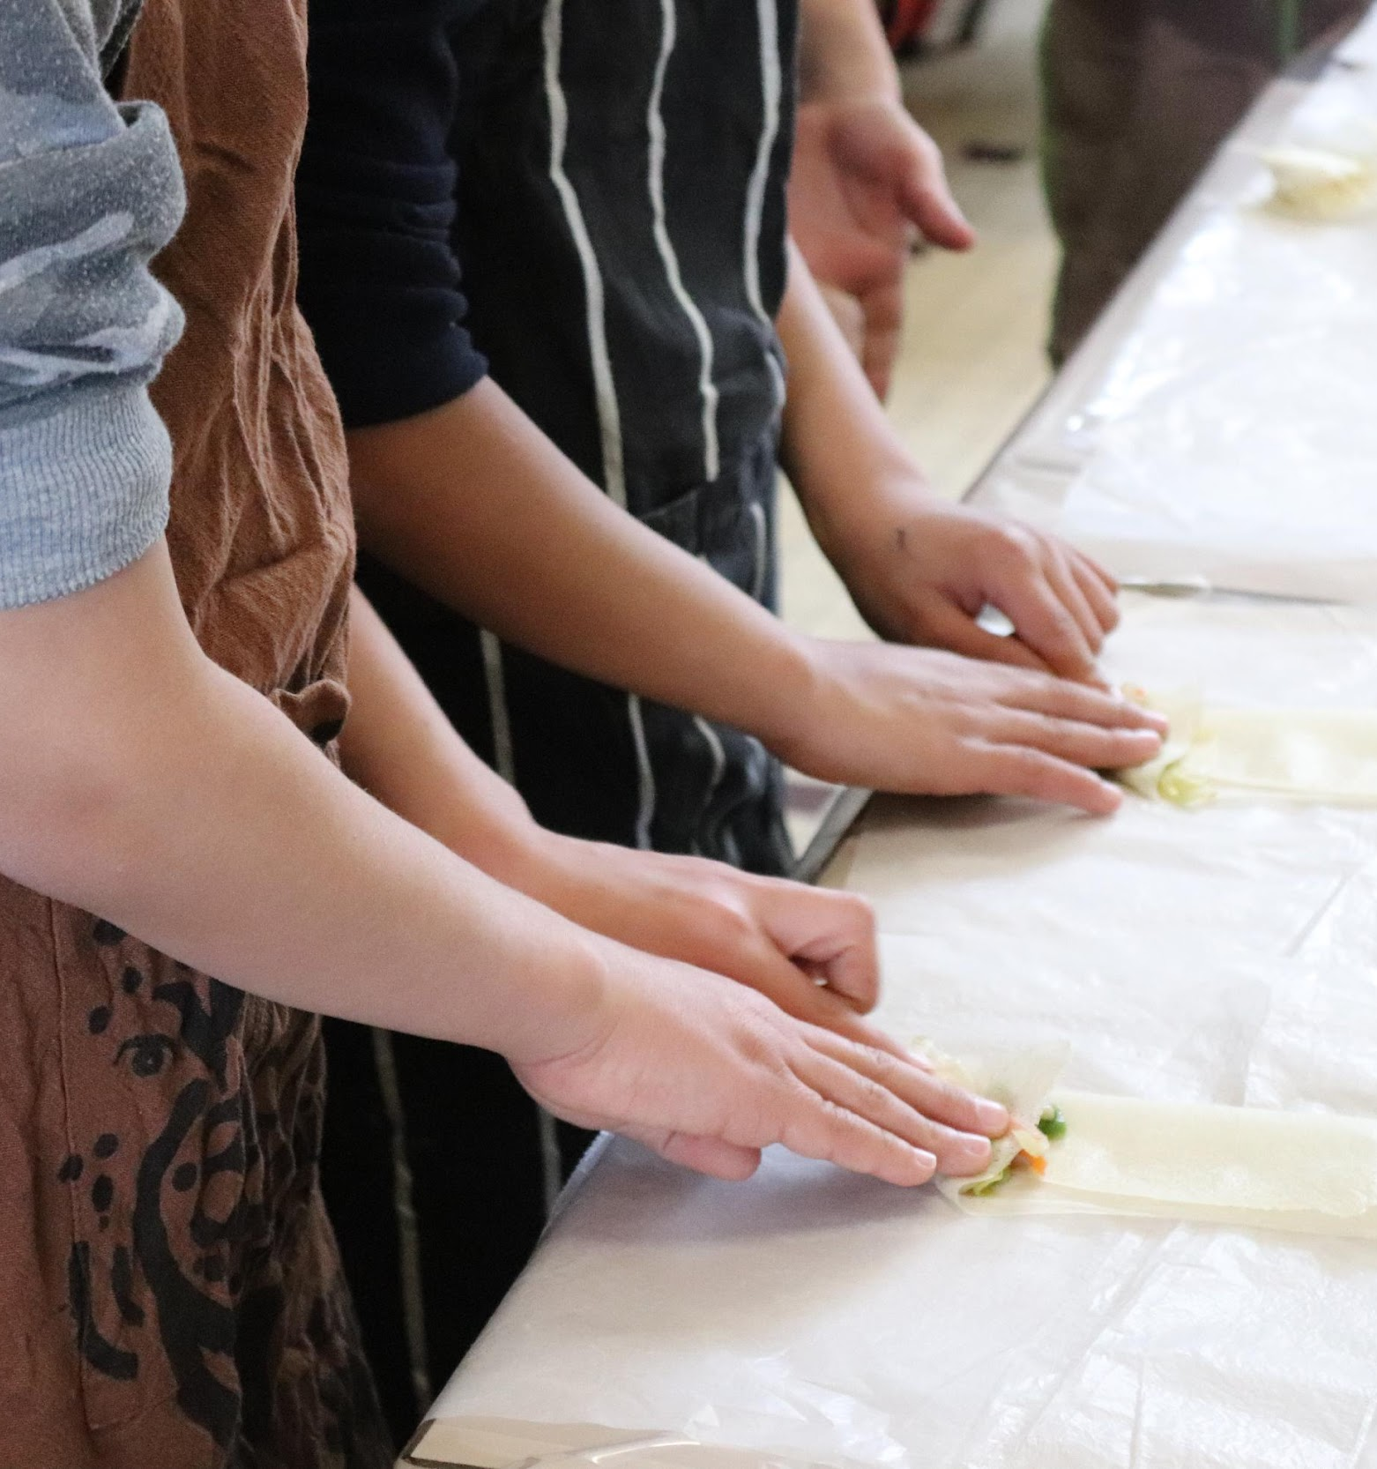
Introduction
In a context where screens are everywhere, one of the solution is doing something else. But what and how ?
Our proposal for professionals is to help parents value themselves in the skills they already have and where there is also a daily useful purpose.
Cooking is for us, one of the answer.
Definition of cooking is quite easy : the practice or skill of preparing food by combining, mixing, and heating ingredients.
Therefore they are many dimensions in cooking that interest us to value skills :
-the act of combining ingredients therefore opening the knowledge of origins and naming them
-the act of being in action with other people, it’s an activity than can be done collectively
-the act of enjoying the food, sharing it.

Slide 4
Introduction
This module has the intention of transferring a successful European project where cooking was one of the activity that helped improve the link between parents and children and therefore avoid possible harmful screentime.
Day One is an Erasmus+ project developed to support the integration of newly arrived young students in France.
The project focuses on creating pedagogical toolboxes for teachers to facilitate the integration process through various activities. Singing, cooking, correspondence, and games are the key workspaces where children can express themselves, share their language and culture, and develop skills for lifelong learning.
In this module we will focus on the cooking workshop that have been a full and complete process where step by step families have been able to create a new connection and community around food.

Slide 5
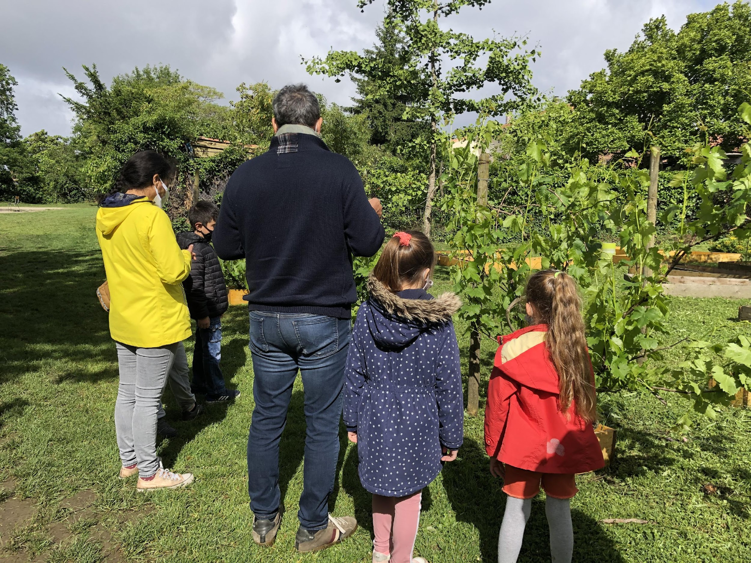
Objectives
Encouraging families to have hands on activities and less time spent on screen
Encouraging kids and parents to explore and share their own culinary knowledge and traditions, be proud of it and share it with others
Developing language skills through communication and expression during the cooking process.
Fostering teamwork and collaboration among kids from diverse backgrounds.
Promoting cultural awareness and appreciation for different cuisines.
Enhancing kids and families integration into the school community and their overall well-being.
Strengthening the link between school and families

Slide 6
Skills adressed
01
Culinary knowledge
02
Language expression
03
Creativity
04
Teamwork
05
Cultural exchange

Slide 7
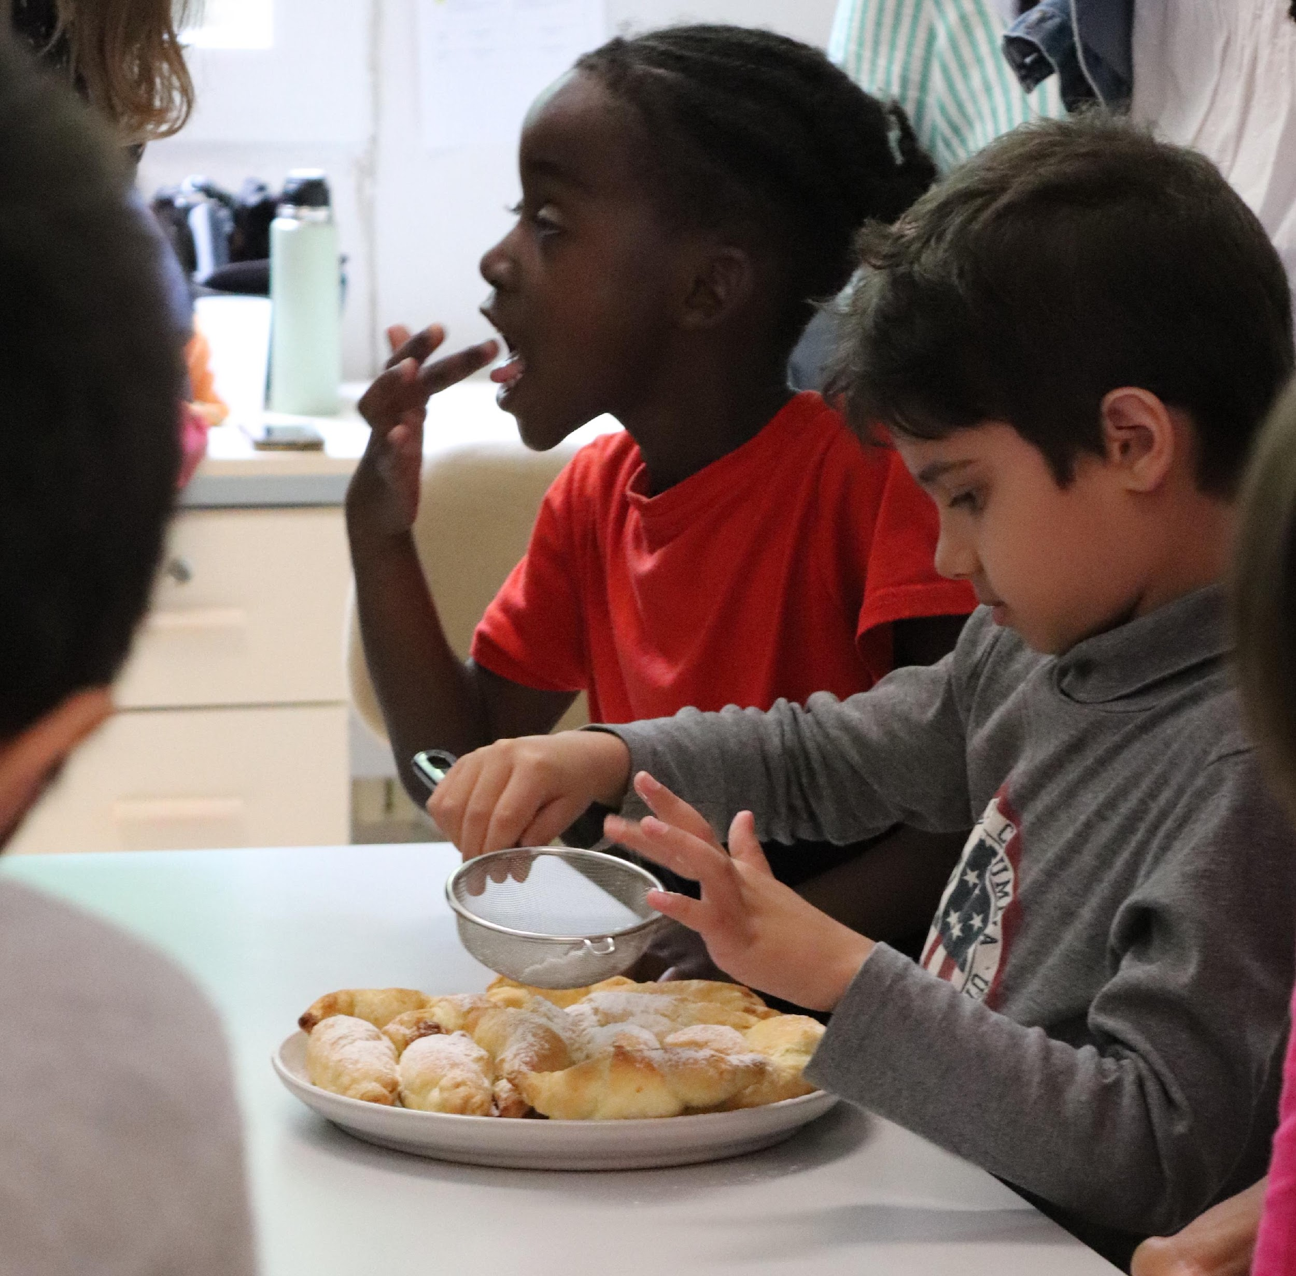
What are the learning outcomes?
Understand the potential and value of cooking instead of being behind a screen
Improve language skills through verbal expression during cooking activities.
Enhance cultural awareness and understanding through the exploration of diverse cuisines.
Development of teamwork and collaboration skills while working together in the kitchen.
Increased confidence and self-expression among kids through sharing their culinary knowledge.
Strengthened integration within the school community by engaging in a meaningful and enjoyable activity.

Slide 8
Theoretical knowledge
Food and cooking are used as tools to stimulate learning in children.
Through cooking different recipes, children learn interpretation and realize their potential to do more with what they have.
This process fosters the development of their imagination and creativity.
Cooking also teaches the value of attention and focus.
Food is a significant aspect of life that shapes existence and brings joy.
Sharing meals with others, including parents, in a secure environment contributes to a positive experience of life.
Children need stimulation and recognition to thrive.
Exploring memories through travel journals and discussing representation through cartography further enhances the learning experience, as seen with the school menu becoming a means for exchange and excitement among the children.
Food is essential to progress. Food and migration are interconnected, and when we eat well, we live better together. Food is the ultimate social link. All behaviour flows from it..

Slide 9
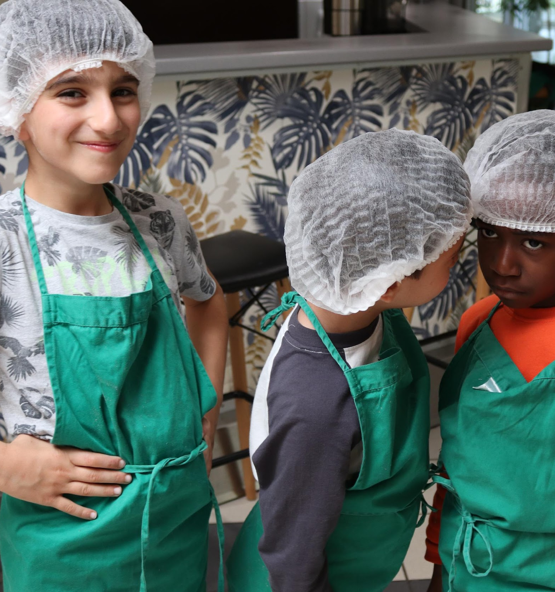
Techniques of Day One
First Phase :Surveys & Questionnaires
Through questionnaires and surveys on the food practices of children in their families, the Lunch Box reveals the practices and customs of each person.
Children make their logbook of food where they draw and write down what they like and dream of regarding food.
Second Phase Imagination, Food Supply & Cooking Practice
The second phase focuses and addresses the notions of food processing through practice, and children’s understanding of the ways in which food is cut up and cooked.
Third Phase Understanding cultures
The third exchange focuses on “understanding”cultures and habits and also the importance of gathering around a meal

Slide 10
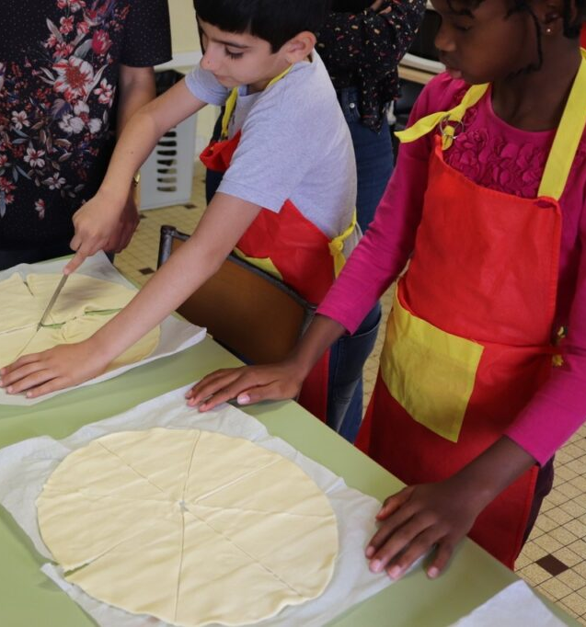
Activity 1 : Taste of home
Target Group: Kids from 4 years old
In a multicultural school, students from various backgrounds collaborated to create a cookbook showcasing recipes from their respective cultures.
The project aims to promote cultural exchange, language development, and community engagement. Students worked together to collect recipes, write descriptions in multiple languages, and design the cookbook. The project not only celebrates diversity but also provided a platform for students to share their culinary heritage and develop their language and communication skills.

Slide 11
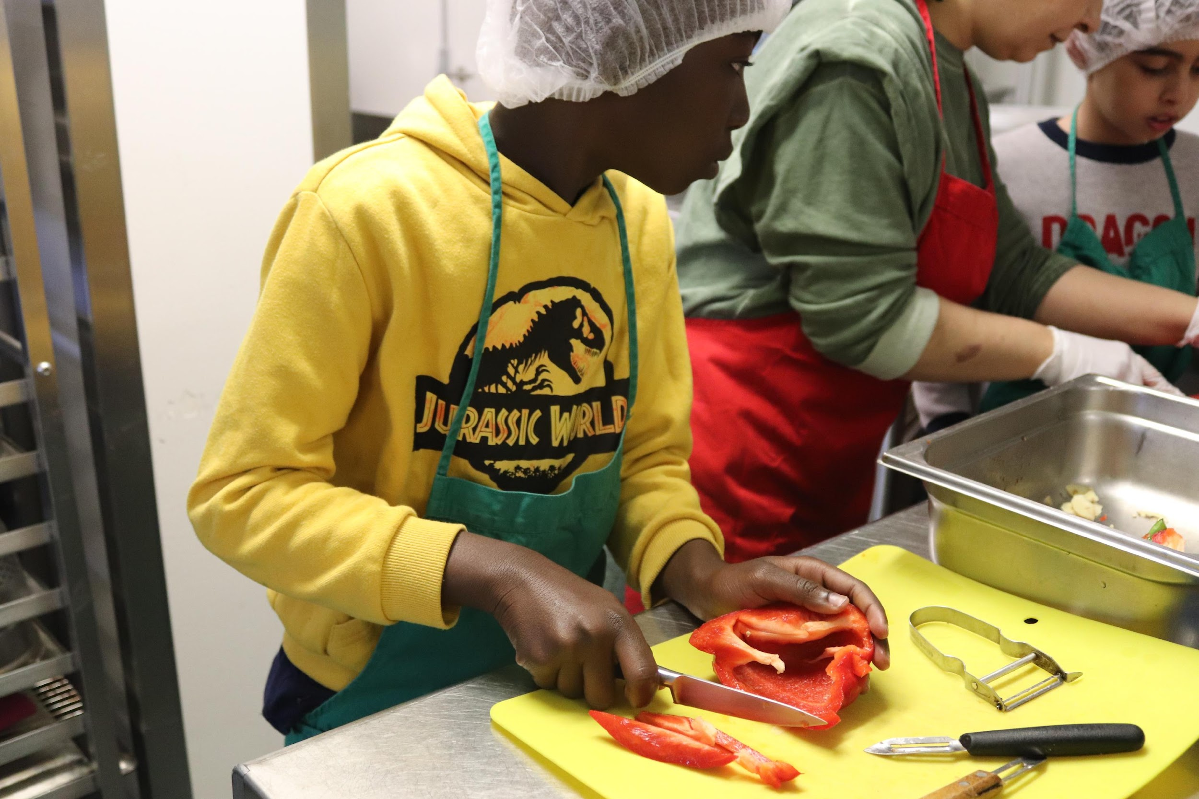
Activity 2: Chef Day
Target group: from 6 years old
Chef for a Day" program partners with local restaurants and culinary institutes to offer underprivileged students a chance to experience the world of professional cooking.
Students spend a day shadowing chefs, learning about kitchen operations, and assisting in the preparation of meals.
The program aims to inspire students, foster their passion for cooking, and expose them to career possibilities in the culinary industry. By immersing themselves in a real-life cooking environment, students developed skills in teamwork, time management, and culinary techniques.

Slide 12
Tips and hints for professionals
01
Clear and Visual Instructions
02
Create a cultural resource bank with info about cuisines, traditional recipes, and culinary practices from different countries
03
Adaptation and Inclusion: accommodate dietary restrictions, cultural preferences
04
Communication with families from the start so they don’t get any surprise
05
Time Management: Plan the workshop activities and allocate sufficient time

Slide 13
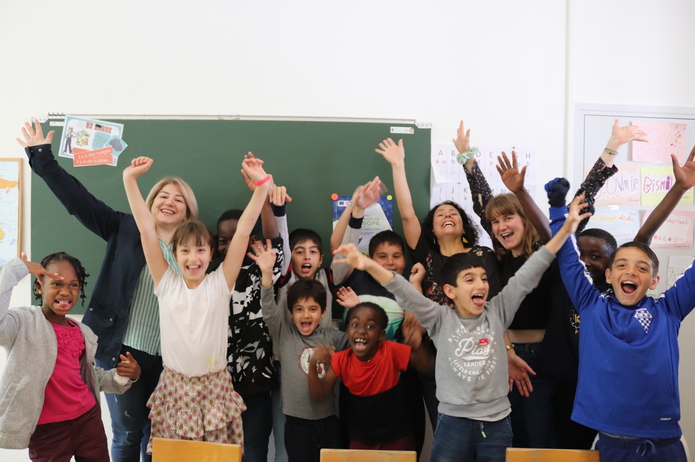
End of module
Thank you for reading this module, and we hope you enjoyed it and learned some useful information. This module is part of the Surviving Digital Training Course, you can find the rest of the modules on our website. Be sure to keep up to date on the project by following us on our social media channels!
www.survivingdigital.eu

