Slide 1


Training Course: Surviving Digital
Module 1 - Parents Guide to Analysing Digital Tools for children under 5
www.survivingdigital.eu
Funded by the European Union. Views and opinions expressed are however those of the author(s) only and do not necessarily reflect those of the European Union or the European Education and Culture Executive Agency (EACEA). Neither the European Union nor EACEA can be held responsible for them.

Slide 2
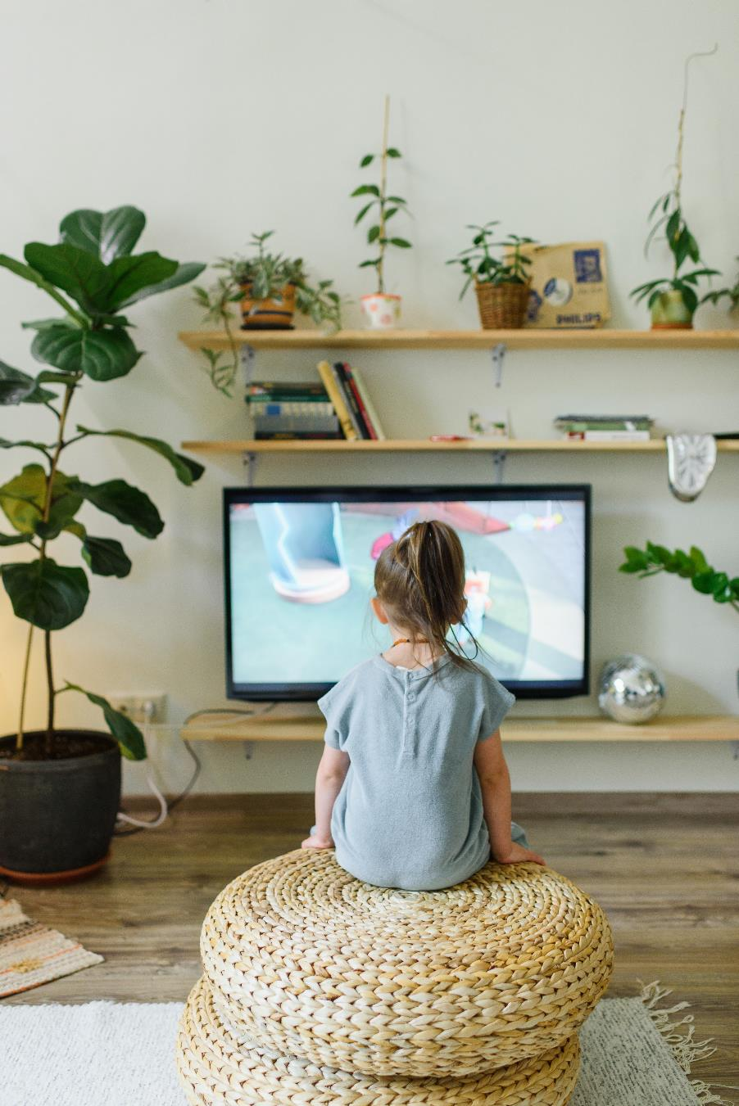
Introduction
Objectives
Skills addressed and learning outcomes
Theoretical knowledge
Techniques
Case study and activities
Tips and hints

Slide 3

Introduction
With screens virtually everywhere, monitoring a child's screen time can be challenging for parents. To complicate matters, some screen time can be educational and support children's social development. So how do you manage your child's screen time?
Any time a child spends looking at an electronic screen is considered screen time (with a few exceptions).
Watching TV and movies
Playing video games
Watching videos on platforms like YouTube
Looking at social media
Using a computer, phone, and tablet for any reason
Using an e-reader
So the question is: “How can we help parents limit this passive screen time for their children?”

Slide 4

Objectives
The purpose of this module is to provide a robust set of criteria and tools for evaluating digital content aimed at young children. The objective is to help these stakeholders assist parents in navigating the complexities of screen time, facilitating the selection of high-quality apps, and fostering an environment where digital experiences are both educationally beneficial and conducive to overall child development.
"If we teach today as we taught yesterday, we rob our children of tomorrow.”- John Dewey
This module will delve into the nuanced skill of effectively managing screen time for children aged 5 and under. The key skill addressed here is the ability of parents to critically assess digital content and make informed decisions regarding the use of screen-based technology in early childhood. It entails understanding the developmental implications of screen time, setting appropriate limits, and identifying digital products that are not only age-appropriate but also enriching and educational.

Slide 5
Skills covered
01
Open parent/child communication
02
Understanding the contents of the various apps
03
Knowledge of security settings
04
Research and testing of various apps
05
Active parental involvement

Slide 6
Theoretical knowledge
It is important that parents enforce certain rules on limits of time spent on screens (and respect them as well). It’s important to note that screen time for virtual learning doesn’t count towards the recommended limits, though the usual concerns about screen time, such as reduced physical activity and poor sleep, still apply. Moreover, video calls with distant family and friends are generally not included in screen time restrictions.
Screen time can accumulate faster than you might realize. It’s easy to hand over a phone to entertain your child, or to share videos and photos online. Additionally, your child may use different devices at school or with friends.
Too much screen time and regular exposure to poor quality programming has been linked to: 1) Obesity; 2) Inadequate sleep schedule and insufficient sleep; 3) Behaviour problems; 4) Delays in language and social skills development; 5) Violence; 6) Attention problems; 7) Less time learning.
Keep in mind that unstructured playtime is more valuable for a young child's developing brain than is electronic media. Children younger than age 2 are more likely to learn when they interact and play with parents, siblings, and other children and adults. By age 2, children may benefit from some types of screen time, such as programming with music, movement and stories. By watching together, you can help your child understand what he or he is seeing and apply it in real life. However, passive screen time shouldn't replace reading, playing or problem-solving.

Slide 7

How to limit screen time?
The problem for many well-meaning parents is that rules limiting or prohibiting screen time can be rigid and hard to enforce. What to do? Lisa Guernsey, coauthor of Tap, Click, Read: Growing Readers in a World of Screens suggests using the “ 3 C’s” to help you decide when screen time is okay:
              Content: What is my child watching or playing? Can they understand what they’re doing or potentially learn from it?
            Context: What has my child’s day been like so far? Have we talked and interacted a lot, or have they been plugged in for hours?
            Child: How does your child respond to screen media? When screen time is over, are they bursting with new ideas and questions they want to explore? Or do they become irritable, anxious, or withdrawn? Why is your child drawn to particular media, and what are they getting out of it?

Slide 8
What are the best techniques to ensure a quality 'screen' time interval?
Preview programs, games and apps, before allowing your child to view or play with them. Organisations such as Common Sense Media has programming ratings and reviews to help you determine what is appropriate for your child's age. Better yet, watch, play or use them with your child.
Seek out for interactive options that engage the child, rather than those that just require pushing and swiping or staring at the screen.
Use parental controls to block or filter Internet content.
Make sure your child is close to you during screen time so that you can supervise his or her activities.
Ask your child regularly what programs, games and apps he/she has played with during the day.
When watching programming with your child, discuss what you are watching and educate him/her about advertisements and commercials.
Another way to better control your children's time spent on electronic devices is to set up a screen limitation plan. Try the AAP's online tool for devising a family media plan designed by the American Academy of Pediatrics. You can personalise it according to your children’s ages, your values and your family's routines.
How to recognise a good app from a bad app? In this digital age, where the app market is flooded with thousands of options branded as 'child-friendly' or 'educational', it is crucial to discern which ones truly contribute to a child's development and which are merely digital distractions. In the following pages, we touch on key factors that help distinguish a good educational app from a less beneficial one.

Slide 9
1. Educational Content and Explicit Learning Goals
A good app will have clear educational objectives that align with developmental milestones. It will provide an engaging learning environment where children can acquire new skills or practice existing ones. These goals should be explicitly stated in the app's description and be evident through its activities.
2. Free from Advertisements
Good apps focus on the child’s learning experience, not monetisation through ads. They do not expose children to advertisements, which can be distracting and may lead to unwanted content. A good app maintains a secure environment for the child to learn and play.
3. Encourage offline activities
Quality apps extend the learning experience beyond the screen by encouraging offline activities. They prompt children to apply what they've learned in the real world, ensuring that the digital experience is part of a broader educational journey.
4. Balanced interactive elements
Interactivity should serve a purpose in the learning process, requiring reasoning and problem-solving rather than just tapping or swiping. A good app will balance intuitive navigation with the need to engage cognitively with the content.
5. Defined play time
Good apps have built-in features to help manage play time, ensuring the experience is rich but finite. They avoid designs that encourage endless play, instead promoting a healthy balance between screen time and other activities.
6. Supports positive behaviour
The best educational apps support learning through positive reinforcement. They encourage children by rewarding progress and offering encouragement for efforts, not just correct answers, helping to build confidence and resilience.
7. Non-violent behaviour
Content should be free from violence, promoting a safe and friendly environment for children. This includes avoiding physical violence, aggressive language, and any form of negative interaction.
8. Promotes meaningful values
Educational apps should instill meaningful values such as cooperation, friendship, and respect. They can do this through storylines, character development, and the challenges presented within the app.

Slide 10
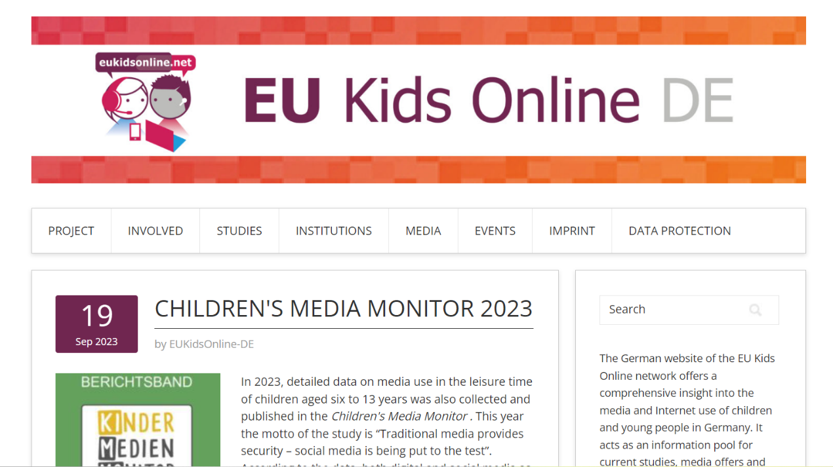
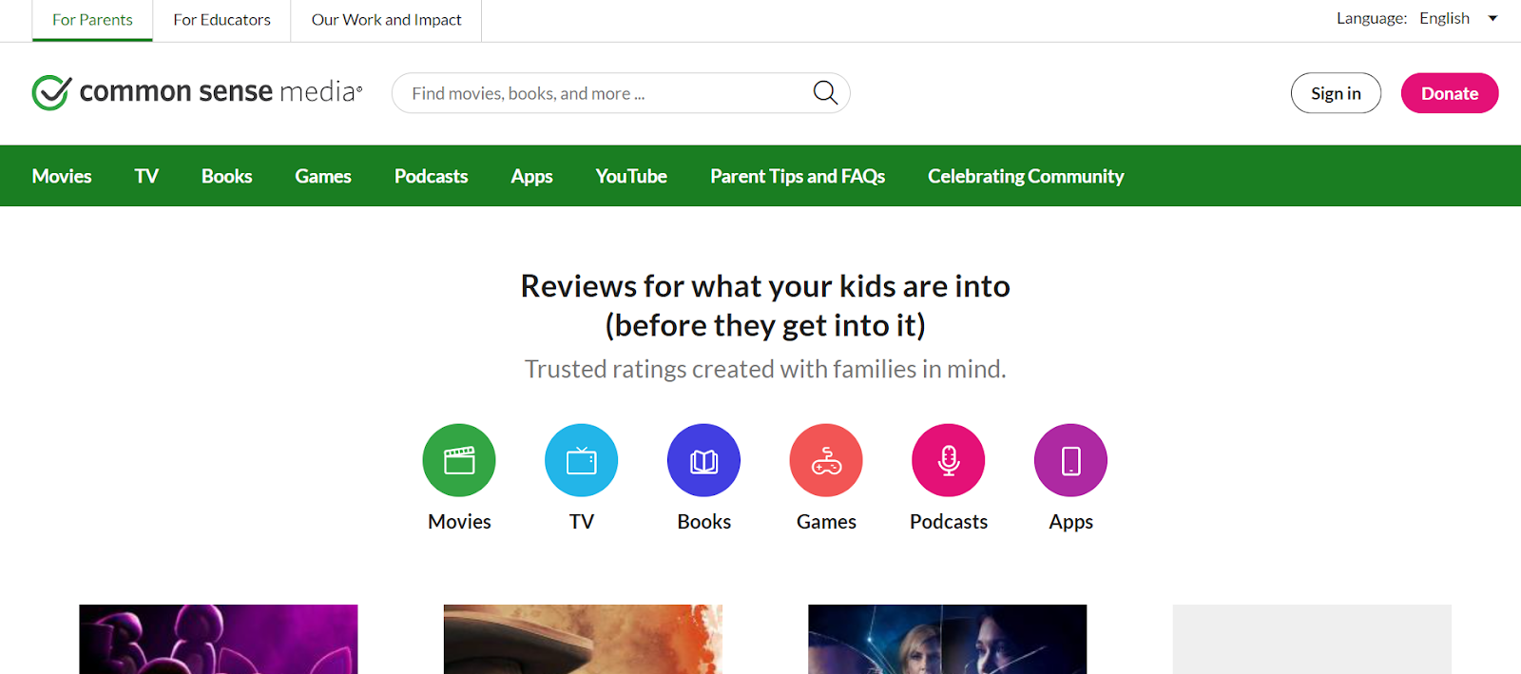
Case Study 1: Common Sense Media Research
Case Study 2: EU kids online
Type: Research Project
Location: Europe
Target Group: Children, parents, policymakers
Description: An international research network that seeks to enhance knowledge of European children's online opportunities, risks, and safety.
Objectives: To provide evidence-based knowledge to inform policy and practice regarding children’s online experiences.
Impact: Their findings are used across the European Union to shape policies and education regarding children's use of digital media.
Online Reference: Reports and publications can be found on the EU Kids Online website: https://eukidsonline.de/
Type: Non-profit Organization
Location: United States (with global resources)
Target Group: Parents, educators, policymakers
Description: Provides independent reviews, age ratings, & other information about all types of media aimed at children and families.
Objectives: To offer information and tools to help families make informed decisions about media and technology.
Impact: Common Sense Media's resources are widely used for choosing appropriate media for children and for digital literacy education.
Online Reference: You can find resources and research at the Common Sense Media website: https://www.commonsensemedia.org/

Slide 11
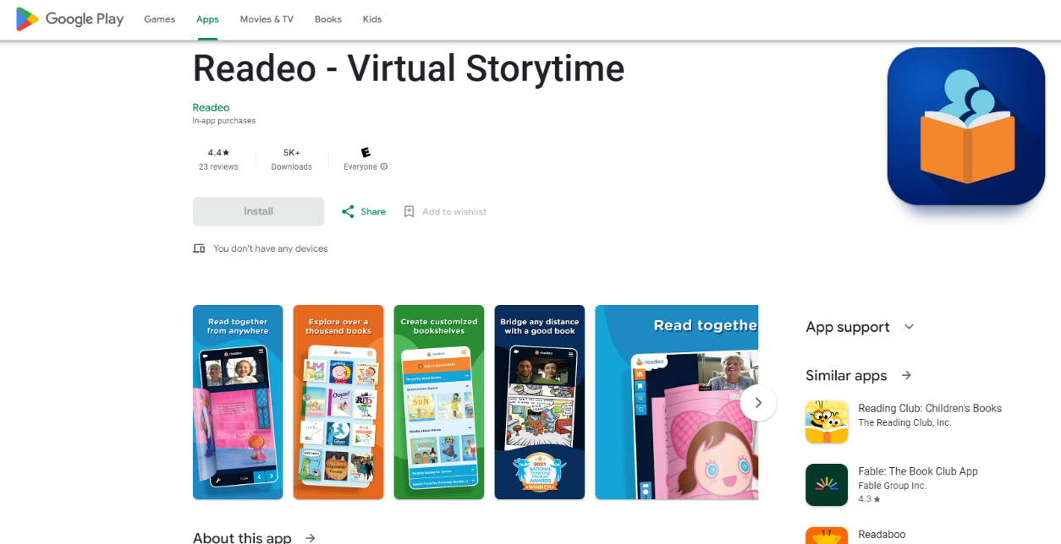
Examples of apps to use:
1.Readeo - Virtual Story Time
For Ages 0-2: At this age, it's important to note that the American Academy of Pediatrics recommends avoiding the use of screen media other than video chatting for children younger than 18 to 24 months. So, for the youngest in this age group, focus on apps that can be used for interaction with parents or family over video chat.
Purpose: Family members can read stories to children through video call.
Strengths: Encourages family bonding and early literacy skills.
Minimum Age: 18 months+, ideally used with parent interaction.
Link: https://www.readeo.com/

Slide 12
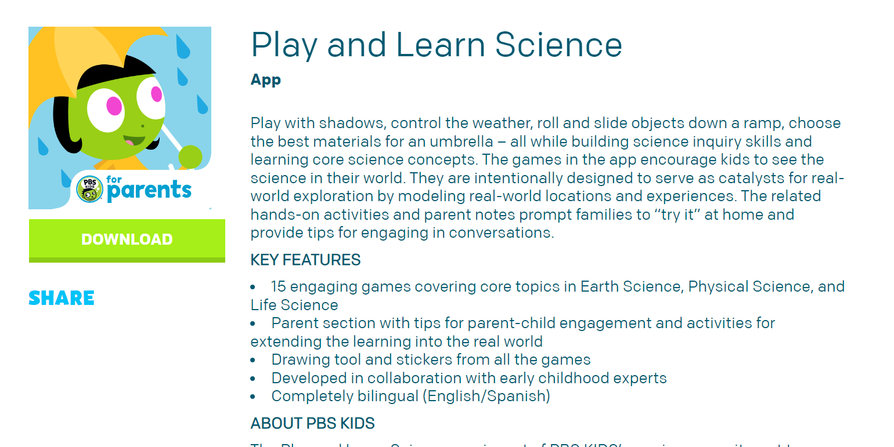
2. Play and learn science by PBS KIDS
For Ages 2-3: At this age, some screen time with educational content can be introduced, ideally through shared experiences with a parent or caregiver.
Purpose: Introduces basic science concepts through games and hands-on activities.
Strengths: No advertisements, promotes offline activities, and aligns with educational goals.
Minimum Age: 2 years old, under parental guidance.
Website: https://pbskids.org/apps/play-and-learn-science-.html

Slide 13
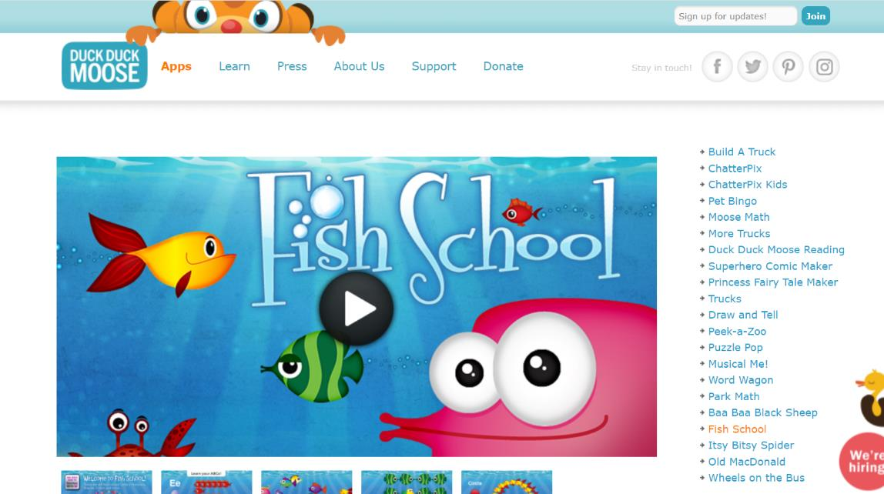
3.Duck Duck Moose App (such as 'Fish School')
For Ages 2-3: At this age, some screen time with educational content can be introduced, ideally through shared experiences with a parent or caregiver.
Purpose: Covers various educational themes from letters to shapes and colors.
Strengths: Ad-free, interactive, and designed for young children's learning.
Minimum Age: 2 years old.
Website: https://www.duckduckmoose.com/educational-iphone-itouch-apps-for-kids/fish-school/

Slide 14
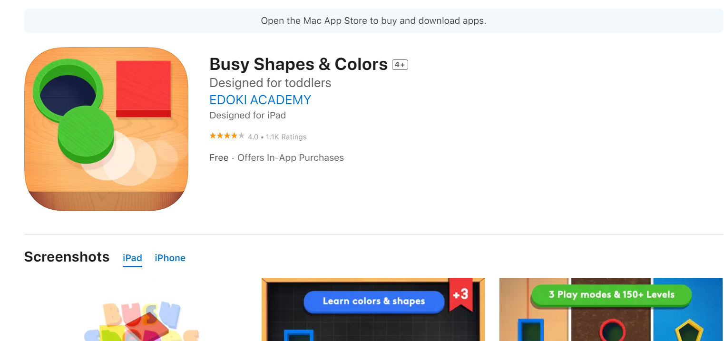
4.Busy Shapes & Colours
For Ages 3-5: Children at this stage can benefit from more structured educational content that still allows for creative play.
Purpose: Enhances problem-solving, color recognition, and shape matching skills.
Strengths: Interactive learning without ads; playtime is limited and focused.
Minimum Age: 3 years old.
Website: https://www.commonsensemedia.org/app-reviews/busy-shapes-colors

Slide 15
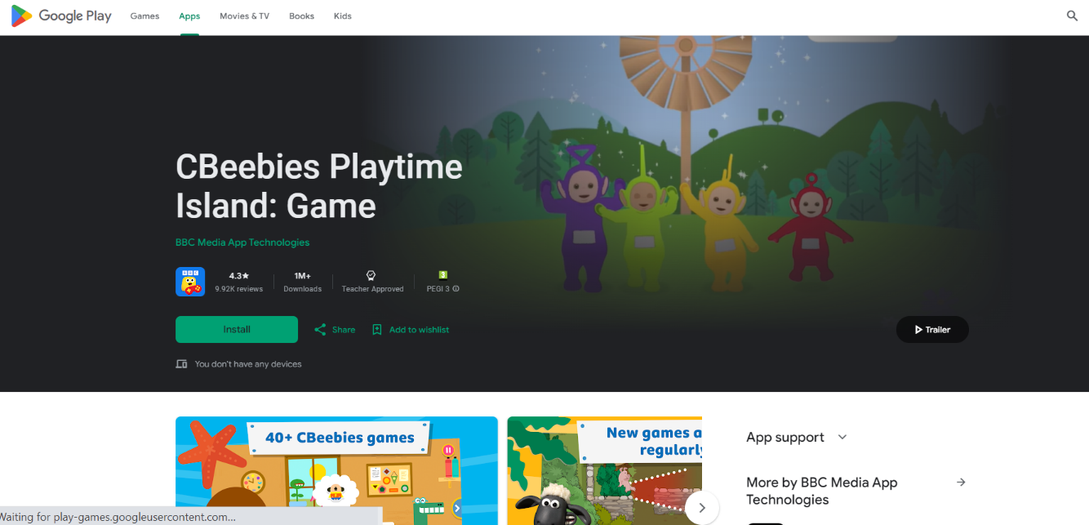
5. CBeebies Playtime Island
For Ages 3-5: Children at this stage can benefit from more structured educational content that still allows for creative play.
Purpose: Offers a variety of educational games based on CBeebies characters.
Strengths: Safe, ad-free environment with content designed for early years.
Minimum Age: 3 years old.
Website: https://play.google.com/store/apps/details?id=uk.co.bbc.cbeebiesplaytimeisland&hl=en_US

Slide 16

Practical activities for parents
App Selection - Workshop Type: F2F Group
Purpose: to practice selecting quality educational apps using the provided criteria.
Duration / Materials: 1-hour session, printed app criteria checklist.
Instructions: Facilitator-led discussion and group activity using real app examples.
Screen Time Family Plan - Type: Individual online
Purpose: to develop a personalised family screen time plan.
Duration/materials: 30-minute session, digital screen time planning tool.
Instructions: Guide on how to use the digital tool to create a balanced screen time plan.
Setting up a child-friendly communication tool
Purpose/Goal: This activity aims to equip parents with the knowledge and skills to choose and set up a child-friendly communication tool. It will help parents become comfortable with the technical set-up process, understand the importance of privacy settings and learn how to enable parental control features.
Duration / Materials: 30-minute session. An internet-connected device (PC, tablet or smartphone)
Instructions: Communication Tool User's Guide.

Slide 17
Instructions:
Reflect: Reflect on your child's learning needs, their likes and dislikes, their strengths, and areas they need to improve on.
Explore: Revisit the list of digital learning tools introduced in this module. Look for tools that match your child's learning needs and interests.
Select: Select a few tools that you find most suitable. Consider a mix of tools that target different skill areas.
Plan: Start drafting a learning routine. This could be daily or weekly depending on your child's schedule. Remember to maintain a balance between different activities and ensure not to overload your child.
Incorporate: Incorporate the selected digital tools into the routine. Schedule specific time slots for each tool/activity.
Review & Adjust: After the plan is implemented, observe your child's engagement and progress. Review and adjust the plan as necessary to keep it effective and enjoyable for your child.

Slide 18
Hints and tips
01
Interactive Demonstrations: Use real-time demonstrations of appl evaluations during training
02
Allow parents time to explore the different functionalities of the digital tools introduced in this module. Encourage them to ask questions, try different settings, and understand how each tool can be customized to fit their child's needs.
03
As a trainer, sharing your personal experiences can be beneficial. If you've used any of these tools in your personal life or have relevant anecdotes from other parents, share them. This can make the learning experience more relatable and engaging.
04
Incorporate group discussions and hands-on activities into your teaching. For instance, you could facilitate a conversation on balancing screen time or create a group activity where parents collaborate to design a digital learning plan for various scenarios.
05
It's essential to talk about the possible challenges and setbacks parents might face while using these tools or managing their child's digital environment. Discussing these openly can help parents feel more prepared and provide them with strategies to overcome these challenges.

Slide 19


End of module
Thank you for reading this module and we hope you enjoyed it and learned some useful information. This module is part of the Surviving Digital training course; the other modules are available on our website. Keep up to date with the project by following us on our social channels!
www.survivingdigital.eu

