Slide 1
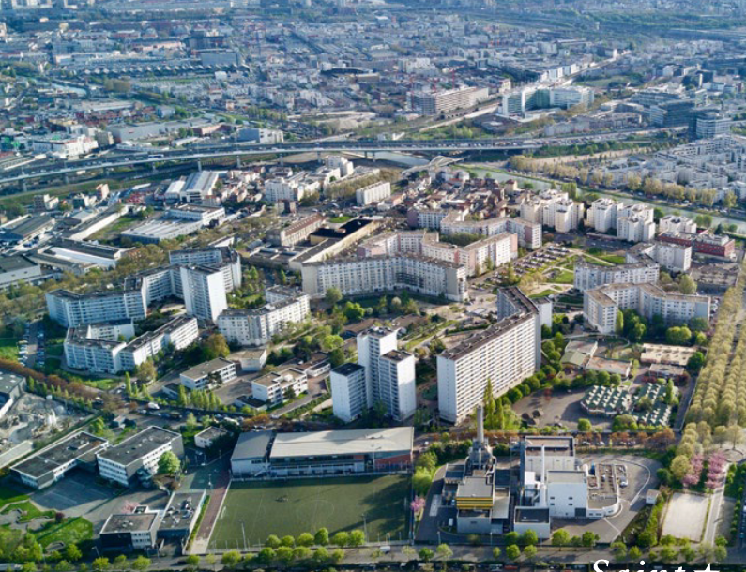
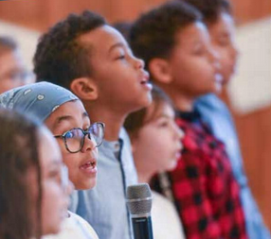
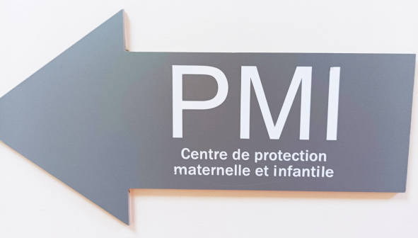
Training Course: Surviving Digital
Module 4 - Parent-child language group
www.survivingdigital.eu

Slide 2
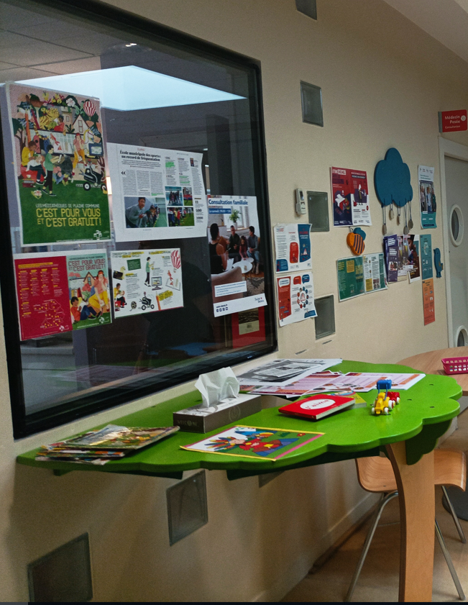
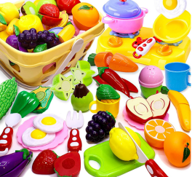
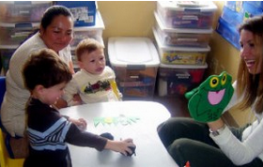
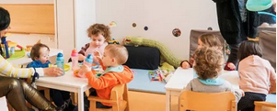
Introduction
Objectives
Skills addressed and learning outcomes
Theoretical knowledge
Techniques
Activities
Tips and advice

Slide 3
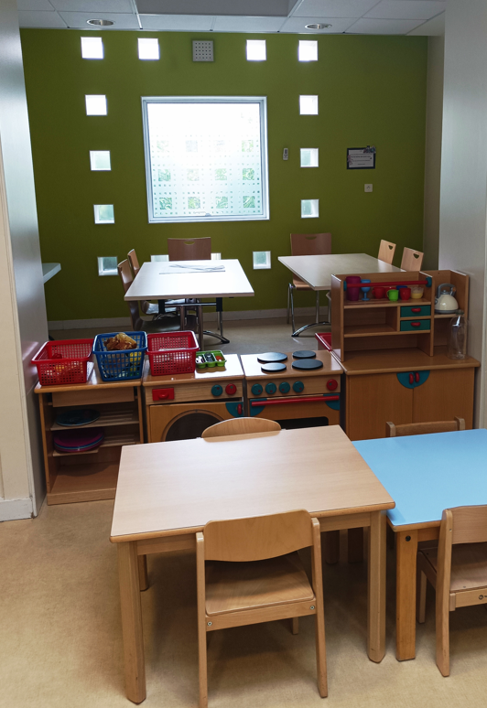
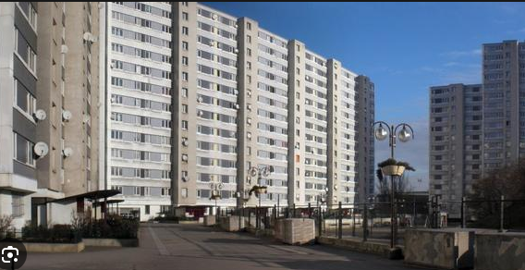
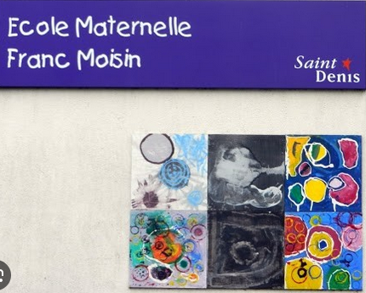
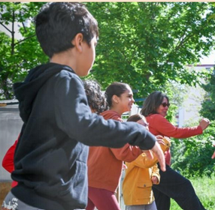
Introduction
In areas with hundreds of foreign populations with different native languages, many of the children cannot speak properly or cannot speak at all the official language of the New Country where they are living by the time they start kindergarten (2½/3 years). This is especially true if they have had little interaction with other adults and children in the context of childcare or collective activities or in the family environment. And for this reason parents are tempted to give them technological devices to keep them occupied.
This training module takes its cue from a programme that was actually implemented in one of the French municipalities with the highest rate of foreign populations and proposes to help identify children with language delays and support their parents to improve oral language acquisition and enable these children to integrate more into the local socio-cultural context by avoiding also overexposure to screens.
This program was implemented in the Franc Moisin urban district of Saint-Denis, characterized by its precarious population, with a large foreign population.
For several years now, professionals, and teachers in particular, have been warning of language problems in small children (aged 2/4). for some, these problems are also linked to the massive use of screens.
Professionals (speech therapists, PMI early childhood professionals) have proposed a curriculum to strengthen children's language skills, with the involvement of parents
The training:
a language awareness group - 5 children (with parents) identified by their teacher as having an oral language delay
1 hour (45 minutes of animation) - 3 month session - Every week: attendance very strongly recommended, in order to make parents aware of their role to play
Small workshops during the session, promoting individual and inter-individual stimulation, especially between parent and child
1 or 2 workshops during the session, promoting individual and inter-individual stimulation, especially between parent and child
Animation by early childhood professionals supported by a local speech therapist .

Slide 4
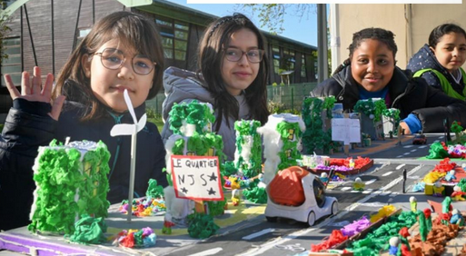
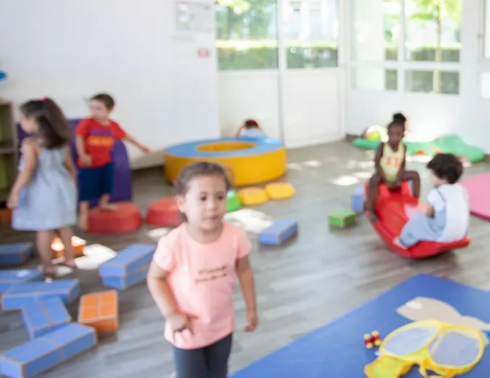
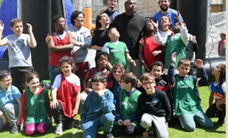
Objectives
The main objectives of this module are:
Developing the oral language of young children. Enhancing language skills by focusing on children's abilities.
Involve parents actively in helping language development through sessions and workshops that encourage individual and inter-individual interaction and stimulation between parent and child.
Giving adults the tools to continue this work and strengthen themselves in their parental role by organising regular workshops and information meetings, ongoing educational sessions, educational material such as books, games or online resources that can be used at home to continue to stimulate language and encourage interaction with their children.
Create supportive communities between parents participating in the programme, where they can share experiences, effective strategies and offer each other support and encouragement to achieve the same goal.
.

Slide 5
Skills covered
01
Children: Stimulate language including speech and all forms of exchange
02
Children: Learn to put words into everyday life
03
Children: Catch up on simple 1st year language delays
04
Parents : Arouse the desire for exchange between parents and children
05
Parents: Learn about the specificities of children in a polyglot context.

Slide 6

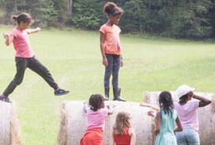
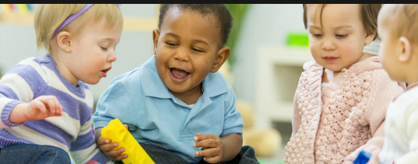
What are the learning outcomes?
Improvements in children's language skills: Observe improvements in language skills, such as vocabulary expansion, verbal comprehension, and the ability to communicate and interact.
Parental involvement: Measuring parental involvement and participation could be an indicator of success. Increased awareness of the role of parents and greater involvement in language development activities could demonstrate the effectiveness of the programme.
Evaluation of children's behaviour: Observing whether children show an increase in confidence, participation and social interaction through language could be a sign of improvement.
Long-term monitoring by assessing the maintenance of progress over time. Long-term monitoring could reveal how effectively parents apply the acquired knowledge and how well children continue to develop their language skills over time.
The aim is to assess not only the children's immediate progress, but also the long-term impact of the programme on the family environment and parent-child interaction to ensure continued support for language development.

Slide 7
Theoretical knowledge
In 2018, the Haute Autorité en Santé (HAS) set up a working group on the health of young children. The conclusions of the HAS working group on language:
Screening for oral language disorders in children aged 3 to 6 must be systematic, even in the absence of complaints.
At the age of 4, the working group positions itself for the use and development of ERTL 4 type tools and proposes carrying out longitudinal studies for these tools. In the case of bilingualism and oral language disorders, the interview with the parents will seek to identify language disorders in the mother tongue.
Specifically concerning the ERTL4 tool for the Identification of Language Disorders in 4-year-old children -This tool has been validated by the HAS (2005 "Recommendations for clinical practice - Proposals relating to individual screening in children aged 28 days to 6 years, intended for general practitioners, paediatricians, PMI doctors and school doctors")
Why test language at 4 years of age?
Health documentation emphasises the importance of examining language at the age of 4, which is the ideal age for screening for language delays and disorders. Unfortunately, 1 in 5 children suffers from a language delay or disorder by the age of 4, which compromises their educational, professional and social future. Most of these children, if not identified and treated early, will fail at school 5 years later. In contrast, in the vast majority of cases, children who are taken into care will be able to recover or compensate for their disorder.
4 years is the right age
At 4 years of age, children typically master their mother tongue, demonstrating vocal, linguistic and conversational skills that facilitate communication and learning. Although it is important to monitor language from the earliest months, systematic screening for language problems is not usually encouraged until this age, as language progress varies widely before that and does not always indicate pathology.
4 is the age limit
For a variety of reasons, children may experience difficulties in language development. In such cases, they and their families need special help to catch up or compensate for deficits so that what they have learnt fits into its 'biological niche' (Rondal) during the critical period. Thereafter, improvements will be laboured and unstable.

Slide 8
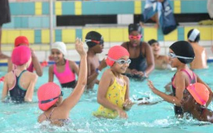
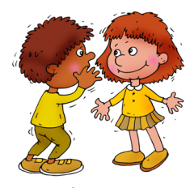
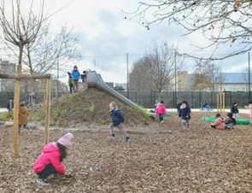
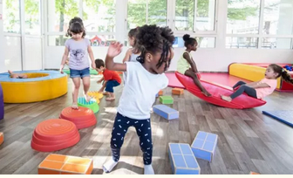
Techniques
Guidelines for parents and teachers on language
Child aged 2 to 3 who communicates in class and/or family but:
How does the child express himself?
And his understanding?
And his behavior?
A child who “does not speak” (distorted words, sounds coming out)
A child who disrupts the group / does not want to do the activities
Introduce the language awareness group to parents
Focus on the sessions themselves and the role of parents
We try to identify specific techniques and strategies that can be implemented to foster progress in children's language skills and involve parents:
Shared Reading programmes?
Integrated Language Activities also using educational and interactive apps
Language Support at Home: Providing materials and resources to parents to help them support their children's language development at home.
Family Learning Sessions: and creation of exchange groups
Feedback and Continuous Communication
Community Involvement: Involve the local community, such as libraries, cultural centres or educational organisations, to provide additional resources and learning opportunities for children and parents.

Slide 9
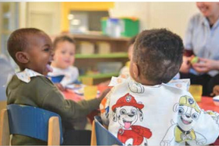
Activities: songs, photos and memories…
Target Group: Kids from 3 years old - Course of the sessions – 45 to 55 min
It is important to alternate short sequences of 5 to 10 min maximum - alternating sitting and standing, speaking and singing, which mobilize attention and the body in different ways.
Involve parents in the holding of sessions and see how they immerse themselves in the proposed topics.
A theme per session. The possible themes, which are chosen the previous session with parents and children: the body and its different parts, clothes, transport, animals, the market, emotions, colors…
5 min : a beginning ritual like a presentation song. For instance here - children stand up in a circle, with their parent next to them - each parent and child says hello, and give his first name- and then sing all together the presentation song.
Have them sit in circle.
5 min - take a photo from the theme of the previous session and ask them in turn if they remember - have all the children repeat the name of the image.
Max 10 min: Comprehension / pronunciation / attention - choose 10 images related to the day's theme - take simple, color images - from everyday life - drawings or photos, in color - have them guess and repeat all together and then in turn - ask everyone which image they prefer (children and parents)
Max 10 min – play a short song (no more than 2 minutes long) related to the session's theme - everyone closes their eyes and listens – you can repeat the listening several times - try to sing the chorus all together or more if possible - move hands, then feet, then head to the rhythm - Moving/dancing song time.

Slide 10

Activity: Use of coloring pictures…
Max 10 min - prepare coloring pictures related to the theme - each child chooses an image, has to name it - and chooses the coloring colors by naming them - have them repeat the images and colors to the animator and to the parent- have them color the picture- at the end, return to the circle and each child recalls the name of his image and the colors chosen.
Or you can also collect old magazines or photopies with different pictures - ask the children to find a picture related to the theme - ask them to name it, cut it out and stick it on a large sheet with the other children's pictures, separating them by theme.
Max 10 min - Choosing a challenge for the next session to parents, based on the exercises of the day - discuss with parents (and children) to choose together a challenge to do during the week - it could be to learn the nursery rhyme, or to color another picture, to repeat the names learnt during the session….
Decide together on the theme for the next session - to help them, propose different session topics (explaining the theme) and see if anyone has another idea - then hold a vote (by raising your hand to choose the theme if needed) for both children and parents
5 min: a ending ritual, a song to say goodbye (always the same).

Slide 11
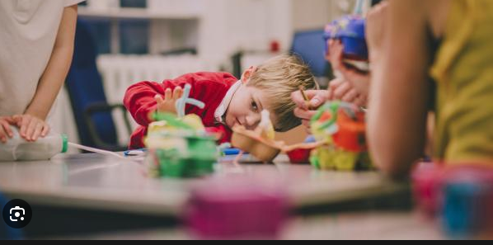
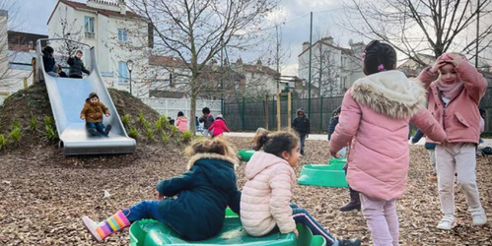
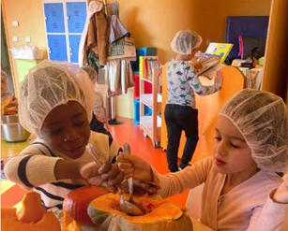
Activity : one session on the theme of the fruits
5 min : each parent and child stand in circle, says hello (give his first name) – all together sing the beginning ritual song. Have them sit in circle.
5 min - take a photo from the theme of the previous session and ask them in turn if they remember - have all the children repeat the name of the image.
10 min : Make guess images with common fruits (max 8 to 10) : apple, banana, grape, apricot, strawberry, lemon, ... you can also have objects / games on the subject so that the children can touch and manipulate them, giving the name.
Have them guess and repeat the names all together and then in turn - ask everyone which fruit they prefer (children and parents)
10 min – Moving/dancing song time example listen to the song (without showing the video, only the sound) - try to find the fruits named in the song and collect the images - stick them in a row on a large sheet of paper on the wall - repeat the song as many times as needed the child asks the parent what he wants to eat, and gives it to him by repeating the name of the fruit.
Max 10 min - prepare coloring pictures of fruits - each child chooses an image, has to name it - and chooses the coloring colors by naming them - have them repeat the images and colors to the animator and to the parent- have them color the picture- at the end, return to the circle and each child recalls the name of his image and the colors chosen.
10 min
Objective for the next session: discussed with the group – for ex try to remember and name the fruits they have eaten during the week. Each child brings home 3 pictures of fruits to be colored and shown at the next session
a ending ritual, a song to say goodbye (always the same) and everyone say « goodbye » in the circle.

Slide 12
Tips and suggestions
01
Duration of sessions: allow 45 minutes rather than 1 hour, in order to have the full attention of children and parents
02
Organization of the sessions: set objectives before each session (objectives with the children / objectives with the parents)
03
Tools: use of different media to talk about the same theme
04
Activities: imagine activities that can be reproduced easily at home, and at no cost for families
05
Group : make the parent work with other children and help with the workshops to limit the competition effect

Slide 13
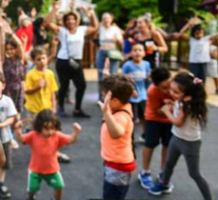

photo credit Journal de Saint Denis https://ville-saint-denis.fr/journal
Departmental Council Seine Saint Denis
https://seinesaintdenis.fr/
End of module
Thank you for reading this module, and we hope you enjoyed it and learned some useful information. This module is part of the Surviving Digital Training Course, you can find the rest of the modules on our website. Be sure to keep up to date on the project by following us on our social media channels!
www.survivingdigital.eu

