Slide 1

Training course: Surviving digital
Module 6 - Expressing yourself as a parent
www.survivingdigital.eu

Slide 2

Introduction
Objectives
Skills addressed and learning outcomes
Theoretical knowledge
Techniques
Case study and activities
Tips and hints

Slide 3

Introduction
As the world becomes more digital, effective parenting extends beyond face-to-face interactions. Nurturing open communication and emotional connection with your child requires navigating the unique challenges and opportunities presented by digital technology.
This module is designed to help you explore various aspects of expressing yourself as a parent in the digital age.
From understanding the impact of technology on your emotional expression to mastering the skills of active listening and validation, you will learn about developmental psychology and reflective parenting techniques.
By the end of this module, you'll be equipped with insights and strategies to foster meaningful connections with your child while adapting to the evolving digital landscape.

Slide 4

Objectives
By completing this module, you will be able to:
• Understand how digital technology influences your role as a parent and its impact on effective emotional expression.
• Apply active listening techniques to engage in meaningful conversations and validate your child's emotions.
• Analyze key concepts in developmental psychology to tailor your communication approach to your child's unique stage of growth.
• Implement reflective parenting strategies to enhance self-awareness and thoughtful responses in digital interactions.
Throughout this module, you will explore practical scenarios, engage in reflective exercises, and gain valuable insights to enhance your ability to express yourself as a parent in the digital age.

Slide 5
Skills addressed
01
Active Listening Skills
02
Emotional Regulation
03
Validation- emotional expression
04
Recognising Emotions
05
Expressing yourself as a parent

Slide 6

Developmental Psychology
Developmental psychology helps to explain the significance of how parents express themselves in shaping a child's emotional, social, cognitive, and moral development. Parents who provide a supportive and nurturing environment through their expressions contribute positively to their child's overall development and well-being.
In developmental psychology, there are several key concepts and theories that can provide valuable insights into how parents express themselves and the impact it has on their children.
Over the next few pages, we will take a brief look at the following three developmental psychology theories.: Attachment Theory, Parenting Styles and Emotional Regulation.

Slide 7
Theoretical Knowledge:
What is Attachment Theory?
Attachment theory, a cornerstone of developmental psychology, examines the deep emotional bonds formed between parents and their children. This theory, developed by John Bowlby and further explored by Mary Ainsworth, underscores the profound impact of how parents express themselves on the attachment styles children develop. According to attachment theory, secure attachment is established when parents consistently and responsively express love, care, and support. When parents express themselves in ways that are emotionally available, sensitive to their child's needs, and consistently reliable, children tend to develop secure attachments.
Children with secure attachments often exhibit higher self-esteem, better emotional regulation, and healthier interpersonal relationships later in life. On the other hand, inconsistent or neglectful expressions by parents can lead to anxious or avoidant attachment patterns in children, which may result in emotional difficulties and challenges in forming healthy relationships. Therefore, understanding how parents express themselves emotionally is pivotal in shaping the attachment bonds that underpin a child's emotional development.
What is Social Learning Theory?
Albert Bandura's Social Learning Theory provides further insights into the dynamics of how children learn and develop through observing and modeling the behaviors of their parents and caregivers. In the context of how parents express themselves, this theory suggests that children acquire their communication styles, emotional regulation strategies, and problem-solving approaches by observing their parents' interactions. Parents who express themselves positively, engage in healthy conflict resolution, and demonstrate effective communication skills serve as powerful role models for their children.
Moreover, Social Learning Theory underscores the importance of reinforcement and punishment in shaping behaviors. When parents express themselves with kindness, empathy, and effective communication, children are more likely to model those behaviors. Conversely, negative expressions, such as harsh criticism or anger, can also be learned and imitated. Therefore, parents who are mindful of how they express themselves contribute significantly to their children's social and emotional development by providing them with positive models of communication and behavior.

Slide 8
Theoretical Knowledge: Emotional regulation
What is Emotional Regulation?
Emotional regulation, a vital aspect of child development, is deeply intertwined with how parents express themselves emotionally. Parents who demonstrate healthy emotional regulation techniques, such as recognising and labeling their emotions, coping with stress in constructive ways, and expressing themselves appropriately, offer invaluable lessons to their children. Children observe and internalize these behaviors, learning how to manage their own emotions in the process.
When parents express themselves with emotional intelligence and regulation, they create a safe environment where children feel comfortable discussing their own feelings and seeking guidance on how to navigate them. On the contrary, parents who struggle with emotional regulation may unintentionally model maladaptive responses, potentially leading to difficulties in managing emotions for their children. Therefore, nurturing emotional regulation skills and mindful expression is integral to fostering emotional well-being and resilience in children as they grow and develop.

Slide 9

Technique: Active listening and validation as a parent
In the journey of parenthood, one of the most potent tools at your disposal is the art of active listening and validation. These skills go beyond merely hearing words – they involve genuinely comprehending your child's thoughts, emotions, and experiences.
By mastering active listening and offering validation, you create a nurturing space that fosters trust, empathy, and a robust parent-child bond.
Over the next few slides, we will take a closer look at the concepts of Active Listening, Validation: Acknowledging Emotions, Reflective Responses, and Creating a Safe Emotional Space.

Slide 10

Validation- acknowledging emotions
Validation, even in the digital realm, remains a cornerstone of nurturing healthy emotional development. As parents navigating the digital landscape alongside our children, we recognise the importance of acknowledging their emotions, whether expressed through emojis, messages, or posts.
Just as in face-to-face interactions, validating digital emotions sends a powerful message that their feelings matter. It creates a safe and supportive digital space where children can express themselves without fear of judgment. When children express their emotions, be it joy, frustration, fear, or sadness, it is essential to respond with empathy and understanding.

Slide 11
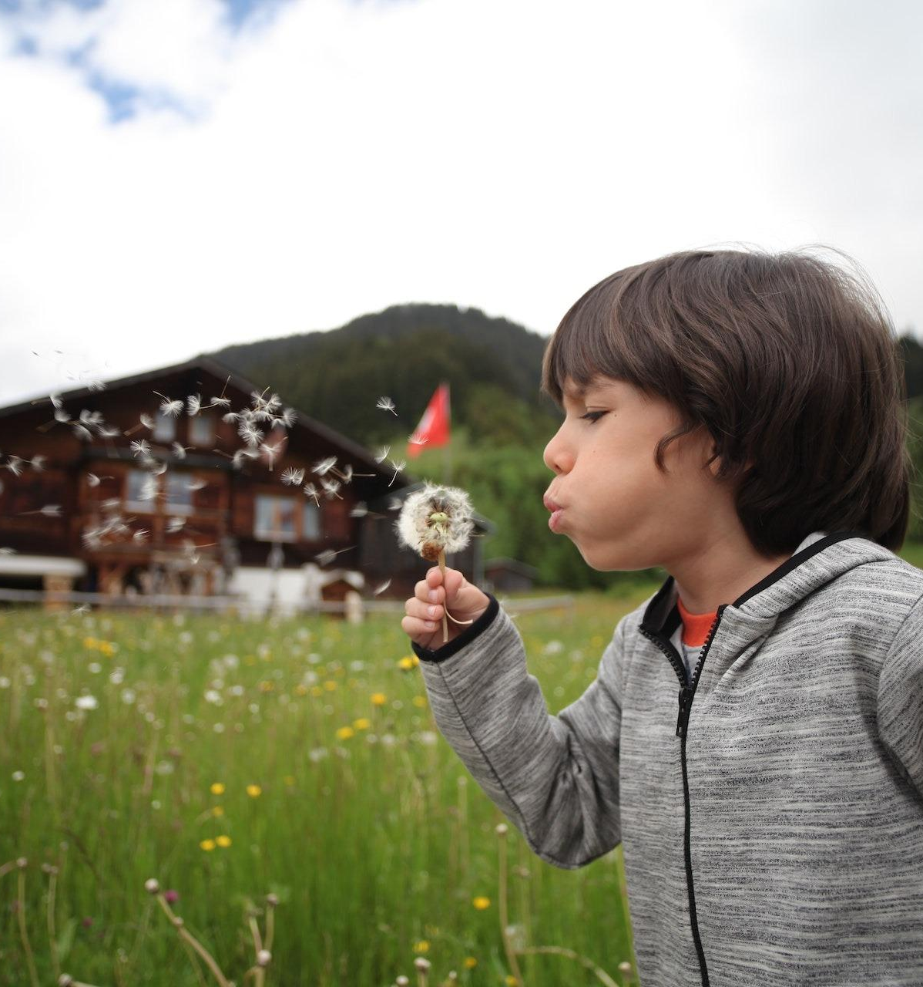
Active Listening
Active listening is a communication skill that goes beyond simply hearing words. It involves giving your complete attention to the speaker and making a conscious effort to understand not just what they're saying, but also their emotions, intentions, and perspectives.
Active listening is marked by nonverbal cues like maintaining eye contact, nodding, and using facial expressions to convey engagement. This technique also includes verbal responses such as asking open-ended questions, paraphrasing, and providing feedback to show that you're actively involved in the conversation.

Slide 12

Creating a safe emotional space
In the context of parenting, creating a safe emotional space for oneself as a parent is equally vital. It involves intentionally setting up an environment where parents can openly and honestly express their own thoughts, emotions, and concerns without feeling vulnerable or judged.
This concept heavily relies on self-empathy, where parents strive to understand and acknowledge their own feelings and needs. It also encompasses the ability to actively listen to one's own emotions, granting them the same attention and care that we give to others.

Slide 13

Case study:
Introduction:
In this good practice example, we will look at the life of Sarah, a devoted mother of two, as she faces the challenges and triumphs of expressing herself as a parent. We'll explore her experiences, the strategies she adopts, and the impact on her children's development.
Sarah, a 35-year-old working mother, is passionate about providing the best upbringing for her two children. However, she has been facing challenges in effectively expressing herself as a parent. She has observed that her communication style occasionally leads to misunderstandings, and she wants to improve her ability to connect with her children emotionally.
Sarah often finds herself overwhelmed by her busy work schedule and daily household chores. This stress occasionally affects her ability to communicate calmly with her children when they misbehave or confront difficulties. She has noticed that her frustrations sometimes result in raised voices and impatience, which she recognises is not conducive to healthy parent-child communication.

Slide 14

Case Study
Strategies and Action:
Sarah took steps to improve her parenting expression. She started by becoming self-aware, acknowledging moments of stress without self-judgment. She actively listened to her children, giving them her full attention to understand their perspectives better.
Sarah also learned emotion-regulation techniques, which helped her respond to her children more calmly and empathetically. She frequently validated her children's emotions, encouraging open communication and empathy within the family. Sarah also taught her children conflict resolution skills, modelling calm discussions and collaborative solutions, creating a more harmonious family atmosphere.
Over time, Sarah's efforts to improve her expression as a parent have yielded positive results. Her children have become more open and communicative with her. They feel comfortable sharing their thoughts and concerns, knowing that their emotions will be respected. Sarah's ability to manage her own emotions has created a more harmonious and understanding atmosphere at home.

Slide 15
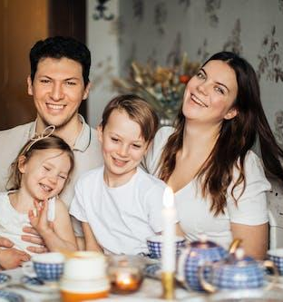
Case Study:
Conclusion:
Sarah’s children also started to emulate their mother's positive communication style. They actively listen to each other, express themselves calmly, and have developed a greater sense of empathy. As a family, they have become better equipped to navigate challenges and conflicts together.
Sarah's journey demonstrates the significance of self-awareness, active listening, and emotional regulation in fostering healthy parent-child relationships. By implementing these strategies, she not only strengthens her connection with her children but also equips them with essential life skills for their own emotional well-being and future relationships. This good practice serves as an inspiring example of how parents can positively impact their children's development by investing in effective communication and expression.

Slide 16
Activity- My parenting Manifesto
For an exercise focusing on self-expression as a parent, consider creating a "Parenting Manifesto." This task involves a straightforward process of introspection and writing, where you'll identify your core values and goals as a parent, acknowledge your challenges, and outline your approach to parenting. The aim is to create a clear, concise document that serves as a personal guide and reference in your parenting journey.
Crafting a Parenting Manifesto encourages you to articulate your values, goals, and strategies in parenting. This process brings clarity to your approach, helping you to focus on what truly matters in your interactions with your children. It serves as a compass, guiding your daily decisions and responses to various parenting challenges.
By defining your principles and objectives, the Manifesto fosters consistency in your parenting style. When you're faced with difficult situations or decisions, referring back to your manifesto can remind you of your core beliefs and goals, aiding in maintaining a consistent approach in raising your children.
The exercise promotes self-awareness by requiring you to reflect on your strengths and challenges as a parent. This introspection can lead to personal growth, as you become more conscious of areas where you excel and aspects where you might need to improve or seek support. Over time, revisiting and revising your manifesto in light of new experiences and insights can further foster this growth.
Please see the next slide for instructions on how to conduct the exercise.
Reflect on Your Values: Start by taking some time to reflect on what values are most important to you as a parent. These could include honesty, kindness, independence, education, or any other values you hold dear.
Consider Your Goals: Think about what goals you have for your children and your relationship with them. What do you hope to achieve as a parent?
Identify Your Challenges: Acknowledge any challenges or difficulties you face in parenting. Understanding these can help you address them more effectively.
Write Your Manifesto: Using your reflections, write a "Parenting Manifesto". This is a personal statement that outlines your values, goals, and approaches as a parent. It can be a few paragraphs or a page long – whatever feels right for you.
Include Examples: For each value or goal, include a specific example of how you plan to implement it in your parenting. This could be through daily routines, special activities, or general approaches to communication and discipline.
Share and Discuss (Optional): If you feel comfortable, share your manifesto with a partner, family member, or friend. Discussing it can provide additional perspectives and support.
Reflect and Revise: Remember that your Parenting Manifesto is a living document. As you grow and learn in your parenting journey, come back to it periodically to reflect on your experiences and make any necessary revisions.

Slide 17
Consigli e suggerimenti
01
Building trust through emotional openness: By creating an environment in which emotions are recognised and validated, trust is created and a safe space for authentic communication is fostered, even in the digital realm.
02
Choose the right medium for emotions: simple messages for casual conversations with emoji etc, video calls or voice messages for more complex emotions.
03
Adapt activities according to the interlocutor: the inclusion of relevant images or GIFs can add deep thoughts to digital conversations.
04
Guide your children to recognise when certain emotions are more appropriate for face-to-face discussions: by teaching them to balance the benefits of digital communication with the authenticity of face-to-face interactions, you can empower them to navigate the digital age while retaining the benefits of emotional expression.
05
Show your children how to make meaningful connections outside the digital world: in this way they will “walk” appropriately also the online world.

Slide 18

End of module
Thank you for reading Module 5, and we hope you enjoyed it and learned some useful information. This module is part of the Surviving Digital Training Course, you can find the rest of the modules on our website. Be sure to keep up to date on the project by following us on our social media channels!
www.survivingdigital.eu

