Slide 1
Do not judge ; accept that, at the start of discussions, parents can see screens as a positive aspect or a resource in their daily livesScreens can be useful to get information for us parents (tv) or in case of stress it allows us to relax.Screens are useful for learning for the 7 year old, my daughter learned things that I could not have taught herIt also allows you to have fun; music channels for example to sing and dance.It also helps to create a link with their origins (nursery rhymes from the country, we have the Ivorian channel too).Screens can improve knowledge and arouse curiosity.Also to calm the anger and whims of the 2-year-old child, with the music on the screens.
MARIAM, Mother of 2 children aged almost 7 and 2 years old
INTERVIEW SUMMARY
In your experience, what are the challenges that are faced by the professionals and caregivers in the fight of screen addiction phenomena?
- Do not neglect passive uses which are often ignored by the family
« There is often the television on in a room without it being intended for the child - When we parents watch TV, the children play in the room because they are not at all interested. When it comes to cartoons, they watch TV.There is sometimes the TV on to liven up the room (bring it to life) without anyone really watching. This is especially so as not to leave a great silence in the house. »
1st challenge:
identify the place of screens in everyday life within the family
it is often very underestimated –
by taking the list of all the screens we often have big surprises;
generally the family forgets certain screens like a tablet or even the TV because they are so used to them
the second step is to describe the uses: when is the screen on, for whom, in front of whom... again, if you do the exercise with several family members the answers can be very different - many uses go unnoticed.

Slide 2
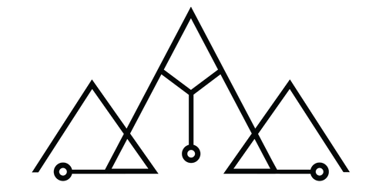
COMPETENCES
What are the relevant competencies expected of professionals that work on overexposure of children?
Do not judge
accept that, at the start of discussions, parents can see screens as a positive aspect or a resource in their daily lives
« Screens can be useful to get information for us parents (tv) or in case of stress it allows us to relax.Screens are useful for learning for the 7 year old, my daughter learned things that I could not have taught herIt also allows you to have fun; music channels for example to sing and dance.It also helps to create a link with their origins (nursery rhymes from the country, we have the Ivorian channel too).Screens can improve knowledge and arouse curiosity.Also to calm the anger and whims of the 2-year-old child, with the music on the screens. »
What are the appropriate conditions for successful contributions and positive outcomes of implementing such interventions in the working or everyday environment?
Specify the practices and the dangers according to the ages of the children
My 7-year-old child is interested because she understands what she is watching (the story of the cartoon for example); My 2-year-old is interested for a few seconds just long enough to change focus. Then he goes to play.
Rely on the family proposals to propose change behaviors
I have precautions: I have a watch on the acronyms of the CSA to authorize to look at certain things. I have a personal strategy which is to put on uninteresting things so that they go play in the bedroom. There is a mastery of the time of use, the broken tablet I do not plan to repair for the moment.
Starting from the words of families and co-constructing responses that adapt to daily life seems to be the only way to change behavior over time
Resources:

