Slide 1
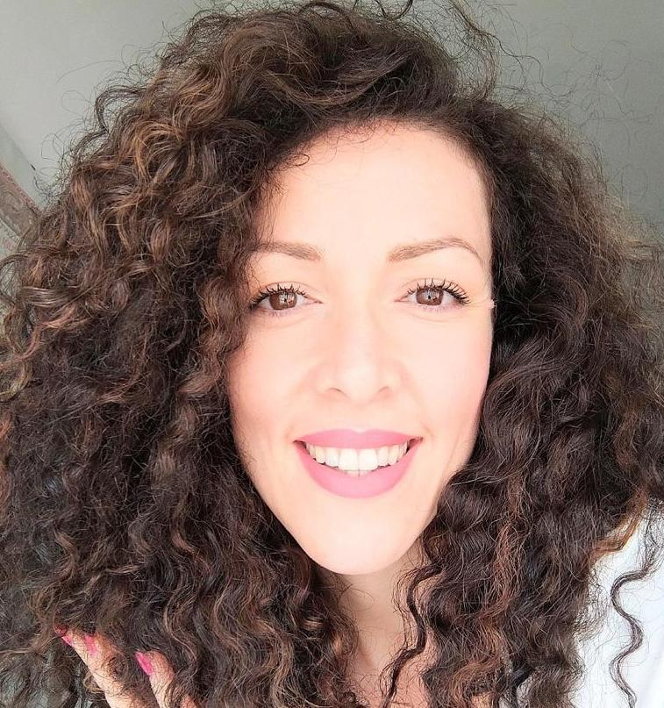
MARINA REGINA: Psychologist - Psychotherapist - Educator and Counselor
After a first degree in Education and Training Sciences, I completed a three-year master's degree in Individual and Group Counseling. During this training period, I discovered my passion for psychology, so I took a master's degree in Clinical Psychology and later a specialization in Gestalt Psychotherapy. In the meantime, I earned several masters, including one in Ericksonian Hypnosis and another in Specific Learning Disorders. I devote most of my time to clinical work within my private practice. During this training period, I discovered my passion for psychology, so I took a master's degree in Clinical Psychology and later a specialization in Gestalt Psychotherapy. In the meantime, I earned several masters, including one in Ericksonian Hypnosis and another in Specific Learning Disorders. I devote most of my time to clinical work within my private practice.
MARINA REGINA: Psychologist - Psychotherapist - Educator and Counselor
After a first degree in Education and Training Sciences, I completed a three-year master's degree in Individual and Group Counseling. During this training period, I discovered my passion for psychology, so I took a master's degree in Clinical Psychology and later a specialization in Gestalt Psychotherapy. In the meantime, I earned several masters, including one in Ericksonian Hypnosis and another in Specific Learning Disorders. I devote most of my time to clinical work within my private practice. During this training period, I discovered my passion for psychology, so I took a master's degree in Clinical Psychology and later a specialization in Gestalt Psychotherapy. In the meantime, I earned several masters, including one in Ericksonian Hypnosis and another in Specific Learning Disorders. I devote most of my time to clinical work within my private practice.
Digital Intervention
INTERVIEW SUMMARY
What is the impact of such approaches?
A more conscious use of technologies and healthy expression of their emotions the person can definitely feel better and be affected but the impact of this contribution. It will also have an impact on the whole family system that will find a new balance given by situational awareness and not be left alone in managing such a complicated situation. This will improve the quality of live of the whole family members.
COMPETENCES EXPECTED IN RELEVANT ENTERPRISES: What are the relevant competencies expected for professionals that work with children of being at high risk of screen addiction?
1) Knowledge of the topic of screen addiction and what the possible risks are.
2) Recognize that time spent on smartphone that are going over a normal “time schedule” it is a true form of pathological addiction and not just a hobby.
3) Know how to identify the warning signs in children/youth behaviors, such as aggressive reactions when the device they are using is taken away from them, or poor socialization with peers, low school performance, poor commitment to homework, etc.
4) Recognize the psychological levers used by tech companies, i.e., why these tools are so persuasive to the human mind.
5) Know how to offer viable alternatives, to encourage children to use time in healthier and more constructive ways.
6) Knowledge of good use of technology for good purposes.
7) Helping children recognize and manage their emotions, especially the anger and frustration that arise at the very moment they are prohibited from using the devices in question.

Slide 2
Do you have any further innovative interventions that you may know or want to suggest for being implemented in your working or everyday conditions?
CONDITIONS FOR SUCCESSFUL CONTRIBUTION AND POSITIVE OUTCOMES: What are the appropriate conditions for successful contributions and positive outcomes of implementing such interventions in the working or everyday environment?
I do not know of any innovative methods in this sense, but I do know of one method that has been returning excellent results forever and in all forms of addiction or distress: psychotherapy. I specialize in Gestalt Psychotherapy, a post-analytic psychotherapeutic method that integrates body, experiential, depth, group and family models into a unique synthesis. The art of Gestalt psychotherapy includes improvisation, creativity, and poetry as the essential word arising from the body. Gestalt psychotherapy applies to the individual, couple, family, group, and organizations. For Gestalt Psychotherapy, any disorder or pathology is a creative act of our mind in response to a situation of suffering. Precisely because of this, the symptom is received as a "message" that comes when the person is very ill. From this perspective, we can look at addiction just as a symptom and then use it to help the person "heal" from his or her inner suffering.
The basic condition from which to start is information and training on these issues. They should involve the child/youth, the family and the school. To create, around the young person, an informed and knowledgeable environment that does not judge but is supportive in order to overcome a condition of extreme difficulty.
Resources:

