Slide 1
Digital Wellness Institute
INTERVIEW SUMMARY
In your experience, especially through your DIGITAL WELLNESS 101 COURSE, and your EBOOK creation and distribution, what are the challenges that are faced by the professionals and individuals, especially parents of young children in the fight of screen addiction phenomena?
Digital Flourishing Model® by DWI
Professionals and individuals, especially parents of young children, commonly face three main challenges in the fight against screen overuse. First, they lack a common definition of what constitutes problematic use. Second, they face stigma and feelings of shame and negativity that accompany the issue of digital overuse. Finally, we find that parents lack the guidelines for how much streentime is “too much,” and how much time leads to detrimental consequences for them or their children
To help eliminate confusion the Digital Wellness Institute created a scientific model called the Digital Flourishing Model® to create the framework and roadmap for behavioral change. The model involves the intersecting dimensions of productivity, environment, communication, relationships, mental health, physical health, the quantified self, and digital citizenship. In its entirety, it provides a roadmap to what we term Digital Flourishing: optimal state of health and well-being that a person using technology is capable of achieving.

Slide 2
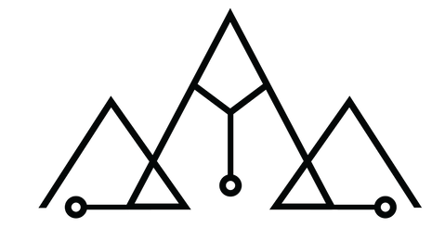
COMPETENCES
What are the relevant competencies expected of professionals that work with children and/or parents, when children are at high risk of screen addiction?
We recommend that professionals working with children and/or parents with children at high risk of screen education should be well-versed in digital well-being and hold a record of training completion from a certifying body
At The Digital Wellness Institute we believe that parents must model healthy screen use and related
behavior in order for the intended changes to be seen in children. Further conditions for successful changes in screentime overuse are a strong community of others engaging in the same habit changing behaviors.
Students who take our courses are automatically added to a community of alumni in a slack channel so they can support each other in the new habits they have formed and practices they have learned throughout the course.
We know from research that specifically for children and young adults, it is important that their peers engage in similar screen habits or implement change together.
Thus, in addition to parents supporting each other, creating an environment where children can practice new habits together is an important condition for success.
Resources:
www.digitalwellnessinstitute.com

