Slide 1
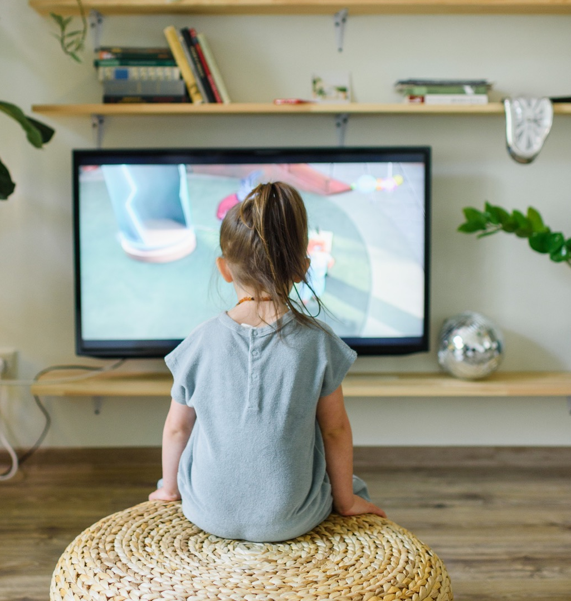
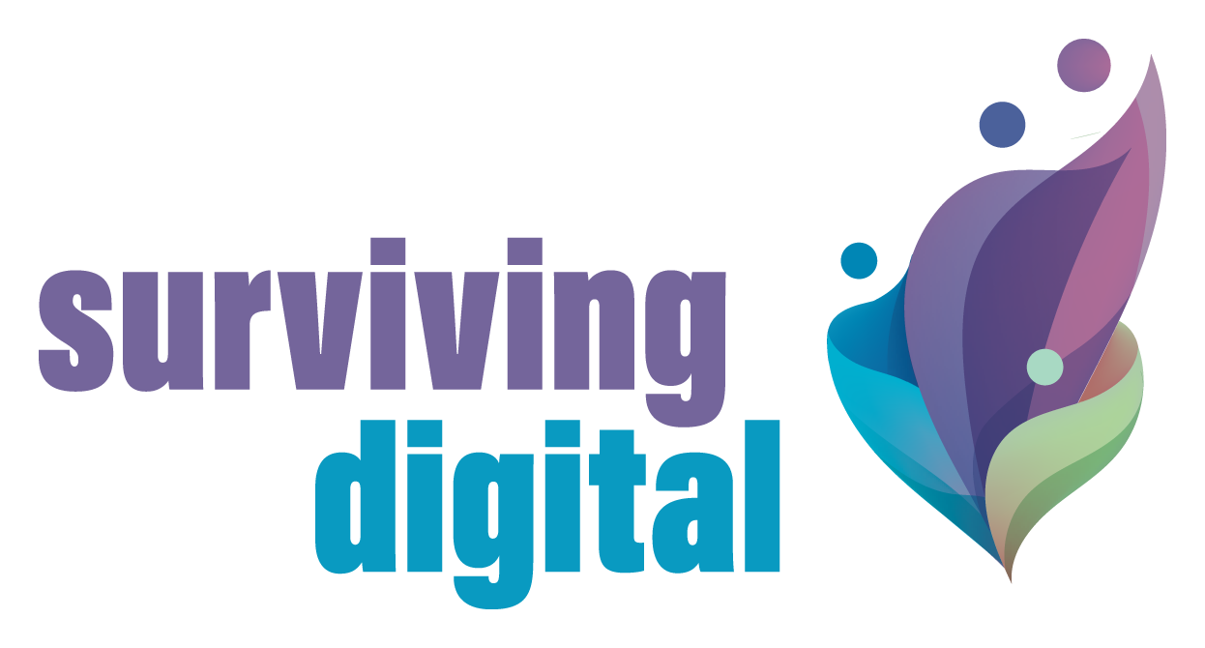
The Methodological
Guide To
Surviving Digital
August 2023
By
Surviving Digital Consortium
www.survivingdigital.eu

Slide 2
contents
01
Introduction
What is this Guide for? 4
Who is this Guide for? 5
How to Read this Guide? 7
Two Definitions before we get Started 8
02
What’s the Problem?
Introduction 10
The Science behind Overexposure 12
Contentions within the Sciences 21
The Development of the Child Disrupted 28
03
What is Contributory Research?
Introduction 39
A Method that Comes out of Philosophy 41
Main Orientations 46
The terms and Why We Use Them 49
The Difficulties of Fighting Against Overexposure and How Contributory Research Responds to Them 54
04
How to Launch a Process of Contributory Research?
Introduction 60
Creating a Core Group 62
Opening the Group to the Public 70
05
One Example of a Capacitation Process: Reason our screens
Introduction 75
The Nine Capacitation Sessions 77
2

Slide 3
01
Introduction

Slide 4
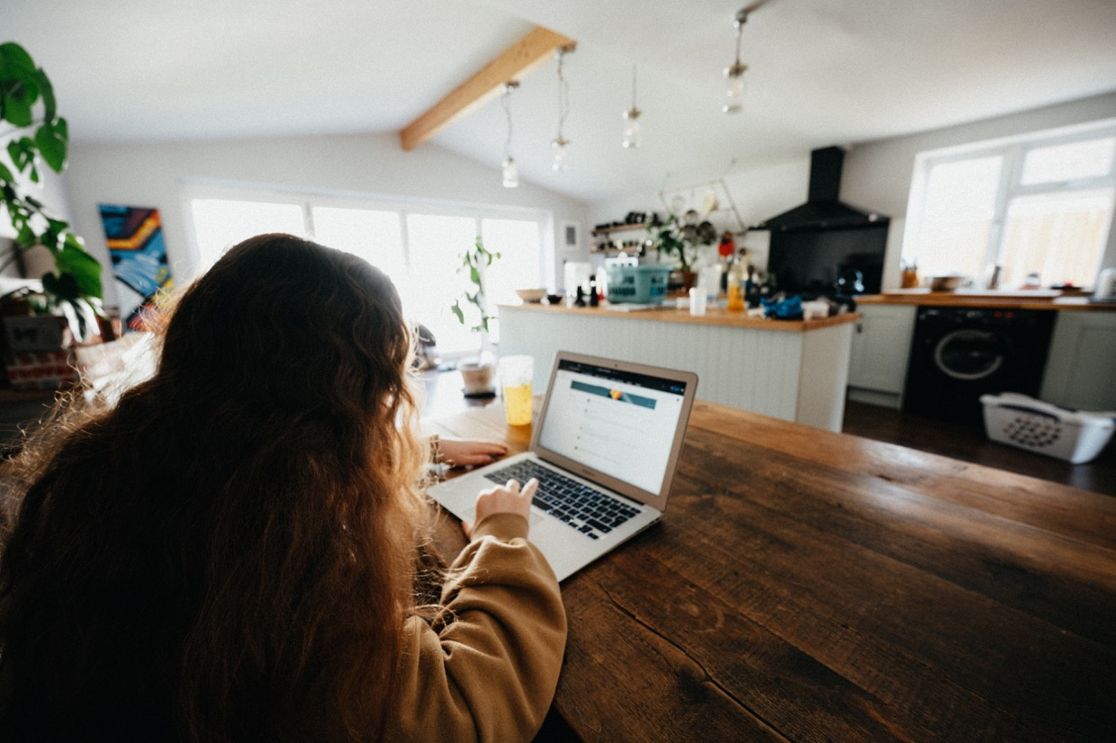
What is this Guide for?
This guide has been conceived by the Institute of Research and Innovation to help you organise collective actions against the overexposure to screens of young children.
In recent years, screens have flooded our lives. Many of us will on a regular basis have the sensation of being connected for longer than what is good for us. Very young children, however, are considered especially vulnerable, as screens risk disrupting crucial early development stages. Many Health Organisations and European governments are beginning to recognize the potential harmful effects of early overexposure. As such, you can today find amble advice on how you ought to use your computer, smartphone, or tablet around your children.
Rest assured. This is not just another guide telling you to keep your children away from your devices. Instead, we offer you a guide that will help you understand the mechanisms behind modern digital technologies, and why sparring small children from them is easier said than done. It will give you insights into the development of infants and how exactly screens disrupt the relations they depend on to learn and grow, so you can take the necessary steps to restore them.
We do not expect you to take these steps alone.
Screens are incredibly pervasive. They are actively promoted by economic actors who gain dizzying sums from keeping us online for as long as possible. That is why we argue that the responsibility for changing our screen usage should not be placed with the individual parent.
With this guide, we want to give you the tools to act against overexposure collectively. It will show you how to create local groups, where you can bring together different kinds of knowledge to invent new, better ways of using digital technologies in collaboration with others.
We call this activity contributory research. We think of contributory research as a new intelligent health care strategy.

Slide 5
Who it is for?
This Guide is for you!
…a child doctor or psychologist worried about a growing number of children showing delays in language, cognition, and motor skills
… a parent struggling to replace screens with other activities
… a public institution or enterprise that wishes to support local economies by investing in the capacities of inhabitants
… a health care professional unsure of how to address parents with children affected by overexposure
… an elected official interested in experimenting new innovative health care initiatives in their territory
… a researcher who is interested in collective research and who wants to channel their knowledge into care practices
… an animator looking for new tools to foster collective intelligence
… or just about anyone else concerned with the effects technology has on our development and mental well-being…
…. This guide is for you!

Slide 6
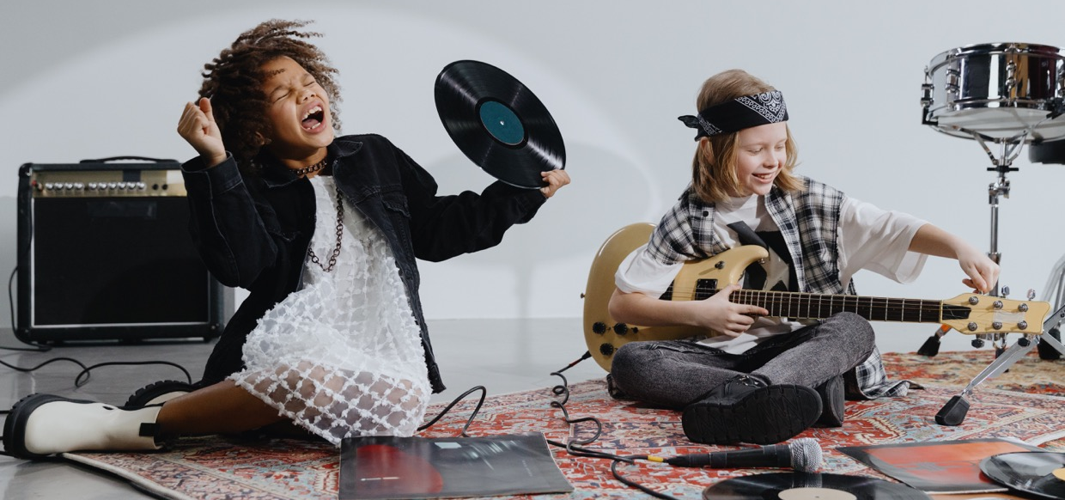
In principle, anyone can instigate a process of contributory research. It is important that you care deeply about the negative effects the misuse of technology can have on our collective wellbeing, and especially on our children.
Maybe you have young children. Maybe you work with young children. Maybe you are concerned about the impact our current actions have on future generations. You might be someone who is looking for new ways to respond to wicked problems, which require multi-stakeholder engagement. You believe in the power of collective intelligence. You are interested in learning more, and open to new ways of knowing. You see a lot of untapped potential around you, and want to invest in the growth of people in your local area.
All of this will help you as you begin to form your own contributory research group. We are not going to lie. The method we are proposing is not an easy fix. Contributory research demands time, energy and patience. Coming up with solutions collectively takes longer than implementing a set of ready-made ‘solutions’ without considering the knowledge and constraints of the people you work with. Careful action takes longer than automated action. If we advocate Contributory Research, it is because we believe that solutions that have been adapted to and adopted by those who need them are more likely to endure in the long-term.
This guide is for you, if you, like us,
believe in investing in the long term.

Slide 7
How to read it?
If you know nothing about screens or contributory research, don’t worry. We have conceived a structure that takes you through all the information you need to get started with forming your own group of contributory research on overexposure. If you, on the other hand, come to this guide with prior knowledge, we invite you to jump directly to the part that seems most relevant for your research or practice. Each chapter has been written so it can be read independently.
Here, some indicators for
Where you might want to start:
01
If you are interested in knowing more about the overexposure to screens, you should start with the first part, Why is this Guide Necessary, which tells you about the different dimensions of the problem. You might also want to look at The Difficulties of Overexposure and How Contributory Research Responds to Them, which explains why we believe Contributory Research is a particularly effective strategy to overcome some of the barriers that prevent people from changing their screen habits.
02
If you are here to learn more about the method we are proposing, you should go to What is Contributory Research, which talks about the origins, principles and orientations of Contributory Research. We also recommend that you read How to Launch a Process of Contributory Research, which describes how the Contributory Clinic came into being.
03
If you feel well informed about the overexposure to screens and the effects it has on small children and the principles of Contributory Research, you can jump directly to How to Launch a Process of Contributory Research, which presents some of the questions you will want to consider when putting in place your own collective action against overexposure. Additionally, chapter five offers you a concrete example of a nine-sessions capacitation-program, which includes specific topics, questions, videos, and texts that you can use to structure your own research group.
04
Finally, we want to stress that this guide shouldn’t be read as a closed piece of work. We would love to hear your comments, questions, and suggestions. This is an integral to the ethos of contribution that structures any contributory research. At specific moments throughout the guide, we will invite you to contribute with your own knowledge or experience, whether it's in the form of an anecdote, expert advice, or insights from your national or institutional setting. Like here below:
You think we’ve forgotten something? You have an experimentation you would like to show us? You know something that we don’t? Please let us know by contacting us on contact@iri.centrepompidou.fr so we can keep on getting smarter together.

Slide 8
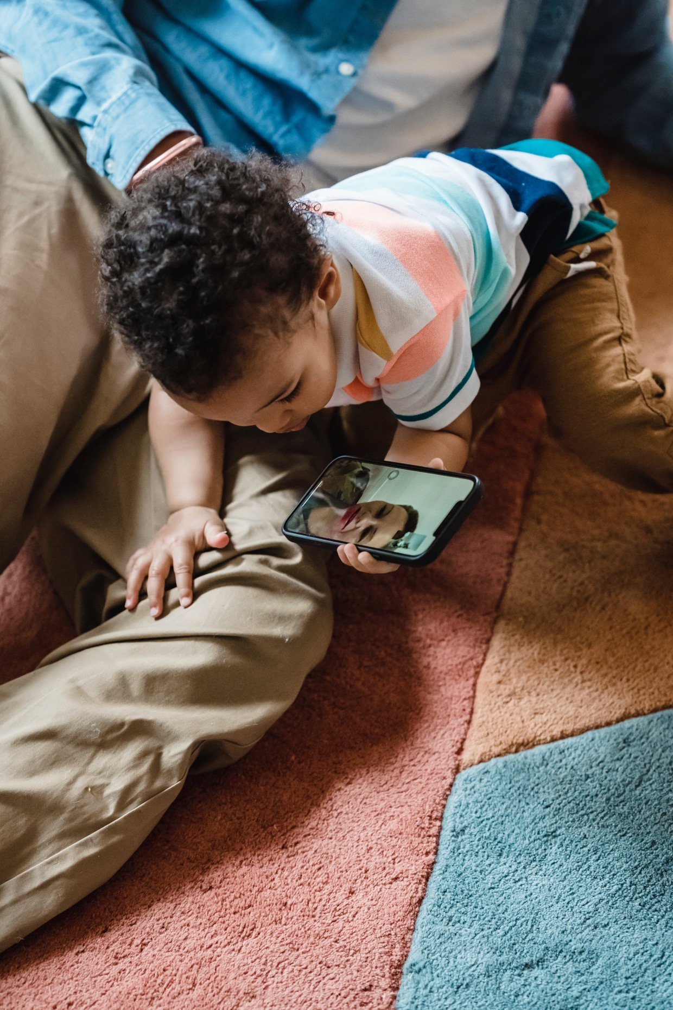
Two definitions before we get started
What exactly do we mean when we talk about an overexposure to screen?
OVEREXPOSURE
We define overexposure as an exposure that harms the person subjected to it. Different people will react to screens differently, depending on their age, genetics, socio-economic context, and usage, and so it’s impossible to set a fixed threshold for when someone is overexposed or not. For some people, only a couple of hours will compromise their wellbeing, whereas others will be able to tolerate more. That is why overexposure always has to be determined on a case-by-case basis.
When it comes to very young children though, we have to be extra careful with how screens are used. Persistent usage of screens are more likely to affect children negatively, just like the repetitive exposure to any kind of behavior or substance is likely to have more subversive effects on children compared to adults. That is because the scaffolding for all further learning is constructed during these early years of life. More than ever, learning depends on meaningful interactions with those around us.
That is also why we often couple the phenomenon of overexposure to that of underexposure. With this, how hope to express that the overexposure to screens is often correlated with an underexposure to social interactions and relations. Considering both is important if wanting to understand the harm caused by placing young children in front of screens.
SCREENS
For older children, it is important to distinguish between the kinds of screens they are using (are they one-directional or interactive) and the kinds of content they engage with (is it educational or not, age-appropriate or not, violent or not), as it will influence the effects it has on its users.
However, when it comes to infants and young children, this distinction is less important. Babies under two years old cannot interact with screens (even when these are advertised as interactive). They have not yet developed the faculties that allow them to discern the meaning of the content they see. They only register light and movement. That is also why the screens we are most concerned with are screens that emit light, show moving content, and which frequently introduce new images, as they, from a biological perspective, are bound to capture the child’s attention. We also urge parents to be extra careful with screens tending to unaccompanied use, like the smartphone and tablet, as it isolates the child from social interactions.

Slide 9
02
What’s the Problem?

Slide 10
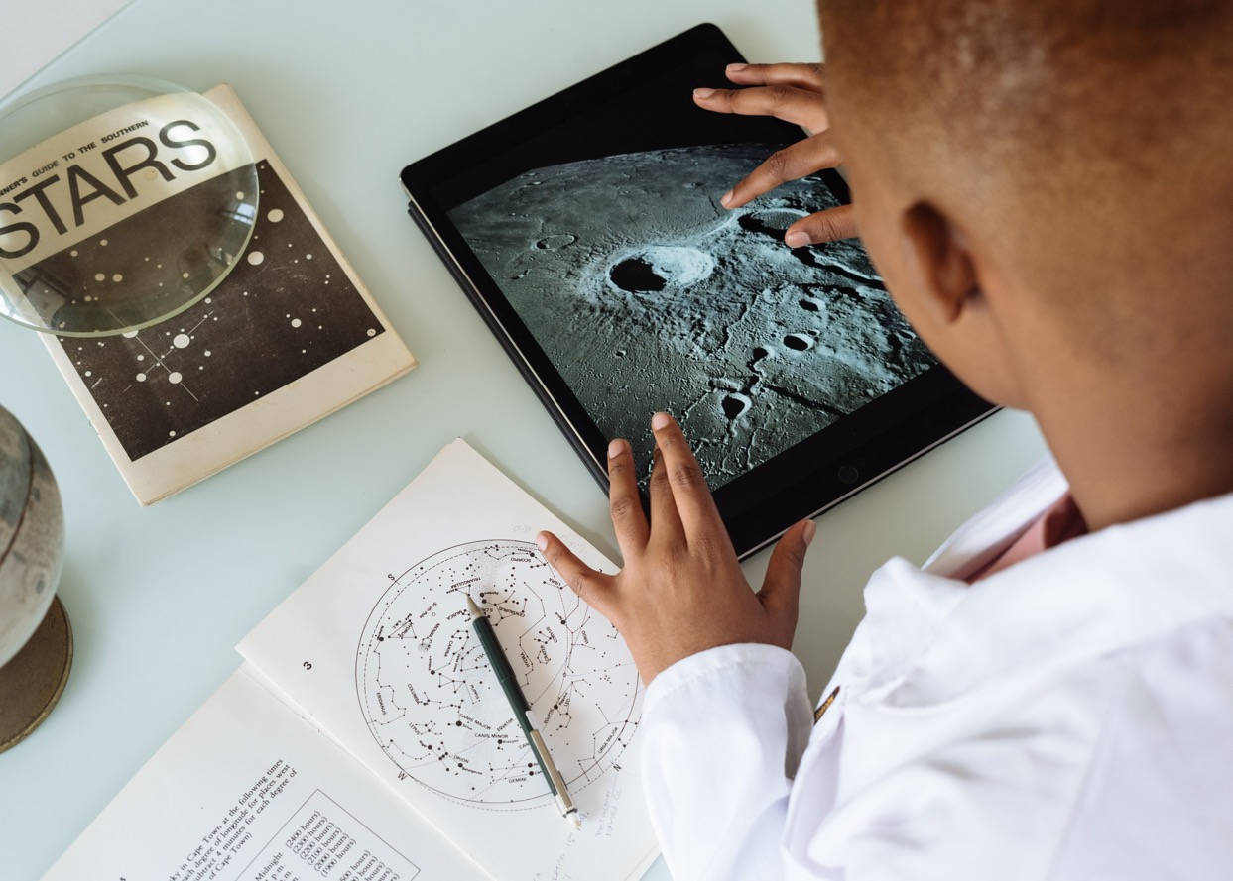
This first chapter makes the argument for why we should care about the number of hours children spend in front of screens. The goal is that by the end of it, you will have more precise arguments than ‘screens are bad’ when discussing overexposure with parents, colleagues, your children, or other family members.
Introduction
We will start by giving you an overview of the empirical studies that can teach us something about the effects of overexposure. By following large cohorts of infants, scientists have in the last couple of decades produced studies that give us a better idea of the areas most at risk of being affected by the excessive use of screens. Systematically observing how children react to screens is a good way of getting a better understanding of some of the discrete effects of overexposure, and the statistical risks associated with each one. Empirical studies also make for compelling arguments in political contexts, which often call for scientific proof to adopt new regulations.
Today, empirical studies are used to promote different – sometimes conflicting – policies on screens. That is because complex multifaceted problems, like the effects of screens, can be difficult to settle within the empirical sciences. In the second part of this chapter, we’ll unpack some of the mechanisms and limits of the studies we’ve looked at, to help you navigate the study results and take an informed position on the topic yourself.

Slide 11

As will become clear, empirical studies are not sufficient when wanting to understand the causes of the harmful effects of screens. That is why the third part of the chapter will look towards different developmental theories that can help us make sense of the correlations accounted for in the studies. A lot can be deduced about the effects of overexposure by drawing on what we already know about young children and the interactions they rely on to develop.
These interactions are most often ensured by parents when they aren’t distracted by their smartphones or tablets. We hope that focusing on them will open up for a different way of thinking and talking about overexposure, one that isn’t just centrered around prohibition, but which also focuses on the kinds of behavior we want to promote going forward.
We furthermore believe that highlighting the importance of parents' knowledge as care-takers is one of the best ways of avoiding coming across as judgemental when working with them to invent strategies for reducing screen time in the home. In general, we think that more nuanced knowledge about overexposure favours interactions free of judgment.
In line with this point, it is important to note that a thorough understanding of overexposure necessitates an analysis that goes beyond individuals or even individual households. Screens form part of a bigger socio-economic reality. It is worth mentioning that some of today’s biggests companies gain their revenue from keeping us online for as long as possible. The prevalence of this business model has led people to announce the advent of what they call The Attention Economy: an economy in which the most valuable resource is no longer gold or oil, but our attention. We won’t be able to go cover the different aspects of The Attention Economy in this guide, nor will be able to analyse other socio-economic factors that might otherwise make people feel inclined to over-rely on screens. Instead, we will, at the bottom of this page, cite a number of resources you can consult if you want to learn more about the topic.
The one most important thing to retain from this chapter is that the overexposure to screens is not a singular, isolated problem to which we might come up with a quick-fix solution. Screens form part of our social, economic, and technological reality. As Maël Montévil, biologist and member of the Contributory Clinic, says in an interview included in PR1, ‘An overreliance on screens is often a symptom of an underlying problem’.
Focusing on these underlying problems is not the same thing as saying that there’s ‘no way out’. In fact, we believe that acknowledging the complexity of overexposure is the first step if wanting to deal with it thoughtfully. As such, with this chapter, our attempt to push the discussion towards around screens thoughtful action.
Learn more about the Attention Economy
The Social Dilemma, Netflix. Availabe on Netflix.
The Attention Economy, United Nations Economist Network. Available here.
The Ecology of Attention. Yves Citton. Available here.

Slide 12
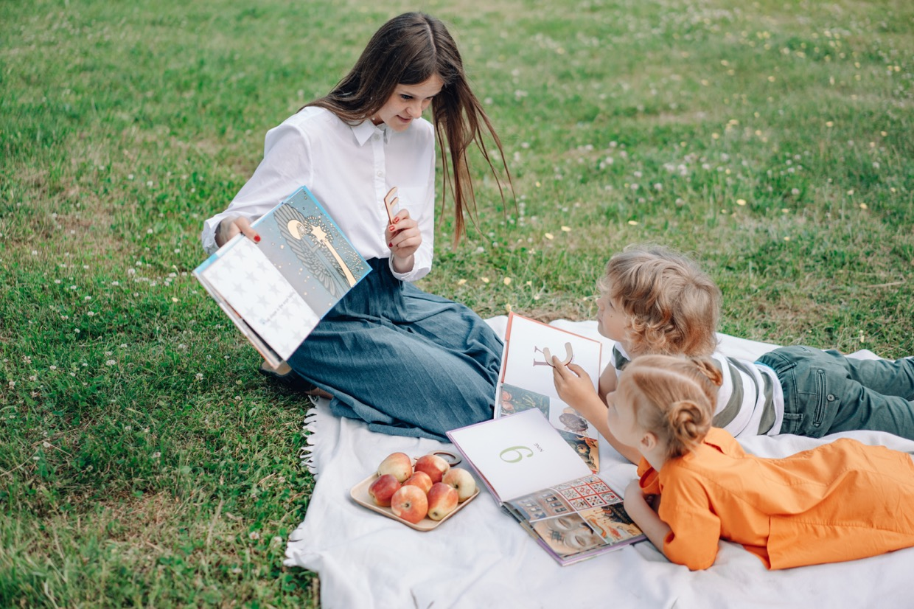
Overexposure to screens: the science behind it
The study of the effects of overexposure to screens of children is a rapidly developing field. The last couple of years, multiple studies have shown correlations between high levels of screen exposure and delays in the acquisition of language, motor skills, attention, cognition, and emotional regulation
Scientists have been interested in the effects that screens have on children since the rapid spread of television in the early 1950s. With children suddenly transfixed by the television for several hours a week, many people worried about how it would come to affect them. In line with other studies on mass-media conducted at the time, there was a particular interest in how different types of content would come to influence children’s psyche: their desires, moods, temper, and self-image.
With the inundation of smart devices from the early 2010s, these worries have only been exacerbated. Today the average toddler in France will be exposed to screens for more than 2 hours every single day. This is a doubling of screen time from 1997. They will also be exposed much earlier than before. In the US, the average age for first exposure has been reported to drop from 4 years in 1971 to only 5 months in 2009 (Christakis, 2009). By 2020, 17% of all children below 2 years old in Australia owned their own smartphone (Children Health Poll, 2017).
Backed by observations made by clinicians, there is a growing concern that this early and excessive exposure to screens has a negative effect on the development of the child regardless of the content shown.
Empirical studies are now corroborating this hypothesis. Below, you will find a synthesis of more than 40 of studies on screens conducted between 2004 and 2022. Held together, they make for a compelling argument for a significant reduction of screen time for children.
At the same time, it is important to highlight that there is no big science speaking with one voice. Quite on the contrary, you will, as you begin to engage with the studies, discover an incremental science, which arrives at conclusions by puzzling together many discrete findings, making for a suggestive rather than an affirmative conclusion about a cause-effect relationship .

Slide 13
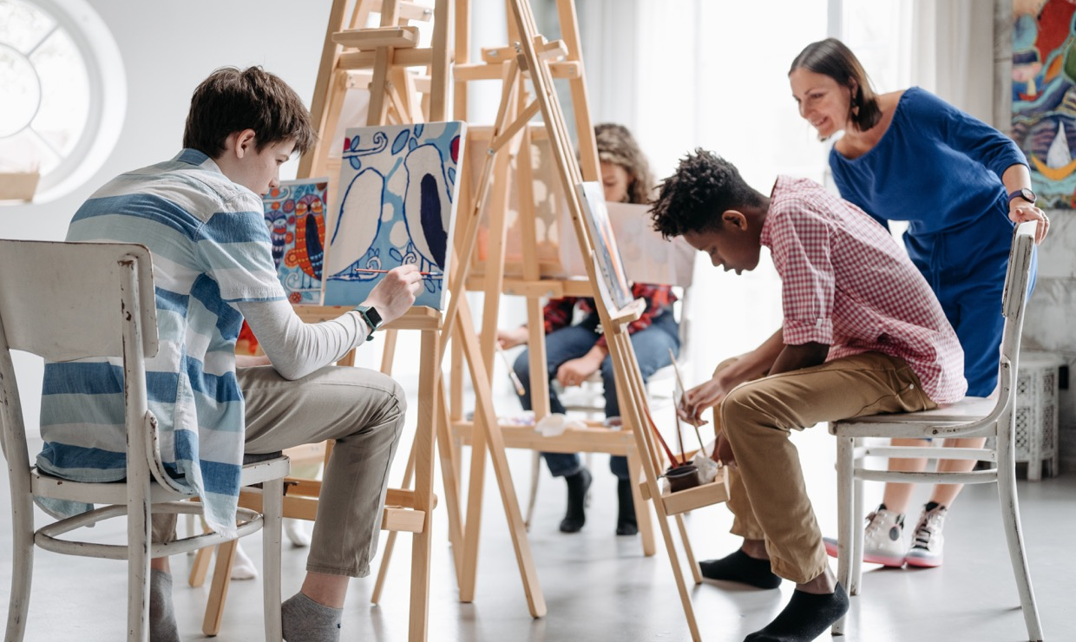
The studies we’ve looked at most often test for the correlation between screen exposure and one aspect of the child’s development (eg: screen exposure and language development, screen exposure and sleep patterns). On the pages to follow, we have decided to adhere to this logic by organising the results of the scientific experiments according to the area studied. In reality, the effects of overexposure cannot be neatly separated in this way: they will often be cumulative (eg: a child that sleeps less will typically be less attentive during the day, a child with no language will struggle to engage in social interactions).
The below sections highlight the studies where the correlations are the easiest to read. There are other studies, where the correlations are less marked. The best way to make up your own opinion on overexposure is to engage critically with the scientific articles yourself. It is also the best way of keeping up to date with new findings that might change the way we think about screens and the way we ought to use them.
It is for this purpose, that we beneath each of the sections have cited all the articles we reference – so you can go look for yourself. While scientific articles might seem daunting, they always offer small summaries of the main findings, accessible for everyone to read . As an exercise, we encourage you to consider how scientists present the results of their studies. Many scientific articles today are published under the open source license, which means you can access the article for free, even if you are not associated with a university. All the articles with a direct link in this guide are free to access.

Slide 14

What does the overexposure to screens do to our mind and bodies?
01.
02 ,
Attention and Cognition
Language
04 ,
03 ,
Myopia
Emotional Regulation
05 ,
06.,
Sleep
Obesity and Motor Skills
07.
Intersubjective Relations

Slide 15
01.
Attention and Cognition
One of the first areas to have been studied systematically is the effects screens bear on attention and cognition (our capacity to acquire and process knowledge). Perhaps you have at some point as a child heard a family member proclaim that television makes you dumber. In 2007, a study was published by researcher Frederic Zimmerman, which seems to partially support this intuition.
With his team, he followed a cohort of children from 1997 to the early 2000s, to see how TV viewing habits during the first three years of life would influence the children’s behavior when they turned five. They found that watching certain types of content correlated with a higher risk of developing attentional problems. While educational content did not have any measurable effect, an exposure to non-educational content did. Worst of all was violent content: each additional hour of violent entertainment per day was associated with approximately double the odds of developing attentional problems 5 years later (Zimmerman, 2007).
Another study conducted in Canada showed how high levels of screen time to correlate with lower scores on ASQ-3, a test tracking the development of the child in areas such as communication, problem solving and interpersonal relationships (Tomopoulos, 2010). Other studies have found negative associations between toddlers’ screen time and their executive functions, a term that groups cognitive processes important for learning, like working memory, task initiation, and organisation (​​McNeill, Jade, et al, 2019).
But what about educational content? Today, you’ll find a range of applications advertised as benefidial to the learning of toddlers. While it is true that preschoolers have shown to benefit from high quality educational content like Seaseme Street (Heather L. Kirkorian, et al, 2008), no studies so far show any positive correlation between early media exposure and learning (Zimmerman et al., 2007b). Furthermore, experiments have shown that even older children struggle to transfer what they’ve learned on touchscreens to the real world (Zack et al., 2009; Barr, 2013), what is also known as the Transfer Deficit.
Find the full articles
Barr, R., and Wyss, N. (2008). Reenactment of televised content by 2-year olds: Toddlers use language learned from television to solve a difficult imitation problem. Infant Behav. Develop. 31, 696–703. doi: 10.1016/j.infbeh.2008.04.006
Heather L. Kirkorian, et al. ‘Media and Young Children’s Learning’. The Future of Children, vol. 18, no. 1, 2008, pp. 39–61. DOI.org (Crossref), https://doi.org/10.1353/foc.0.0002.
Read in open access here.
McNeill, Jade, et al. ‘Longitudinal Associations of Electronic Application Use and Media Program Viewing with Cognitive and Psychosocial Development in Preschoolers’. Academic Pediatrics, vol. 19, no. 5, July 2019, pp. 520–28. www.academicpedsjnl.net, https://doi.org/10.1016/j.acap.2019.02.010.
Tomopoulos, Suzy, et al. ‘Infant Media Exposure and Toddler Development’. Archives of Pediatrics & Adolescent Medicine, vol. 164, no. 12, Dec. 2010, pp. 1105–11. Silverchair, https://doi.org/10.1001/archpediatrics.2010.235.
Read in open access here.
Zack, E., Barr, R., Gerhardstein, P., Dickerson, K., and Meltzoff, A. N. (2009). Infant imitation from television using novel touch screen technology. Br. J. Develop. Psychol. 27, 13–26. doi: 10.1348/026151008X334700
Read in open access here.
Zimmerman, Frederick J., et al. ‘Television and DVD/Video Viewing in Children Younger Than 2 Years’. Archives of Pediatrics & Adolescent Medicine, vol. 161, no. 5, May 2007, pp. 473–79. Silverchair, https://doi.org/10.1001/archpedi.161.5.473.
Read in open access here.
Haut Conseil de la Santé Publique. ‘Effets de l’exposition des enfants et des jeunes aux écrans’. March 2021.
Read in open access here.
You know other studies on screen exposure and attention? Add them here.

Slide 16
02.
Language
Teachers often suspect that a child suffers from an overexposure to screens if the child upon entering school still hasn’t developed any form of language. Professionals will testify to meeting children as old as three years that do not respond to their own name. The correlation between language delay and overexposure is one of the areas that have gained the most attention in research this past decade.
One study from Canada following 893 children between 18-24 months revealed that every thirty minutes’ increase in daily screen time would increase the children’s risk of language delays with 49% (van den Heuvel, Meta, et al, 2019). Another study from Thailand examined language delay in children between 15 and 48 months) and found that children who started watching TV before 12 months, and who spent more than 2 hours a day watching TV, were six times more likely to struggle with language acquisition (Chonchaiya et al, 2008).
During one study from Turkey, parents to children with language delay were asked to no longer use the screen at home. After following this recommendation, 22% of the children were reported to show improvements (Zengin-Akkuş et al, 2018).
Find the full articles
Chonchaiya, Weerasak, and Chandhita Pruksananonda. ‘Television Viewing Associates with Delayed Language Development’. Acta Paediatrica, vol. 97, no. 7, July 2008, pp. 977–82. DOI.org (Crossref), https://doi.org/10.1111/j.1651-2227.2008.00831.x.
Van den Heuvel, Meta, et al. ‘Mobile Media Device Use Is Associated with Expressive Language Delay in 18-Month-Old Children’. Journal of Developmental and Behavioral Pediatrics, vol. 40, no. 2, 2019, pp. 99–104. PubMed Central, https://doi.org/10.1097/DBP.0000000000000630Read the full article here.
Zengin-Akkuş, Pınar, et al. ‘Speech Delay in Toddlers: Are They Only `late Talkers`?’ The Turkish Journal of Pediatrics, vol. 60, no. 2, 2018, p. 165. DOI.org (Crossref), https://doi.org/10.24953/turkjped.2018.02.00 Read the full article here.
Zimmerman, Frederick J., et al. ‘Associations between Media Viewing and Language Development in Children Under Age 2 Years’. The Journal of Pediatrics, vol. 151, no. 4, Oct. 2007, pp. 364–68. www.jpeds.com, https://doi.org/10.1016/j.jpeds.2007.04.071

Slide 17
03.
Behavioral patterns
The past three decades, we’ve seen a soaring increase In the number of children diagnosed with attention deficit hyperactivity disorder (from 0.05% of all children in 1980 to 1% in 2021 (US)) and autism spectrum disorder (from 0.01% of all children in 1980 to 1% in 2020 (global) (Zeidan et al, 2022. The growth has happened too fast be explained by an actual change in our genetic make-up. As a result, scientists today are looking for factors in the environment to explain why more and more children fall on the spectrum of neurodivergent conditions.
Some scientists have conducted studies on screen time to see if there is a correlation.
One study from Japan reported that boys who had been exposed to screens at an early age were more likely to fall under the autism spectrum disorder at 3 years (no correlation was measured for the girls who partook in the study) (Kushima, Megumi, et al, 2022).
Another study from Canada shows how children who had been exposed to screen more than two hours per day were more than 7 times more likely to show signs of ADHD at age 5 (Tamana, Sukhpreet K., et al, 2019)
Some studies look more generally at behavioral patterns, some of which are associated with the autism spectrum and attention deficit disorders. One study conducted in China reveal a correlation between screens and anxious/depressive symptoms, somatic complaints, social withdrawal symptoms, attention problems, and aggressive behaviors (Lin, Han-Pin, et al, 2020). A large review of 87 studies back these results in showing a correlation between exposure time and aggression, inattention, anxiety, and depression in children less than 12 years old (Eirich, Rachel, et al, 2022).
As for other adverse effects, the correlation appears more significant if the child has been exposed early in life when the brain is still developing. One paper suggests that excessive early exposure can alter the neural circuitry of the brain in a way that makes children more responsive to audio-visual stimulation and less attentive to other environmental stimuli, like faces and social situations (Heffler, 2016). Another experimental study shows how mice that were exposed to a TV-simulation for four hours every day would become more risk-averse and impulsive, traits typically associated with ADHD (Christakis, 2018).
Find the full articles
Christakis, Dimitri A., et al. ‘How Early Media Exposure May Affect Cognitive Function: A Review of Results from Observations in Humans and Experiments in Mice’. Proceedings of the National Academy of Sciences, vol. 115, no. 40, Oct. 2018, pp. 9851–58. DOI.org (Crossref), https://doi.org/10.1073/pnas.1711548115. Read the full article here.
Eirich, Rachel, et al. ‘Association of Screen Time With Internalizing and Externalizing Behavior Problems in Children 12 Years or Younger: A Systematic Review and Meta-Analysis’. JAMA Psychiatry, vol. 79, no. 5, May 2022, pp. 393–405. Silverchair, https://doi.org/10.1001/jamapsychiatry.2022.0155.
Heffler, Karen Frankel, and Leonard M. Oestreicher. ‘Causation Model of Autism: Audiovisual Brain Specialization in Infancy Competes with Social Brain Networks’. Medical Hypotheses, vol. 91, June 2016, pp. 114–22. ScienceDirect, https://doi.org/10.1016/j.mehy.2015.06.019.
Read the full article here.
Kushima, Megumi, et al. ‘Association Between Screen Time Exposure in Children at 1 Year of Age and Autism Spectrum Disorder at 3 Years of Age: The Japan Environment and Children’s Study’. JAMA Pediatrics, vol. 176, no. 4, Apr. 2022, pp. 384–91. PubMed, https://doi.org/10.1001/jamapediatrics.2021.5778.
Lin, Han-Pin, et al. ‘Prolonged Touch Screen Device Usage Is Associated with Emotional and Behavioral Problems, but Not Language Delay, in Toddlers’. Infant Behavior and Development, vol. 58, Feb. 2020, p. 101424. ScienceDirect, https://doi.org/10.1016/j.infbeh.2020.101424.
Tamana, Sukhpreet K., et al. ‘Screen-Time Is Associated with Inattention Problems in Preschoolers: Results from the CHILD Birth Cohort Study’. PLOS ONE, vol. 14, no. 4, Apr. 2019, p. e0213995. PLoS Journals, https://doi.org/10.1371/journal.pone.0213995
Zeidan, J. et al. (2022) ‘Global prevalence of autism: A systematic review update’, Autism Research, 15(5), pp. 778–790. doi:10.1002/aur.2696. Read the full article here.

Slide 18
04.
Myopia
Screens have also been shown to affect our bodies, particularly eyesight. It’s been known for some time that spending a lot of time reading things up close increases the risk of developing myopia. In a review of 27 empirical studies, it was found that the risk of developing myopia for children aged 6-18 years increased by 2% for every additional hour of near work per week (Huang, 2015). Another study focusing specifically on digital screens suggests that the earlier children are exposed, the greater the risk of developing preschool myopia. The most significant correlation is measured for children who were exposed during their first year of life (Yang, 2020).
Find the full articles
Huang, Hsiu-Mei, et al. ‘The Association between Near Work Activities and Myopia in Children-A Systematic Review and Meta-Analysis’. PloS One, vol. 10, no. 10, 2015, p. e0140419. PubMed, https://doi.org/10.1371/journal.pone.0140419 Read the full article here.
Yang, Gui-You, et al. ‘Associations Between Screen Exposure in Early Life and Myopia amongst Chinese Preschoolers’. International Journal of Environmental Research and Public Health, vol. 17, no. 3, Jan. 2020, p. 1056. www.mdpi.com, https://doi.org/10.3390/ijerph17031056. Read the full article here.
You know other studies on screen exposure and attention? Add them here.
05.
Sleep
One commonly established fact is that the use of light-emitting digital devices before bed-time has adverse effects on sleep quality (for adults and children alike). That is because it suppresses the levels of the sleep-promoting hormone melatonin, which prolongs the time it takes to fall asleep and reduces RER sleep (deep sleep), leaving us less alert in the morning and less performative during the day.
One study from 2018 shows that screens tend to disturb the circadian rhythm of the infant, with exposed children sleeping fewer hours during the night and more hours during the day (Beyens, 2019). The significance of these results are best understood in light of other studies suggesting that children who get higher proportions of their sleep at night perform better at executive functions when entering school (Bernie, Annie, et al., 2013).
Find the full articles
Bernier, Annie, et al. ‘Sleep and Cognition in Preschool Years: Specific Links to Executive Functioning’. Child Development, vol. 84, no. 5, Sept. 2013, pp. 1542–53. DOI.org (Crossref), https://doi.org/10.1111/cdev.12063.
Beyens, Ine, and Amy I. Nathanson. ‘Electronic Media Use and Sleep Among Preschoolers: Evidence for Time-Shifted and Less Consolidated Sleep’. Health Communication, vol. 34, no. 5, Apr. 2019, pp. 537–44. Taylor and Francis+NEJM, https://doi.org/10.1080/10410236.2017.1422102.Read the full article here.
You know other studies on screen exposure and attention? Add them here.

Slide 19
06.
Obesity and motor skills
An excessive usage of screens is correlated with a higher risk of obesity (Robinson, 2017). Unlike the studies concerning myopia, the cause of obesity is not associated with exposure to the screen itself. Instead, it is explained by what scientists sometimes refer to as The Displacement Theory or the Stolen Effect Theory, which describes the way digital media ‘steals’ time from other activities and interactions. Put succinctly, an hour spent inside in front of the television is one hour that is not spent outside doing sports or playing.
Children have also been reported to increase the intake of high-density foods when eating in front of a screen (Blass, Elliott M., et al., 2006). These findings are concerning when held up to other statistics suggesting that a growing number of children ingest their food while watching some form of media entertainment. One study from Lithuania following children between 2 and 5 years in age reported that more than half of the sample group was exposed to screens while eating, with 22% being exposed during meal-time every single day (Jusienė, Roma, et al., 2019).
In younger children, the lack of movement and exploration of the surrounding environment is not immediately associated with obesity, but rather with delays in motor skills. Studies suggest that there’s a negative relation between the number of screen hours and basic motor skills, like the child’s stability, mobility, strength, coordination, and capacity to manipulate objects (Webster, 2019).
Find the full articles
Blass, Elliott M., et al. ‘On the Road to Obesity: Television Viewing Increases Intake of High-Density Foods’. Physiology & Behavior, vol. 88, no. 4, July 2006, pp. 597–604. ScienceDirect, https://doi.org/10.1016/j.physbeh.2006.05.035.
Jusienė, Roma, et al. ‘Screen Use During Meals Among Young Children: Exploration of Associated Variables’. Medicina, vol. 55, no. 10, Oct. 2019, p. 688. www.mdpi.com, https://doi.org/10.3390/medicina55100688. Read the full article here.
Robinson, Thomas N., et al. ‘Screen Media Exposure and Obesity in Children and Adolescents’. Pediatrics, vol. 140, no. Suppl 2, Nov. 2017, pp. S97–101. PubMed Central, https://doi.org/10.1542/peds.2016-1758K. Read the full article here.
Webster, E. Kipling, et al. ‘Fundamental Motor Skills, Screen-Time, and Physical Activity in Preschoolers’. Journal of Sport and Health Science, vol. 8, no. 2, Mar. 2019, pp. 114–21. ScienceDirect, https://doi.org/10.1016/j.jshs.2018.11.006. Read the full article here.
André, Alexandre, et Odile Cochetel. « Effet du temps d’exposition aux écrans sur le graphisme des enfants de 5 à 6 ans. Une étude transversale conduite au cours de l’année scolaire 2019-2020 chez des enfants âgés de 5 à 6 ans, en grande section de maternelle, dans sept écoles d’Auvergne », La nouvelle revue - Éducation et société inclusives, vol. 95, no. 3, 2022, pp. 191-214. Read the full article here.
You know other studies on screen exposure and attention? Add them here.

Slide 20
07.
Intersubjective Relations
Delays in language, lack of attention, anger, depression, and anxiety, less time to move around, less time for play: given the correlations associated with, it isn’t difficult to speculate as to how an overexposed child might have trouble entering into meaningful relationships with others.
What is more, it isn‘t only children that will be affected by screens. Screens affect parents too. Just like one hour spent in front of the television is not an hour spent outside playing, one hour scrolling through social media is one hour which is not spent looking at, speaking to, or playing with the child. Even if the child is not overexposed directly, it might suffer from parents being entirely or partially unavailable, even when physically present.
Through studies, it has been shown that even when our attention is not directed at the screen, it interferes with social interactions. In the early 2010s, a number of results from experiments on the effects of background television were published. One study found that play is interrupted when the TV is on in the background, leading to less playtime overall (Schmidt, Marie Evans, et al., 2008). Another study looking at parent-child interactions reported that both the frequency and quality of interactions decreased whenever the TV is playing in the room (Christakis, Dimitri A., et al, 2009).
Find the full articles
Schmidt, Marie Evans, et al. ‘The Effects of Background Television on the Toy Play Behavior of Very Young Children’. Child Development, vol. 79, no. 4, July 2008, pp. 1137–51. DOI.org (Crossref), https://doi.org/10.1111/j.1467-8624.2008.01180.x.
Christakis, Dimitri A., et al. ‘Audible Television and Decreased Adult Words, Infant Vocalizations, and Conversational Turns: A Population-Based Study’. Archives of Pediatrics & Adolescent Medicine, vol. 163, no. 6, June 2009, pp. 554–58. Silverchair, https://doi.org/10.1001/archpediatrics.2009.61. Read the full article here.
Christakis, Dimitri A., and Michelle M. Garrison. ‘Preschool-Aged Children’s Television Viewing in Child Care Settings’. Pediatrics, vol. 124, no. 6, Dec. 2009, pp. 1627–32. DOI.org (Crossref), https://doi.org/10.1542/peds.2009-0862.
Harlé, Bruno. ‘Intensive Early Screen Exposure as a Causal Factor for Symptoms of Autistic Spectrum Disorder: The Case for «Virtual Autism»’. Trends in Neuroscience and Education, vol. 17, Dec. 2019, p. 100119. ScienceDirect, https://doi.org/10.1016/j.tine.2019.100119.
Rhodes, Anthea. ‘Screen time and kids: What’s happening in our homes?’. Australian Child Health Poll. 2017.
2022, pp. 191-214. Read the full article here.
You know other studies on screen exposure and attention? Add them here.

Slide 21
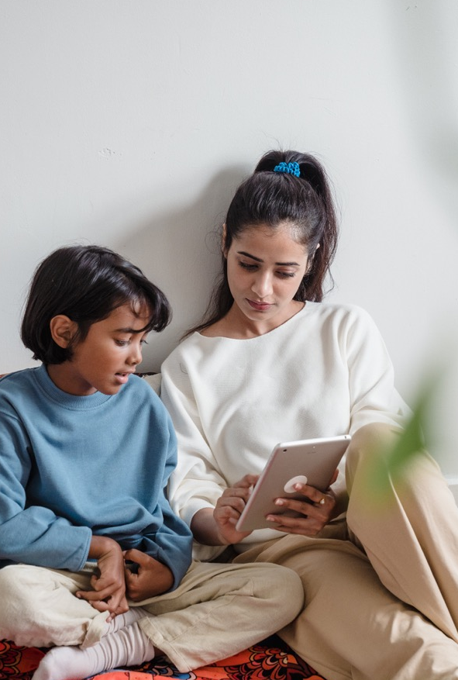
Contentions within the Sciences
When reading the above studies, not much doubt seems to prevail: for infants and young children screens should be limited, if not banned entirely. With correlations shown between screen time and delays of language and cognition, behavioral disorders, myopia, obesity, anxiety, and social isolation the risks seem to greatly outweigh hypothetical gains, none of which have been proven so far (Christakis, Dimitri A., 2009).
If this is true, you might wonder why some people take more lenient approaches when it comes to screens. People who – just like you now – can back their arguments by referencing scientific studies, if they aren’t scientists themselves. To make sense of these disagreements, it is important to know that there within the scientific community still are debates on the precise effects that overexposure to screens have on children.
Above, we have chosen the studies that most clearly show where screens might come to interfere with the development of children. You can find other studies where the correlation between exposure and development delays is less marked. This difference in results means that reviews of the empirical studies sometimes conclude that we need more studies before we can say with certainty that there is a relationship between overexposure and the problems outlined above.
Calling for more studies is absolutely normal within the empirical sciences, which advance slowly and cautiously. Still, it can sometimes create confusion for parents and healthcare professionals, who do not know how to position themselves on the topic. In our work on the ground, we are often confronted with questions like, Can we be certain that screens are the real cause behind the troubles observed amongst children? Are the problem caused by how we use the screen or by the screen itself? Can we use studies conducted a decade ago to make conclusions about the technologies children are exposed to today?
Below, we’ll look closer
at these questions.
Just like the scientific community, we will not be able to provide you with definite answers. Instead, we will give you insights into why it can be so complicated to settle these questions within the empirical sciences. We will also talk about why these points of dissensus do not seriously undermine the reasons for why we should be concerned about the effects of screens on children. Lastly, we will discuss the importance of advancing regulatory standards against overexposure even in the absence of perfect scientific consensus.
Christakis, Dimitri A. ‘The Effects of Infant Media Usage: What Do We Know and What Should We Learn?’ Acta Paediatrica, vol. 98, no. 1, Jan. 2009, pp. 8–16. DOI.org (Crossref https://doi.org/10.1111/j.1651-2227.2008.01027.x.

Slide 22
First
Discussion Point
“While there is a correlation between overexposure and development delays, we cannot say with certainty that overexposure is the cause.”
Today, there are multiple studies that show the correlation between high levels of exposure during the first years of life and delays in development. Still, to establish a causal relationship between the two phenomena, you have to rule out all other factors that might come to influence the development of the child. And that is really complicated to do. For ethical and practical reasons, scientists cannot control all the factors that might affect an infant, which would require taking the baby away from their family or monitoring the family at all times. Ideally, you would want to conduct tests on cohorts of identical babies, which is impossible to do.
Because of the impossibility of controlling all variables of a study on screens, it can be difficult to say with certainty that the symptoms observed are caused by screen exposure and not by other environmental or hereditary factors. For all we know, parents who overexpose their babies to screens might happen to share a genetic trait that puts their children at risk of developing the symptoms described above. Maybe they are all bilingual, which is known to slow down the language acquisition of children. Maybe they interact less with their child, screen or no screen. As the authors of one paper on television and cognition write:
“It is possible that parents who allow their children to watch large amounts of television, especially at early ages, are systematically different than parents who do not and that these differences may also be associated with cognitive outcomes” (Zimmarman, 2005).
Fortunately, there are strategies for minimizing the number of factors that might influence the results of a study, even when conducting it outside of the laboratory.
One way of doing this is to work from large data sets. If following 10,000 children, it is statistically improbable that half of them will grow up to be bilingual, or that a large proportion of their parents will share a deviant genetic trait. In fact, the bigger a fraction of a population you follow, the more likely the average of your sample group is to resemble the average of the entire population. Some of the empirical studies we’ve mentioned above, like the ELFE study conducted in France, follow 18300 children – or every 50th child born in France in 2011.
Another way to increase the statistical significance of a study is to cross-analyse the results with other variables. While you cannot control the environment of the child by interfering with it directly, you can measure other factors that tend to influence how the child develops. Some factors are accounted for routinely when conducting studies on families, like ethnicity, the parents’ level of education, the constitution of the family, or household income. Many of the studies we’ve looked at above do take these variables into consideration before making any conclusions about screens. Alternatively, some scientists have chosen to focus on a specific type of community to reduce the number of variances that can affect the results. This is the case in the article ‘Effects on TV in the bedroom on Young Hispanic Children’ (Feng, Du, et al., 2011) and ‘Television and young Hispanic children’s health behaviors (Kennedy, 2000), which by looking at families that are likely to share cultural or social traits are ruling out a number of extraneous variables that could otherwise influence the results.
Feng, Du, et al. ‘Effects of TV in the Bedroom on Young Hispanic Children’. American Journal of Health Promotion, vol. 25, no. 5, May 2011, pp. 310–18. DOI.org (Crossref), https://doi.org/10.4278/ajhp.080930-QUAN-228.
Kennedy, C. M. ‘Television and Young Hispanic Children’s Health Behaviors’. Pediatric Nursing, vol. 26, no. 3, 2000, pp. 283–88, 292–94.
Zimmerman, Frederick J., and Dimitri A. Christakis. ‘Children’s Television Viewing and Cognitive Outcomes: A Longitudinal Analysis of National Data’. Archives of Pediatrics & Adolescent Medicine, vol. 159, no. 7, July 2005, pp. 619–25. Silverchair, https://doi.org/10.1001/archpedi.159.7.619

Slide 23
Second Discussion Point
“Babies are not overexposed to screens, they are underexposed to other stimuli” or “The screen is not the problem – the problem is how we use the screen.”
Two different statements, which express the same type of conundrum: how do we know that it is really the screen that’s the problem and not the passive, sedentary, solitary, and repetitive behavior it incites over other, more active and interactive activities.
This idea is partially captured by The Displacement Theory, which posits that the problem of screens is the time it steals from other activities, noticeably those that involve the interactions that we know are crucial for the development of the child.
To gain certainty about this hypothesis, you would have to find a cohort of children who are overexposed to screens without being deprived of any of the activities their non-exposed peers participate in. And that is almost impossible to do. There is a limited number of hours in the day, and so usually the excessive usage of digital technologies will come at the cost of other activities. In fact, studies have shown that more screen-time is consistently associated with a reduction of the time children spend with their relatives, or otherwise engage in social interactions (Vandewater, 2006).
However, there are other ways of getting an idea of whether or not screens are ‘inherently bad’.
Recently, the ELFE study conducted in France showed that watching screens during mealtimes seemingly had greater consequences on the development of the child than if the child’s screen time was augmented with one hour daily (source?). Results like these support the displacement theory, in suggesting that the reduction of otherwise valuable interactions is at the cause of the problem, rather than the very act of being exposed to screens.
Another way is to see if different kinds of screen usage will have different effects on the child. With the introduction of touchscreens and interactive programs, scientists sometimes make the argument that we ought to distinguish between ‘active viewing’ and the more passive viewing associated with traditional TV (Sweetser, 2012).
While it is true that active screen usage has been proven less harmful by some studies (Sanders, 2019), no studies we’ve found show any consistent benefits of interactive content, such as video games. For the interest of this guide, we might add that we’ve found no studies on active vs. passive viewing conducted on children aged 0-3 years old, most likely because children at this age are still incapable of properly ‘interacting’ with digital media when left unguided.
What is more relevant if wanting to gain insights about different types of usage and very young children is to look at the effects of co-viewing, where the child is accompanied by an adult when engaging with the screen. Some studies suggest that co-viewing aids the child’s chances of picking up on cues from videos, which means they’re more likely to remember words that they’ve heard than when watching content by themselves (Strouse, 2018), while other studies conclude that the presence of the parent does not aid the child’s comprehension significantly (Skouteris, 2006;
Dorr 1989). Some of this disagreement comes from studies using different definitions of co-viewing, from an active mediation of content to simply being next to the child during screen-hours.
Even if some form of co-viewing proves to be an effective strategy for canceling out some of the harmful effects of screens described above, it would imply radically altering how we use screens today to mitigate the risks associated with overexposure. Studies teach us that parents often rely on screens as a low-cost babysitter (Chen, 2020; Hesketh, 2020), and not as a means of instigating activities with the child. Indeed, you might ask: if screens require an active mediation to have any positive effects on the baby’s development, why not use any of the other – and often cheaper – toys available for children?

Slide 24
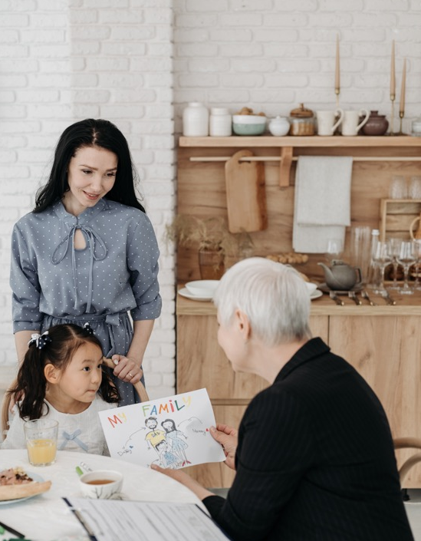
Furthermore, one might note that a number of experimental studies suggest that there is in fact something inherent to the screen that can affect the brain of the growing baby. The authors of one paper hypotheses that screens can change the neurocircuit in this early period of life where the brain is incredibly plastic, causing irreversible change in the way the child – and later adult – respond to the surrounding world (Heffler, 2016), although these results are still subject to much controversy.
Lastly, it has been scientifically proven that the blue LED light of smart devices disturb the sleep of both adults and children. When knowing the importance of uninterrupted sleep during the child’s early development, this particular negative effect is, as pediatrician Eric Osika argues, ‘in itself sufficient to warrant a warning against screen usage for young children‘ (intervention at the ‘Reason our screens’ education (01/12/22).
Chen, Chen, et al. ‘Are Screen Devices Soothing Children or Soothing Parents?Investigating the Relationships among Children’s Exposure to Different Types of Screen Media, Parental Efficacy and Home Literacy Practices’. Computers in Human Behavior, vol. 112, Nov. 2020, p. 106462. ScienceDirect, https://doi.org/10.1016/j.chb.2020.106462. Read the full article here.
Dorr, Aimee, et al. ‘Parent‐child Coviewing of Television’. Journal of Broadcasting & Electronic Media, vol. 33, no. 1, Jan. 1989, pp. 35–51. Taylor and Francis+NEJM, https://doi.org/10.1080/08838158909364060.
Heffler, Karen Frankel, and Leonard M. Oestreicher. ‘Causation Model of Autism: Audiovisual Brain Specialization in Infancy Competes with Social Brain Networks’. Medical Hypotheses, vol. 91, June 2016, pp. 114–22. ScienceDirect, https://doi.org/10.1016/j.mehy.2015.06.019.Read the full article here.
Hesketh, Kylie D., et al. ‘Children′s Physical Activity and Screen Time: Qualitative Comparison of Views of Parents of Infants and Preschool Children’. International Journal of Behavioral Nutrition and Physical Activity, vol. 9, no. 1, Dec. 2012, p. 152. BioMed Central, https://doi.org/10.1186/1479-5868-9-152. Read the full article here.
Sanders, Taren, et al. ‘Type of Screen Time Moderates Effects on Outcomes in 4013 Children: Evidence from the Longitudinal Study of Australian Children’. International Journal of Behavioral Nutrition and Physical Activity, vol. 16, no. 1, Nov. 2019, p. 117. Springer Link, https://doi.org/10.1186/s12966-019-0881-7.Read the full article here.
Skouteris, Helen, and Leanne Kelly. ‘Repeated-Viewing and Co-Viewing of an Animated Video: An Examination of Factors That Impact on Young Children’s Comprehension of Video Content’. Australasian Journal of Early Childhood, vol. 31, no. 3, Sept. 2006, pp. 22–30. DOI.org (Crossref), https://doi.org/10.1177/183693910603100305.
Strouse, Gabrielle A., et al. ‘Co-Viewing Supports Toddlers’ Word Learning from Contingent and Noncontingent Video’. Journal of Experimental Child Psychology, vol. 166, Feb. 2018, pp. 310–26. ScienceDirect, https://doi.org/10.1016/j.jecp.2017.09.005.Read the full article here.
Sweetser, Penelope, et al. ‘Active versus Passive Screen Time for Young Children’. Australasian Journal of Early Childhood, vol. 37, no. 4, Dec. 2012, pp. 94–98. DOI.org (Crossref), https://doi.org/10.1177/183693911203700413.
Vandewater, Elizabeth A., et al. ‘Time Well Spent? Relating Television Use to Children’s Free-Time Activities’. Pediatrics, vol. 117, no. 2, Feb. 2006, pp. e181–91. PubMed Central, https://doi.org/10.1542/peds.2005-0812. Read the full article here.

Slide 25
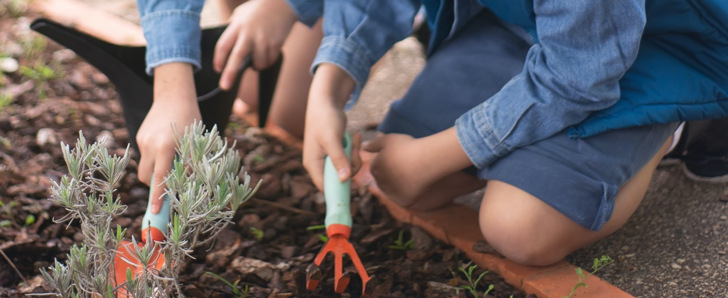
Third Discussion Point
“The studies we use today are too old to be relevant‘
Science is slow. This feels especially true when looking at the effects of screens on children. To get a real sense of how screens come to influence the development of a child, you will often want to produce what is called ‘longitudinal studies’, where you follow a group of children over a number of years.
After the experiment is over, the scientist needs time to analyse the results. Before publishing the results, this analysis has to be submitted to a process of peer review. It means that between the design of a study and the publication of results, five to six years can easily pass.
Five to six years appears long when contrasting it to the media landscape that seems to be changing by the minute. Many of the studies we rely on today to make conclusions about screens date from before 2010, before the smart revolution would alter our relationship to our digital devices. Few studies have accounted for the children growing up during the COVID pandemic, which increased screen hours of adults and children alike.
In this sense, science is rarely describing the reality we’re currently facing. However, this does not mean that none of the studies that have been conducted so far are of use to us. While the television, tablet, and smartphones offer different modes of engagement, they also share many characteristics. They all lack the reactiveness of other human beings, who will adapt their responses according to the infant. They keep the young child in a passive state, with little to no physical movement or experimentation with objects. For babies, who cannot properly manipulate touch screens, they are often used to show the same type of content.
If televisions, tablets, and smartphones have been correlated with adverse effects on the development of the child, it seems more than likely that other screen-based media will affect them negatively too, at least for the age group 0-3 years, which is unlikely to gain much from new technological features.

Slide 26

How to Pass from Imperfect Science to Regulation?
Above, we’ve discussed some of the questions that animate the emerging scientific field on screens in the hope that it will help you make sense of the sometimes conflicting messages you might hear from people considered experts on screens and overexposure.
As we already stated: dissensus within the scientific world is normal. In fact, it is a really good thing. It is what propels us towards new scientific experiments and a better understanding of the phenomena that preoccupy us. There are still plenty of questions to explore around screen usage, which might help us determine the gravity of excessive screen usage, the direct effects of screens on children’s brain neurons, and potential ameliorative conditions for screen exposure (at least for children old enough to distinguish between different types of content and engage with screens in a meaningful way).
It is equally important that dissensus, which is a natural feature of the sciences, does not get misused to unnecessarily halt political action. As the documentary The Fabrication of Ignorance (original title: La Fabrique de l’ignorance) shows, scientists have historically been hired to conduct scientific experiments that would sow doubt about hypotheses otherwise proven by the scientific community, like the correlation between tobacco and lung cancer or human-caused CO2 outlets and climate warning. Here, industry relies on the natural mechanisms of science – identifying blindspots in previous research – to provoke unnecessary confusion in a political sphere.
That is not to say that everyone who contests the negative effects of screens are paid by big tech companies – far from it.

Slide 27
Instead, we hope to highlight that the logic of science and the logic of politics should not be confused. Whereas scientists seek to highlight gaps in our knowledge, elected officials are often asked to make decisions based on imperfect evidence. If politicians had to wait for a scientific community to agree on a topic, they would frequently run the risk of responding much too late to imminent threats.
Most of us saw what an extreme version of political risk assessment looks like during the COVID-19 pandemic, where state leaders would make decisions by evaluating the imperfect knowledge available about the virus, the probable human and economic loss associated with different types of interventions, and their respective political agendas. While some countries did better than others in managing the virus, it was not because they were adhering to a scientifically proven agenda. Retrospectively, the strategies that proved the most successful combined a prudent attitude and fast decision making (see countries like New Zealand or Iceland).
The massive presence of screens is of course very different from the disruptive and lethal force of a global pandemic. However, some parallels can be made: both are global phenomena; both are almost impossible to regulate if relying solely on individual actions. While the effects of COVID-19 are immediate and dramatic, screens are insidious in different ways. As opposed to COVID-19, no vaccine can make our dependence on screens go away.
It means that when regulating the access to screens, we will have to come up with regulations that can be endured over time. Luckily, limiting the access to screens is nowhere near as extreme as keeping people in their homes for many months at a time. Indeed, as we’ve seen above, spending the first years of life without screens does not seem to set the child back in any way. Economically, the consequences of making screens less attractive would also be much less detrimental than the wide-spread closure of workplaces that took place during the pandemic. It is true that regulating screens would imply targeting certain companies within the tech-industry, but it would never seriously affect the wider global or national economy.
Despite the seemingly few risks associated with screen-regulation, only one country has to this day put in place an ambitious set of policies aiming to reduce the time children spend in front of screens. In 2021, the Chinese government introduced a ‘video game ban’, which preempts children younger than 18 years old from playing video games during the week, and limits gaming to one hour per day during the weekend. This kind of intervention relies on a sophisticated surveillance system that sets aside individual rights, and so this ‘Chinese model’ isn’t actually suited for a European context. While this is true, European countries might learn from a policy that acknowledges official bodies responsibility in minimizing what by Chinese officials has been named ‘spiritual opium’. The Chinese government has shown that when weighing the potential risks of acting and not acting on children’s access to screens, there is enough ground for action.
While state regulation is yet to be seen on the European continent, influential institutions have since the late 1990s used the scientific studies available to disseminate advice on how to use screens around children. In 1999 already, The American Academy of Pediatrics came out with their first set of official advice on screen usage, which promoted a no screen policy for children younger than two years old. In 2019, The World Health Organisation published a rapport advising parents to limit screen time for children younger than five years old. This guide also included advice stressing the importance of regular physical activity, play, and uninterrupted sleep (https://apps.who.int/iris/bitstream/handle/10665/325147/WHO-NMH-PND-2019.4-eng.pdf). Le Haut Conseil de la Santé Publique from France advice that screens are to be avoided unless they are appropriately accompanied by parents.
The french Collective COSE (Collective Overexposure to Screen) has become known for advocating what they call the ‘4 NO’s’:
No screens in the morning.
No screens during dinner.
No screens before sleeping.
No screens in the bedroom of the child.

Slide 28
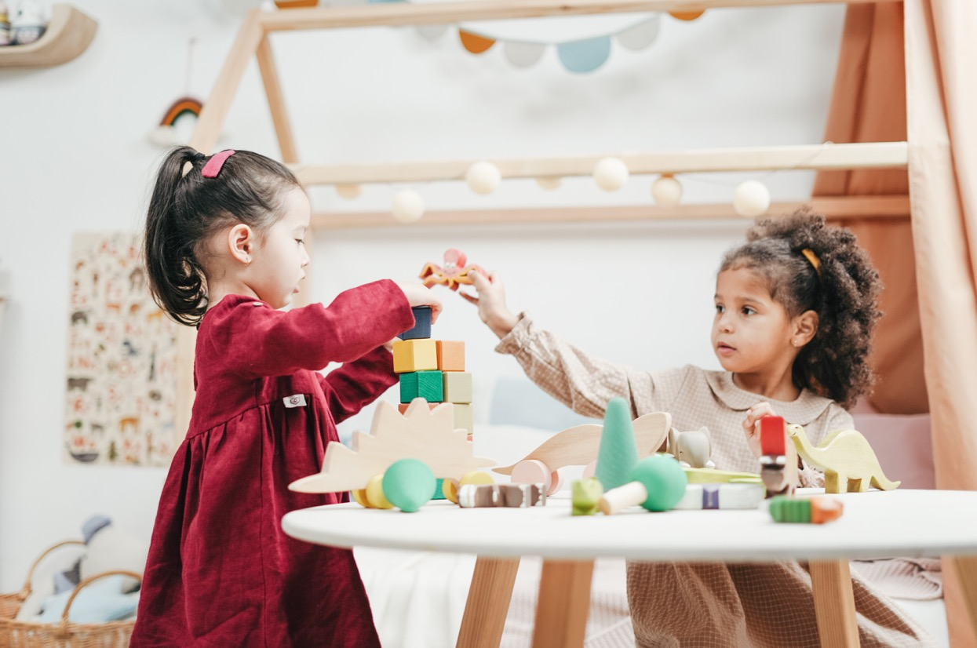
The Development of the Child Disrupted
How does the baby within its first year of life evolve into a being that communicates with sophisticated grammar, understands symbols, metaphors and concepts, regulates its emotions, and empathizes with others? It is a question that has preoccupied pediatricians, psychologists, neuroscientists, and psychoanalysts throughout the past century.
While some try to answer this question by looking at our inborn qualities, most agree that the environment is instrumental in shaping the child. With recent discoveries in epigenetics, we know that our surroundings can literally influence how our genes function. From observing children who grow up with no parents, many have stressed the importance of early relations for the child’s ability to acquire the faculties it relies on for its social well-being, stressing especially the relation to the parent or parent figure. Many aspects of this relation are unconsciously attended to by the parent. It entails looking at the child, smiling at the child, speaking to the child, pointing to objects, creating the conditions for play, setting boundaries, and slowly allowing the child to create its own world independent of the parent, to be by itself. Just as unconsciously, we often let the screen come in between ourselves and the child during these precious everyday interactions. An otherwise well-functioning child can recover from momentary neglect, but if this behavior is repeated, she might start to compensate in ways that are harmful to herself and those around her. To avoid such harm, you don’t have to be a ‘perfect’ parent. Rather, it is important to secure what we might refer to as acts of ordinary attention. In the words of Hakima Yakuben, a parent ambassador of reasoned screen usage, responding to a scientist enquiring about the care practices she had put in place to combat overexposure: ‘What you call care, I just call that looking after my child’.

Slide 29
Of all the babies in the animal kingdom, the human baby is by far the most dependent. Whereas big primates gain independence after a couple of years, the human child relies on its parents, family, or community for up to two decades to develop the faculties and knowledge it relies on to become fully integrated in the adult world.
This dependence is all the more acute the first months after birth. Some actually consider the human baby to be born prematurely! When coming into the world, the child’s brain is a quarter of the size of the adult brain, the approximate size of a chimpanzee’s brain. While she has all of her neurons (brain cells), it is only after birth these neurons will only begin to connect into what are called synapses. Synapses are what allows us to sense, move, communicate, store memories, and perform just about any cognitive function you can think of. During childhood, more synapses are created than at any other moment in life. For the infant, one thousand new neural connections are created every second. As we grow older, the production of synapses will slow down significantly. In fact, the brain will begin to eliminate unneeded synapses in a process called pruning to make for more efficient brain functioning. It means that childhood is the most opportune moment for setting in place the brain structures required for different types of learning.
The creation of synapses depends on exterior stimuli. In fact, studies have shown that the brains of neglected children develop differently, with the worst cases of neglect leading to long-term cognitive impairment. These studies confirm that children do not only require sufficient nutrients to develop properly: they also depend on what we might refer to as emotional and cognitive nourishment. In this part of the guide, we will try to describe what this kind of affective and cognitive nourishment looks like.
We will do this by referring to different developmental theories conceived by practitioners and scientists who have worked closely with children and their families. As opposed to the empirical studies we looked at in the previous chapter, they offer broad theories of what happens in the relationship between the parent and child, by drawing on a range of knowledge practices, like first-hand observations, scientific studies, philosophy, common sense, intuition, and empathy. We will, for example, reference theories from psychoanalysis, which is one of the first schools to systematically argue that what happens in childhood and infancy will affect us all the way into our adult lives, a hypothesis that has since been confirmed by neuroscientific studies. Because of its varied methodologies, psychoanalysis also comes in handy where scientific observations fall short, in providing tentative answers to questions like, How does the baby become conscious of itself? What gives rise to thought and thinking? What makes (the baby’s) life worth living? Finally, psychoanalysis is interesting in this context, because it has been developed in clinical settings, in direct contact with patients. Unlike descriptive scientific studies, and unlike most of philosophy, they were conceived of as acting-tools, used to set in motion new ways of doing, and being.
That does not mean that you should expect very specific advice. ,like ‘doing baby algorithmics’ or ‘playing Mozart to the fetus’. In fact, many of the (inter)actions we’ll mention can seem almost banal. They are so ingrained in our ways of caring for children that they often go unseen. That’s perhaps why we don’t always acknowledge their importance. While there’s a plethora of ways to recognise professional or academic skills, you will find that we are much worse at describing the practices required as a parent, whether it’s to pay attention, to put yourself in the place of, to respond, to be incredibly(!) patient, overbearing, firm, inventive, to know when to let go, and when to put your foot down. And that is a real problem. Without the right words to describe something, we cannot valorise and defend it.

Slide 30
For the purpose of this guide, we will offer you three words to think through: Synchrony, Frustration, and Play
It isn’t just that these dynamics are incredibly important for the child’s psychological development. As we will try to show, no smartphone or tablet today can feasibly ensure either one of them despite what we are sometimes made to believe. Here as elsewhere, human relations are irreplaceable.
‘I am asking that this which is naturally done well by mothers who are caring for their babies shall not be taken for granted,’ the pediatrician D.W. Winnicott writes. With this guide, so are we.
XS
01.
Synchrony
02.
Frustration
03.
Play

Slide 31
01.
Synchrony
“When I look I am seen, so I exist. I can now afford to look and see. I now look creatively and what I apperceive I also perceive”
D.W WInnicott
In the first months of life, the parents enter an almost symbiotic relation with the child, adapting to its needs, gestures, and expressions. It is this capacity for adaptation we refer to when we talk about ‘synchrony’.
The psychoanalyst D.W Winnicott used the term the Good Enough Mother to describe something similar. The Good Enough Mother (which isn’t necessarily the biological mother), is someone who can intuit the child’s feelings and respond to them, adapting their body to the body of the infant, or – in the words of Winnicott – changing their ‘holding’ and ‘handling’ to appease her.
In order to hold and handle the child satisfactorily, the parent has to lend its full attention to the baby. With digital devices at hand, such full attention is constantly under threat. Being met with split-attention can be frustrating enough for an adult, but for a young infant the stakes are more serious. Unlike adults, infants have not developed the faculties to relativise momentary lapses of attention. In fact, much seems to suggest that the young child still doesn’t know how to distinguish between herself, her needs, and her environment. If these elements are in contradiction, Winnicott writes, it will be as if the infant’s whole world breaks apart. He wrote before the advent of screens, and so his primary concern was parents suffering from depression, who were so engrossed in their own suffering that they were incapable of responding to the emotions of the child. However, that doesn’t disqualify his argument for this context. For the infant, there’s no way to distinguish between ‘captured by the screen’ and ‘depressed’. What she registers is an environment failing to satisfy its need, which, if experienced systematically, can lead to withdrawal and disengagement from the surrounding world.
Synchrony also guides early communication with the child. We know that children are interested in animal faces, and that they from the age of three months gain a particular interest in other human faces. When the newborn looks towards a human face, what does it see? Often, it will see itself mirrored back. Without realising, we tend to mimic the expressions of the newborn: a smile is met with a smile, a frown with a frown, a yawn with a yawn. In fact, studies have found that mothers engaging with their child will imitate its expressions one time per minute! Winnicott refers to this phenomenon as ‘mirroring’. He suggests that before the famous ‘mirroring stage’ described by the French psychoanalyst Jaques Lacan, the child will see itself reflected in the parent’s face. Seeing itself imitated, Winncott writes, will allow the child to attribute images to their inner states.
Interestingly, recent studies from developmental psychology suggest that children whose parents have imitated their expressions will themselves be better at imitating. For a long time, scientists considered children’s tendency to imitate actions the result of an inborn quality, what they referred to as a ‘mirroring gene’. In the book Cognitive Gadgets, the psychologist Cecilia Heyes makes the argument that imitation, like other cognitive functions like reading and biking, is acquired through social interactions. She shows that both children and adults find it difficult to imitate an action if they are not assisted by mirrors, whether inanimate (an object-mirror) or animate (a parent-mirror). We need to see the action while doing it to be able to copy it later — that is, unless we already know how to imitate similar actions. It means that children whose parents have imitated their gestures are more likely to learn how to imitate those same gestures and more likely to pick up new gestures later on in life.

Slide 32

Just like we unconsciously wrinkle our faces into theatrical expressions when in front of a child, we also tend to adapt the way we speak, switching into what is sometimes referred to as ‘baby speak’. Baby speak is characterized by exaggerated mouth movements, a higher pitched voice, and the repetition of words and phrases. We know today that speaking in this way actually helps the child acquire language faster. Parents also tend to leave space between phrases, indicating the moments where the child will eventually respond: here, the beginning of dialogue.
The psychiatrist and psychoanalyst Daniel Stern suggests that as children grow older, parents tend to replace direct imitation with differentiated imitation, a kind of non-verbal communication. They will begin to ‘recast the affects’ of the child, using expressions, gestures, or actions. He calls the recasting of affects attunements. In the book The Interpersonal World of the Infant, to show what an attunement might look like, Stern describes a young boy who excitedly reaches for a toy and a parent responding to the situation with an ‘uuuh uhh’ to express the excitement the child is experiencing in that moment. Through attunements, he writes, the child starts to acquire the sensation of sharing the same experience or reality of someone else, what is also known as intersubjectivity.
The screen, however interactive it is branded, can not do any of this. It does not speak in a way that’s attuned to the sensibilities of the infant, and it does not leave space for the child to intervene. It cannot interpret the affective state of the child and recast it in altering responses or actions. The language in videos is standardised, containing few of the variations or intonations that human beings effortlessly switch between. The screen doesn’t bolster sound with expressions adjusted to the baby’s moods and reactions. Without imitation, the baby will not learn how to imitate. Without the space to respond, it will feel no desire to communicate back.
It is concerning then, when the screen comes to disrupt situations that are particularly conducive for imitation games. When born, the child can look forty centimeters ahead. Forty centimeters happens to be the approximate distance between the parent and the child held by the parent, like during breastfeeding. For some years now, companies have advertised smart phone holders that you can attach to your forehead, to capture the attention of the infant when in the arms of the adult. Instead of cues about her inner life, or the inner life of those around it, the baby will be exposed to disembodied images that hold no information about herself, and offer no opportunities for learning.
Today, a lot of parents would know better than sticking a smartphone on their head. Still, many of those same parents will have a device at hand or in close proximity when interacting with the child. There is nothing unusual about this, as we generally tend to have a device on hand, regardless of where we are or what we do. In fact, it is so common that we today have a name for when technology comes to interfere with social relationships. We call it technoference. As we’ve shown above, the felt consequences of techoference are much more acute for a child than for an adult. For a visceral image of the distress such disruption might provoke, we recommend that you turn to the still face experiment conceived of by the American developmental psychologist Edward Tronick. During this experiment, a mother is asked to meet her child with no expression. Within seconds, the child begins to contort and cry before breaking down when finding itself unable to recapture the mother’s attention. In less than a minute, the child withdraws, turning its head and body away from the mother’s expressionless face. At last, the mother breaks the ‘evil spell’, becoming again responsive. The mood of the baby changes almost immediately. Through the engaged gaze of the parent, the child once more feels safely contained in the world.

Slide 33
02.
Frustration
“It is worth noting that, if you have done well at the early stages and are still doing well, you cannot count on a smooth running of the machine. In fact you can expect troubles.“
D.W. Winnicott
It is all the more important to highlight the importance of frustration because we rarely think of frustration as something valuable. In fact, to many parents, the absence of frustration is lived as a positive thing. Many use the smartphone to avoid conflicts with the child – to make her go quiet or comply. However, many psychoanalysts have made the argument that frustration, just like synchrony or play, bears an important role in the psychic development of the infant.
Accepting frustration is different from provoking frustration. No matter how good a parent is, they will inevitably fail at satisfying every need of their child. And that is not necessarily a bad thing. It all depends on the nature and frequency of this kind of ‘failure’. In his work, Heinz Kohut differentiates between ‘optimal frustration’ and ‘chronic frustration’. Whereas chronic frustration is a result of continued deprivation, optimal frustration takes place in an environment where the baby feels generally understood and seen. The former is likely to have negative consequences on the child’s psyche, whereas the latter offers moments of potential maturation by introducing the child to a more realistic sense of the relationship between herself and the world.
Winnicott arrives at a similar conclusion in his work. He describes the process of reality-acceptance as a kind of disillusionment where the child little by little comes to accept that she does not have full control over her surroundings. It is important that the young child feels all-powerfull in the first months after birth, he writes, but equally important that the parent eventually breaks this illusion, which if carried into adult life would be considered a kind of madness. That is also why Winnicott insists that the mother (or nursing figure) should be good-enough (providing an environment that at most times satiates the child’s primary needs) – not perfect.
The psychoanalyst Wilfred Bion also sees growth-potential in frustration, on the condition that it is attended to by the parent. He interprets frustration as a natural response to what he calls ‘raw emotions’: unfiltered sensory reactions that the child does not yet have the conceptual tools to make sense of. Bion also calls these reactions beta-elements. He argues that the only way to tolerate raw sensations of frustration is to represent them in our mind as thoughts. During the first months of life, the infant still hasn’t developed the tools to create the distance necessary to ‘think’ an emotion. Therefore, Bion writes. she will rely on her parent to do it for her. The parents’ role, as he sees it, is to alleviate the unfiltered experience of beta-elements by containing these emotions: to take on the child’s experience of dread, process it, and present it back to the child in a tolerable format. He describes this transformation of beta-elements into thought as an alpha-function. In the exchange between beta and alpha-elements, a type of shared thinking emerges – why he will go on to describe the parent-child dyad as a thinking-couple. Through the process of thinking together, the child will eventually internalise the parent’s tolerance, which will create the mental space allowing her to develop her own thought-representations of the sensations she’s undergoing.

Slide 34
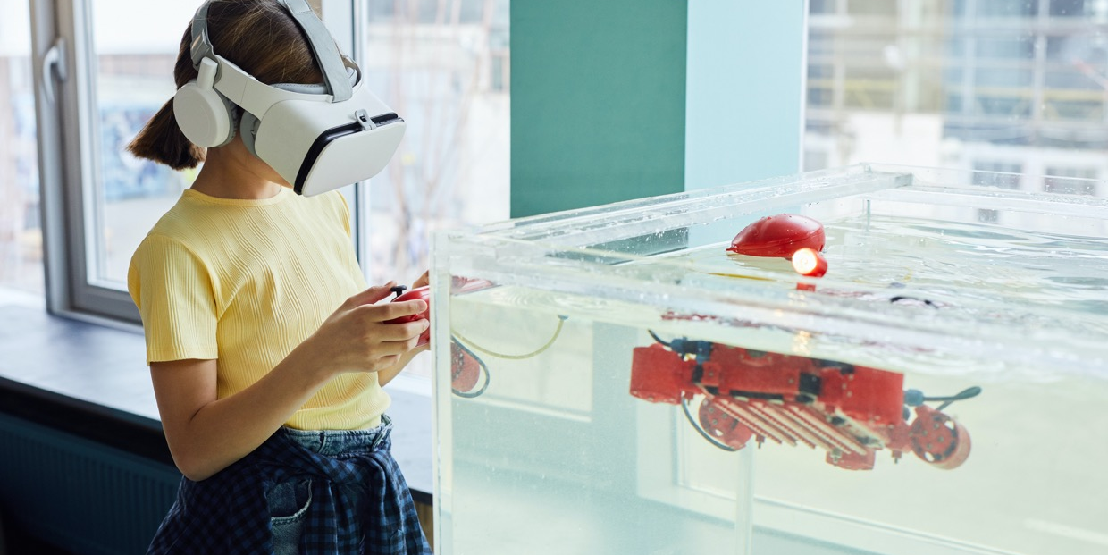
‘Becoming angry for the first time at eighteen months must be terrifying for a child,’ Winnicott writes in a paper on aggression. With screens around, keeping anger at bay throughout most of childhood is a real possibility. If parents turn to screens, it is because it is a guaranteed recipe for calm and silence. However, as shown above, thwarting frustration also preempts the child from learning how to deal with negative emotions. Instead of making the frustration ‘disappear’, the parents’ role is to show that frustration isn’t abnormal or dangerous.
Frustration can be a sign of genuine distress. At other times, it is used consciously by the child as a way of communicating and demarcating boundaries. Act of refusal are already manifest in the first months of life. Just consider meal times. From the first weeks, the child will turn her head away from the breast to indicate that she isn’t hungry and, later, smack her lips shut to block the food from entering. The French children's food association reports that one third of children in France under 3 years old are exposed to screens during meals. When captured by a screen, the parent robs the child from her ability to discern and communicate her own needs and desires. The psychoanalyst René Spitz has paid particular attention to early signs of refusal, dedicating a whole book to the utterance of the word No. Like Bion, Spitz considers the No an important step for developing new mental faculties. The No, he argues, is one of the first signs that the child has become an autonomous agent who can enter into conflict with its parents. However frustratingly it might be lived, the No is a sign of remarkable awareness of the self and an ability to communicate abstract ideas, like negation. While counterintuitive to some parents, there is often more cause for concern if a child never says no than if a child stubbornly engages in acts of dissent.
While parents might come to accept a No, it can be more difficult to make sense of more extreme reactions of anger. Sometimes children go through episodes of unhinged aggression, kicking over and destroying things, pronouncing phrases like ‘I hate you’ or ‘I want to kill you’. Sometimes they’ll inflict actual harm on their parents, scratching, kicking, and biting. Here, even the most strong-willed parent can be tempted to reach for a screen, which works as an effective pacifier. However, screens do not actually allow the child to come to rest. They simply capture their attention momentarily, displacing the problem to a later point in time. In a text dedicated to the question of aggressivity, Winnicott asks us to rely on a different ‘tool’: our faculties of empathy. He writes how feelings of love and hatred are present in us from when we are very small. The child will feel the desire to inflict harm on others, just as she will feel the desire to protect them from harm. He considers the dramatization of hatred, as manifest in fits or outbursts, as a healthy response to this latent impulse, which will otherwise be internalised. It is the adult’s responsibility, he writes, to make sure that this anger does not get out of hand. They ought to become ‘a confident authority’, creating a space where the child can exercise their penchant for destruction without actually putting herself or anyone else in danger. Doing so, ‘[the child] will become more and more capable of recognising [thier] own cruelty, he writes.’ ‘Then, and only then,’ he continues, ‘[can it] be controlled’.

Slide 35
03.
Play
‘We learn to talk with a pot and a spoon’
Eric Osika
‘Playing is what becomes art but also religion and science, in brief, genius.’
Bernard Stiegler
There are many definitions of play, but in the context of this guide, we will talk about play quite broadly as “the meeting between a subjective reality and an exterior world”. You might think of play as a kind of intermediary space, where children can begin to explore objects and phenomena by submitting them to their own rules of experimentation. The psychoanalyst D.W Winnicott considers play-settings particularly auspicious for acts of creation.
If defined in these general terms, play actually begins very early. Even before being born, children have been recorded interacting with the environment of the mother’s stomach, tucking and swimming around the umbilical cord (why some children end up getting entangled). During the first months of life, they will turn their attention towards their own limbs, sucking on a finger or grabbing a foot, and, later, reach for objects that are presented to them. Around eight months old, their interaction with objects takes on a more intentional nature: they will consciously reach for certain toys. Soon, they will begin to place the toys in a space, arranging them, taking them apart, reassembling them. The Swiss psychologist Jean Piaget has written extensively about the importance of such early object experimentation. In his work, he argues that it is essential for the development of intelligence, especially during the first two years of life, which he refers to as The Sensorimotor Stage. During this stage, the child will discover the world predominantly through its senses, through sight, touch, hearing, taste, and smell. By grasping for objects, sucking on them, picking them up, or letting them fall, she will start to form ideas about the object’s qualities, which, according to Piaget, will lead to the development of more general concepts. One cognitive break-through is what Piaget calls Object Permanence: the understanding that objects exist even when they cannot be sensed. He observed how young children at six months will lose interest when an object is out of sight, whereas toddlers at 18-24 months will start to look for the object. Piaget argues that where a six month’s old sees an object, feels a texture, hears a sound, and smells a smell, a child at 18 months will have organised this input into a single concept: a toy.
We can’t actually insert ourselves into the mind of the toddler, but findings in neuroscience seem to underpin the theories of Piaget, in showing how concepts activate different areas of the brain associated with the senses. We know too, that stimulating more than one of our senses will help us retain knowledge in the long term. It seems more than likely that if a child only knows an object through one sense (like through vision on the screen), she’s missing the basic information that will allow her to attribute meaning to what she sees. Observations from the ground confirm this hypothesis. Pediatricians testify to children who know the names of colours or numbers but who cannot associate them with the quantities of real objects. While studies suggest that cognition does not exactly develop in set stages like Piaget imagined, it does not compromise his other big, and perhaps more important, hypothesis: that infants aren’t empty vessels ready to ‘be filled up with knowledge’. If put in the right conditions, children are skilled independent learners – like ‘little scientists’, as he wrote.

Slide 36
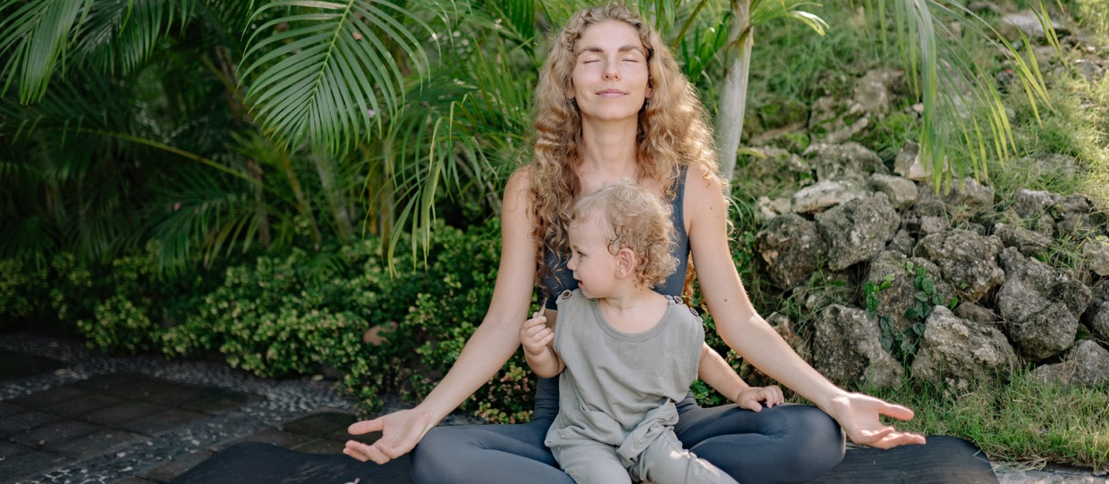
D.W. Winnicott has also consecrated big parts of his writing to the notion of play. He’s especially known for his analysis of that one special toy most toddlers tend to get attached to. He refers to this special toy as a Transitory Object. In a world still composed of mostly unknown objects and phenomena, the transitory object is ‘a place of rest’. It is a buffer between the baby and the exterior world, and serves as an aid when the child has to separate from her primary caregiver. Whether in the form of a teddy, a cloth, or some other toy, the transitory object is ‘found-created’: it already exists in the world but gains meaning through the child’s investment in it. Investing in the object involves acting on and with the object. “To control what is outside,” Winnicott writes, “one has to do things”. “Doing things’ to the transitory objects opens up for the more sophisticated types of playing of older children, which also consists of instigating actions somewhere between objective reality and their own imagination; and later for what Winnicott refers to, broadly, as Culture, as manifest in the arts, science, and religion.
Is the smartphone a transitory object? the child psychiatrist Marie-Claude Bossière asks in her book The Baby in the Digital Age. While the dependence on a digital device might resemble the dependence on a teddy bear, the dynamic between the child and the screen is entirely different. First of all, the smartphone does not offer a place of rest. When in front of the screen, the child’s attention is captured by light and motion, and so there’s no time for the child to recharge or process new impressions. Secondly, the screen does not incite any doing. The child cannot invest herself in a smartphone – it offers no opportunities for creation. Thirdly, the screen is rarely transitionary. Whereas the child tends to grow out of their toy or cloth when they’ve internalised the security it represents, the screen does not allow this kind of divestment. By appealing to our instincts, it can turn into a source of dependency all the way until adult life. To sum it up in a sentence, you might say that the transitory object offers an opening to the world (through play and, later, culture) whereas the screen tends to close the world of the infant.
If dynamics of synchrony and frustration happens in direct interactions between parent and child, parents are slightly displaced in play situations. Unlike what some parents believe, it is not their responsibility to come up with the rules of the game. Quite on the contrary. As seen above, play is most valuable when the child gets to make up her own rules. The parent’s role is not to play but to create the conditions for play. Creating these conditions can be quite subtle. It consists predominantly of being present, attentive to, and supportive of the child’s actions. When beginning to manipulate objects, the child will often look towards the adult for reassurance. In some respects, learning how to play is not much different from teaching the child to be alone. Paradoxically, Winnicott writes, the child will learn to be alone in the presence of someone else. Only when the child feels safe alone in the company of others, will she be ready to be properly alone. Similarly, children who are supported in play, will soon turn into autonomous play agents, which will ultimately free up time for their parents. If encouraged, young children quickly become independent in – and independent through – play. In fact, when it comes to playing, most adults could learn a lot from their children.

Slide 37
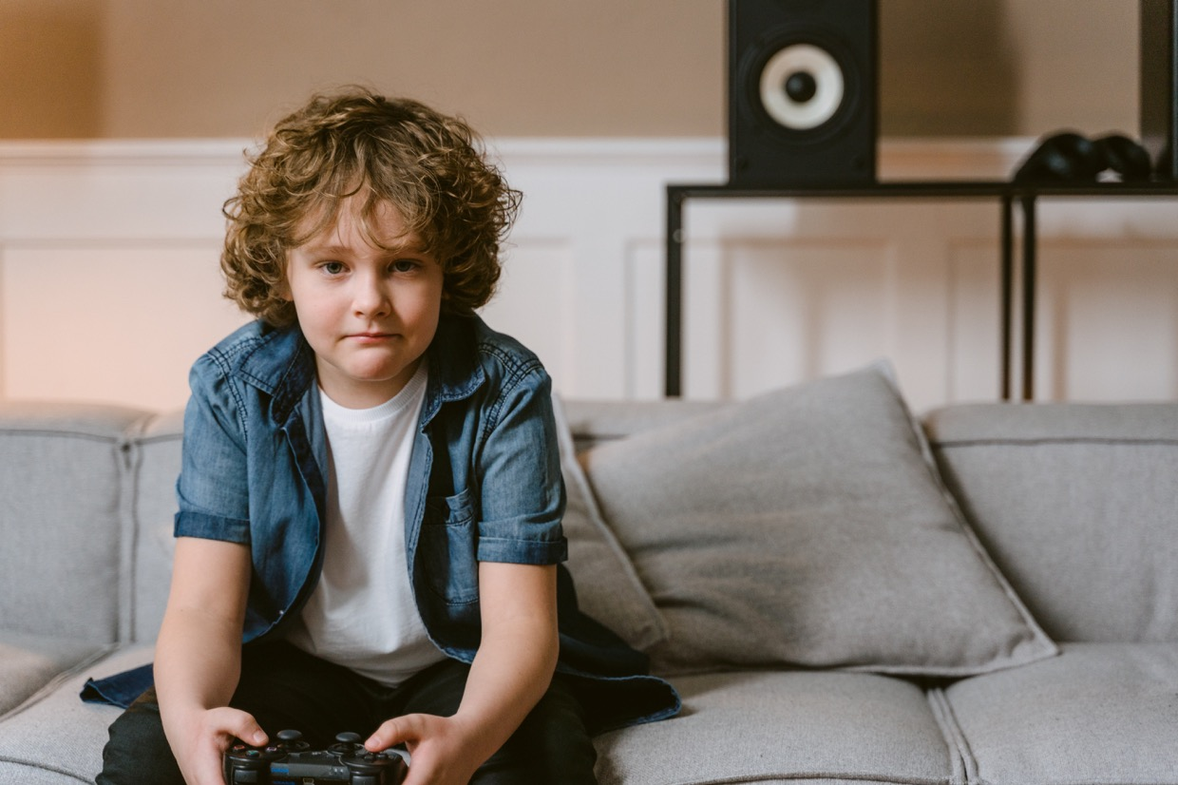
Why rules are complicated (attention, all babies are different)
For a guide format, it might seem odd that we are presenting long paragraphs of texts instead of bullet points, rules of thumbs, or steps to follow. It is done quite consciously. For the three dynamics of Synchrony, Frustration, or Play, we wouldn’t be able to tell you exactly how to enact them with your child. One infant will respond well to a parent mimicking their expressions in perfect synchrony while another will grow bored, demanding slight variations. Sometimes frustration is a sign of genuine distress and sometimes it is a way of testing boundaries; depending on which one it is, a different type of response will be needed.
If you can observe different responses, it is because children are different. Unlike what was believed for a long time, children are born into this world with distinct personalities. The American pediatrician Berry Brazelton was one of the first to demonstrate how children just after birth show varying sets of capacities and will react differently to similar stimuli. With what has become known as the The Brazelton Neonatal Behavioral Assessment Scale, or simply The Brazelton Test, he would test children’s behavioral responses, to indicate the child’s strengths and vulnerabilities, with the aim of helping parents adapt their care strategies to their child.
Some pediatricians perform the Brazelton test today. However, even without the test, much can be deduced about the child’s personality from paying close attention to her. As argued by Winnicott and others, parents are particularly sensitive to picking up on their children's cues, if only because they are usually the people who spend the most time with them. However, that doesn’t mean that there isn’t room to becoome even more sensitive to the child’s modes of tacit communication. In the book Cognitive Gadgets, Cecila Hayes argues that what we sometimes refer to as ‘mind reading’ does not develop naturally. She traces this capacity to the advent of reading and literature, which for the first time gave us insides into different types of subjectivities, making us more adept at imagining what people around us might think and experience.
Similarly, it seems natural that reading about the child’s inner life and experience will make us better at putting ourselves in her place. In this chapter, we’ve tried to give you some elements that might help you in this direction, by accounting for different interpretations of the child’s early experience of being in the world. As said in the introduction, these interpretations rely on equal amounts of scientific knowledge and imagination. Another really interesting example that combines these two modes of knowledge is The Diary of the Baby by psychologists Daniel Stern, which gives an account of the first six months of life from the infant’s perspective. Still, the most interesting exercise is perhaps to venture such a diary yourself, if only in your mind, by asking yourself questions like (see below).
What is my baby seeing right now?
What senses are stimulated?
What could my child possibly understand from the given context?
Does it allow her to communicate?
Does it allow her to create?

Slide 38
03
What is Contributory Research?

Slide 39
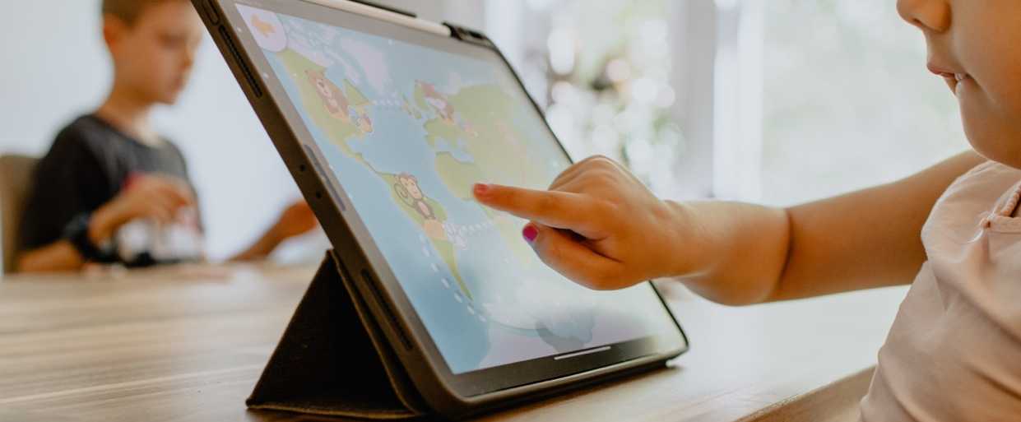
Introduction
As seen in the previous chapter, we have plenty of information available that can help us make sense of the phenomenon of overexposure to screens of young children. Studies show how prolonged exposure is correlated with negative effects on language development, motor skills, obesity, emotional regulation, and social well-being, while theories from psychology and psychoanalysis give us a better insight into some of the underlying causes of these effects, noticeably how screens come to disrupt some of the basic dynamics children rely on to develop (in the previous chapter we talk about synchrony, frustration, play).
We believe that a good understanding of what’s at play when it comes to screens and children is more likely to change how you use your devices than simply being told ‘not to use screens’.
However, at the same time, we recognize that knowing about the effects of screens isn’t always enough to change the way we use them. Often, we have no choice but to engage with screens several hours every day, whether it's through work, administrative processes, or social obligations. And once online, big tech companies will do anything they can to keep us there for as long as possible, by applying fine-tuned strategies developed using knowledge from psychology and neuroscience. However well-intentioned, when it comes to using screens differently, it can often feel as if we are up against something that is stronger than us.
At least stronger than any one of us. Like for most bad habits, we think the odds of breaking bad screen habits are better if teaming up with others.
That is why we within the Contributory Clinic promote a collective approach, where everyone contributes with their own experience to create a shared pool of knowledge that will support each participant in developing their own strategies for cutting down on screen time. In constituting a group that can work on the question of screens together, we hope to foster a supportive environment that can ease the transition into new digital habits.

Slide 40
We call this method Contributory Research. Put in one sentence, Contributory Research is a type of action research that brings together academic researchers, professionals, and inhabitants to address issues concerning technology. It is particularly adapted for new (health) problems, where there still isn’t a complete overview of its causes and effects, and where it seems that no quick-fix solution, like a drug or technology, will make the symptoms go away. Instead of waiting for some magic cure (which often doesn’t exist), Contributory Research proposes to bring together all the different types of knowledge that can help us make sense of a problem, and which can help us imagine sustainable new practices in real life settings.
One thing that’s particular about Contributory Research, compared to other participatory research methods, is that it is anchored in a philosophical tradition. It means that instead of advocating specific steps to follow, like most methods from the social sciences, Contributory Research is guided by a number of concepts and orientations.
The best way to grasp these concepts is to engage with the primary texts around Contributory Research directly. However, for those who do not have the time to dive into these texts, or who want a better sense of what’s at stake before deciding whether it's worthwhile to go any further, we offer you with this chapter an introduction to some of the founding ideas.
The first part will give you a short overview of the main concepts that direct the method. Engaging with philosophical concepts might seem daunting. However, as we hope to show, a good concept is really just a way of putting words on something – a process, a dynamic, a relation – that you already know. As said in the second chapter, naming something in this way is really important, as it is the first step in being able to consciously address it. All the concepts evoked in this part indirectly point to some important aspect of overexposure that we ought to consider, noticeably, how humans – their relations to the world and to one another – are profoundly affected by our usage of technology.
Concepts can also help us develop new theories for how to work together. As we will see in the second part, the concepts in the first part open up to the orientations that guide a process of Contributory Research. ‘Orientations’ are, as the word indicates, that which orients the research. More so than its actual outcomes, Contributory Research is defined by a set of ambitions that we’ll refer to here as the ‘practicing of technology’, the ‘experimentation of a new (contributory) economy’, ‘the capacitation of participants’, and the ‘production of transferable knowledge’, or, put more succinctly, Contributory Research’s ‘organological’, ‘economic’, ‘capacitive’ ’and ‘scalable’ dimensions.
Another way of understanding the nature of something is to understand what it is not. For the third part, we will compare some of the terms we use to describe Contributory Research to other terms that either explicitly or implicitly guide other research processes or social work, so as to give you a better sense of how Contributory Research is different from other approaches you might encounter today.
Finally, we will in the last part summarize how Contributory Research responds to some of the challenges intrinsic to the overexposure to screens, identified through the studies conducted in Project Result 1 of this Erasmus project. This part is particularly useful if meeting people who are skeptical of the method. Today, few institutions valorise open-ended methods that require the long-term investment of multiple actors. With this part, we hope to indicate how investing in a process like Contributory Research might actually help us overcome some of the problems that make other approaches against the overexposure to screens ineffective.
Throughout the chapter, we will strike a blow for the particular philosophical aspect of the method. Within all processes of Contributory Research, we try to address the perhaps oldest philosophical question: who are we? To us, this isn’t just an interesting, existential question. We believe that a curiosity about who we are is the pre-condition for intelligently taking care of ourselves and each other.

Slide 41
A Method that Originates From Philosophy
Contributory Research comes out of the philosophical work of Bernard Stiegler. Below, we’ve summarized some of his principal ideas, organized around his primary concepts. Held together, they show the reasoning behind and impetus of Contributory Research.
XS
01.
02.
Individuation
Pharmacology
04.
03.
Disruption
Proletarianization
05.
06.
Economy of Contribution
Contributory Research

Slide 42
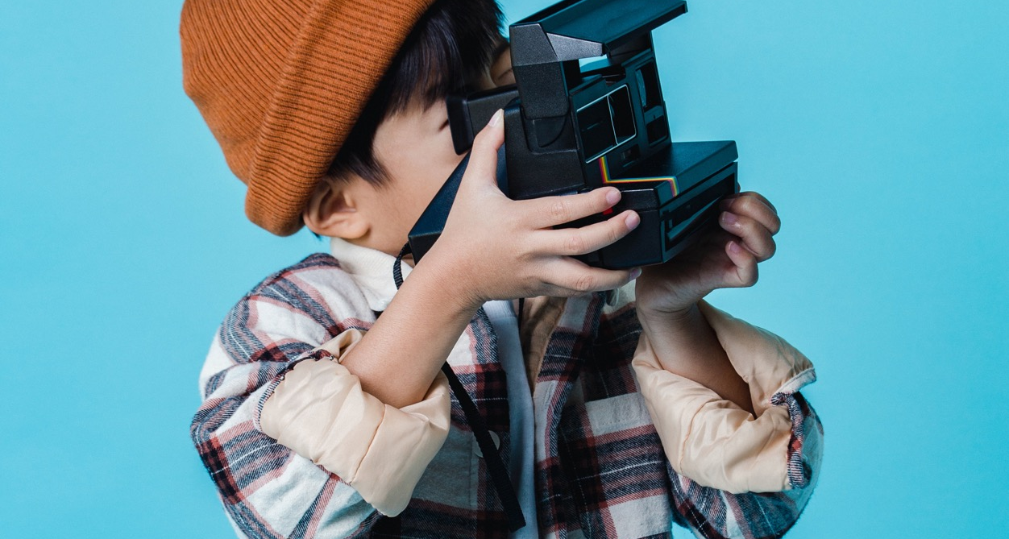
01.
Individuation
The main proposition of Bernard Stiegler is that human beings are co-constituted with their artificial environment. He complicates the otherwise intuitive idea that techniques are created by humans, in posing that human beings, in turn, are created by the techniques that surround them. Before our individual existence, he argues, there is a technical world that we are born into, which will define the boundaries or our memory, knowledge, skills, and desires.
According to his theory, Individuals are constantly made and remade in the interaction with their biological, social and technical milieu. At the same time, the milieu will invariably undergo changes as individuals change. The two forms of becoming – individual and collective – are in this sense entwined, founding and, as such, altering the existence of each other.
After French philosopher Gilbert Simondon, Stiegler calls each process of becoming, whether individual (psychic) or collective (social) for individuation. Individuation has nothing to do with individualism. In fact, the two can in many ways be considered opposites. Whereas individualism favors the individual above anything else, individuation forces us to acknowledge that the becoming of individuals – which to Stiegler is the same thing as the existence of individuals – depends on their continuous investment into our social and technical world.
Transindividuation is the concept Stiegler uses to describe the way by which individuation is taking place between individuals and collectives. Once more, he highlights the role of the technical milieu, as it is through techniques – language, writing, visuals materials etc – that the individual will feed into the collective spirit, and vice versa. Often, he will describe Transindividuation as the transformation of the ‘I’ by the ‘we’ and of the ‘we’ by the ‘I’.

Slide 43
02.
Pharmacology
Another way of describing the relationship between humans and technologies is to think of individuals as being constituted of both biological and technical organs.
In his first book, The Technique and The Time 1, Bernard Stiegler references the Greek myth of Epimetheus and Prometheus. In this myth, the Greek’s origins story, the titan Epimetheus is charged by the gods with attributing one positive quality to each of the newly created animals in the worldly kingdom. Lacking foresight, Epimetheus runs out of qualities before arriving at the last animal: the human being. To compensate for this lack, his twin brother, Prometheus, decides to steal the power of fire from the gods and grant it to the humans. That is why, the story goes, the greatest strength of humans would become a certain technological acumen instead of an innate quality.
Bernard Stiegler used this myth to point to how humans throughout history have used technology to compensate for what he sometimes refers to as an ‘originary default of origin’. E.g: we cannot run very fast, but we have invented vehicles that make us traverse distances faster than most other animals; we cannot fly, but we have created machineries that can transport us through air; we do not have the strength to carry large burdens, but we’ve refined techniques allowing us to transport objects surpassing our own body weight; we do not have infinite memory, but we can store our memories in materials external to us (text, photos, video).
In his writings, Bernard Stiegler pays particular attention to this latter example, the technical objects that store memory, what he with a Greek word calls hypomnemata. He does not only consider hypomnemata one of our ‘strong qualities’. If he refers to the myth of Epimetheus and Prometheus, it is to illustrate how humans, unlike other animals, depend on techniques to prosper. This dependence, he argues in his later work, might turn into an overdependence. That is because we, with every externalization of a function to a technical object, are at risk of forgetting how to perform that specific function ourselves.
Stiegler is not the first philosopher to highlight this risk. In Ancient Greece already, Plato warned against the unwanted effects of hypomnemata, more specifically of writing. Writing allows us to store and accumulate knowledge, he argues in the dialogue Phaedrus, but at the same time it degrades our capacity of memorising things ourselves. To indicate the doubleness of the writing technique, he goes on to call it a Pharmakon, the Greek word used to designate, at once, poison, cure, and scapegoat.
Bernard Stiegler appropriates this term to describe techniques in general. All techniques, according to Stiegler, carry the potential to make us more intelligent, just as they carry the potential to make us dumber.
Often, it isn’t difficult to identify the pharmacological aspect of technologies. Extending Plato's analysis of writing to current writing techniques, you could argue that the keyboard puts us at risk of ‘forgetting’ how to write by hand, autocorrect how to spell, and new advances in artificial intelligence, such as Chat GPT, how to structure a text or construct an argument.
In the philosophy of Bernard Stiegler, there is never question of renouncing technologies (which in any case isn’t possible). Rather, he highlights the necessity of working actively to limit their harmful or ‘dumbing’ effects. Work that, in the philosophy of Stiegler, begins by acknowledging technology’s pharmacological aspects.
At the Institute of Research and Innovation, we also refer to this kind of work as a General Organology, to describe an analytic approach that studies the relationship between technical and artificial organs.

Slide 44
03.
Proletarianization
The process
by which technology renders us
stupid is, by Bernard Stiegler, called proletarianization.
He takes this term from the political scientist Karl Marx, who in his writings described how the industrial revolution had led to the loss of the workers’ knowledge, by standardising, automating and, hereby, replacing it with machines. This, he argued, had led to an inversion of the relationship between man and machine, with the proletariat coming to serve the machine instead of the other way around.
Today it is not only the proletariat that has lost their knowledge to machines. If industrialisation standardised and automated the gestures of factory workers, new technological advances have automated other types of knowledge. It means that proletarisation has come to attain people at all strata of society, however powerful. Stiegler often uses the example of the former chair of the Federal Reserve in the US, Alan Greenspan, who following the financial crash in 2008, admitted to not having understood the technologies that guided the decisions fatal in bringing about the global economic recession.
In recent years, proletarianization has also come to touch types of knowledge that were previously considered distinctly human. In an article from 2008, the then-Wired editor, Chris Anderson, argues that the creation of scientific hypotheses might be replaced by powerful data processing. Robots are already replacing certain care functions in nursing homes and hospitals. With a simple Google search, you can find educational programs and entertainment that effectively replace, however poorly, the role of parents and teachers. In general, you might say that we are in the process of delegating not just our ‘doing’ (savoir-faire), but also our knowledge of how to theorise (savoir-theoriser) and how to live (savoir-vivre). Stiegler will often refer to this massive loss of knowledge as a generalized state of proletarianization.
04.
Disruption
The massive loss of knowledge described by Stiegler is a natural consequence of the rapid investment into the innovation of new technologies, which are often introduced into society before we have a real understanding of the consequences they’ll have on our social make-up.
Stiegler writes how these unexpected consequences can lead to something akin to a state of shock, what he also calls a Disruption. Following each disruption, there’ll be a need to introduce new technical and social orders. One way of instilling new orders is by passing new laws. Acknowledging the disruptive effects big tech companies have had on local economics, politics, and personal well-being, we have in the past two decades seen new types of regulation, particularly within the European Union, which with their Digital Service Acts have passed a number of laws to protect digital users, and certain countries, like Germany, Denmark, and Canada, which have banned or reduced access to services like Airbnb and Uber.

Slide 45
05.
Economy of Contribution
However, as technological evolution accelerates, it can be hard for traditional institutions, whether legal or scientific, to ‘keep up’. This trend, Stiegler writes, is only aggravated by a general divestment in the public institutions that could otherwise introduce new social and technological orders.
In response to this, Bernard Stiegler would, after the financial crash, make a proposition for a new type of economy, what he, together with a large interdisciplinary network of researchers, called an Economy of Contribution. The purpose of an Economy of Contribution is to invest in the production of new knowledge that can reduce the undesired consequences of technologies, or, to reuse the vocabulary from above, fight against a generalized state of proletarianisation.
06.
Contributory Research
Contributory Research is the process that, within an Economy of Contribution, is meant to fight a generalised state of proletarisation.
Acknowledging the speed with which technology develops, Contributory Research is conceived from the premise that we cannot rely on one field or one type of knowledge to develop new ways of practicing technology: we have to bring together different types of knowledge to, in this way, allow for the rapid transfer between different fields of competences. To use the example of the overexposure to screens, we cannot rely purely on researchers to come up with strategies to reduce screen time; we also have to implicate professionals, who will know how overexposure to screen plays out on the ground, and parents, who are particularly adept at imagining how to replace screens in the household.
We also refer to the valorisation and creation of new ‘practicable’ knowledge as a process of capacitation.
Bringing all of the above concepts together, you could say that Contributory Research is the process envisioned to exit our current epoch of disruption by producing new knowledge that can counter a generalised state of proletarianisation. More concretely, it seeks to bring together people from different fields who together will practice and theorize technologies that are always treated as pharmakons, that is, as objects containing both positive and negative aspects. The interaction between individuals and their social and technical milieu foster individuation: the becoming of those who participate in the Contributory Research process as well as the becoming of their technical and social milieu. Becoming being in the philosophy of Bernard Stiegler the same as existing, Contributory Research can, fundamentally, be thought of as a way of guaranteeing our continued existence and the existence of the world we inhabit.

Slide 46
Four Main Orientations
We often say that there isn’t one way of doing Contributory Research. Each instance of Contributory Research will be articulated according to the people who undertake it, the territory of intervention, the topics treated, the technologies experimented – what we might with one word refer to as ‘the locality’ of the research (much more on this in the third chapter). There is, however, a set of orientations that will often direct a process of Contributory Research. Note that this is not an official list of orientations, which means that other people might prioritize different values or objectives in their practice.
In our work, we like to
highlight the following:
01. Contributory Research is organological:
it analyses and practices the relationship
between our biological, technical, and
societal organs
02. Contributory Research is economically
sustainable: it is supports contributors
financially and creates new work activities;
03. Contributory Research is capacitative:
it valorises the knowledge of participants in order to open up to new modes of actions;
04. Contributory Research is scalable, it produces
knowledge that can be transferred between
different localities.
XS
01.
02.
Organological
Economically sustainable
04.
03.
Scalable
Capacitative
It is important to stress that we talk about orientations – not finalities. Even if you haven’t found ways of accomplishing the above ambitions, you might still be operating within the remits of Contributory Research. The orientations should not be thought of as exclusionary criteria, but rather as principles to guide your decisions as you develop your research.

Slide 47
01.
Organological
Contributory research is organological. With reference to the Greek myth of prometheus (see above), it is based on the premise that technology, and techniques more generally, are constitutive of who we are and how we interact with one another. It means that the question of technology – what it does to our thoughts, desires, and relations – is always at the heart of a Contributory Research.
In a contributory research, the question of technology is posed both theoretically and practically:
Theoretically, we analyse how our biological, social, and technical organs influence one another in the context of the topic you’re hoping to address (like the overexposure to screen).
Practically, we want to find and experiment technologies that support the collective work and fabric. We often talk about developing or using preexistent contributory technologies: techniques that facilitate the contribution of those who form part of the research.
02.
Economically sustainable
While there isn’t as of yet an Economy of Contribution, the question of economics and solvency remains at the heart of Contributory Research. This is true in at least two different ways:
Firstly, we consider how to valorise participants’ contribution. It is important that you do up with rules about who ought to receive financial support for their contribution. While you’re conducting research, the contribution of academic researchers isn’t worth more than the non-academic researchers (everyone in contributory research engages in the search of new knowledge making them researchers in a general sense). Considering the kinds of contributions necessary to your research – whether it is to contribute with knowledge, a skill set, or care work – and making sure that it is valorised financially, is intrinsic to the work of contributory research. It is also the only way to guarantee the sustainability of your project.
Secondly, we ask what types of employment your research opens up to. As new technologies emerge, we have to reimagine how we work: some jobs are likely to be replaced by machines while other, new jobs will emerge. One goal of a contributory research is to identify the types of employment which are necessary given our current technical reality.
In the context of the Contributory Clinic, we’re attached to the position of the Parent-ambassador: a parent who informs about the effects of overexposure to other parents and launches new activities that work against an unmeasured usage of screens in their community.

Slide 48
03.
Capacitative
Like all research processes, contributory research aims to produce knowledge. However, the kind of knowledge we want to produce is not necessarily like the knowledge you associate with traditional academic work. Instead, we often talk about it as having ‘capacitative qualities’.
The term ‘capacitative’ is a reference to the work by the Nobel prize winning economist Amartya Sen, who became known for the work he’s conducted on what he calls capabilities: the quality or state of being capable. Through studies of different populations, Sen observed that having the freedom to perform certain acts won’t have much effect if people don’t possess the knowledge to enact them. In a famous comparison made between Harlem and Bangladesh, he showed how societies rich in capabilities have a higher life expectancy than societies with few capabilities, even if the latter societies are more financially prosperous.
We are of the firm belief that most people are already highly capable, and that the promotion of territorial resilience has to pass through people’s existing knowledge. In this sense, you could say that contributory research aims to create the conditions for people to act on what they already know.
04.
Scalable
Each instance of contributory research is articulated with a locality. That doesn’t mean that it as an approach favors the local over the systemic. Instead, it hopes to change the relationship between the local and what has sometimes been called the universal. Instead of thinking of solutions ex nihilo and imposing them from above, it wants to arrive at general rules by abstracting from local ingenuity and know-how.
There are many different ways of tying your experimentation to that of others. When contributory research was conceived, the ambition was that all territories practicing contributory research would form part of a network that, using a term by the anthropologist Marcel Mauss, was to be called an Internation. In later projects, the image of the archipelago has been evoked, to describe a kind of relationship between territories that doesn’t efface the specificity of each locality. Until one of these models has been formalised, the easiest way to ensure the dialogue between your local context and a trans-local debate is to analyse and share the results of your research. This can be done through academic articles, presentations, seminars, and transnational projects (like this Erasmus project), as well as other non-textual forms, like art pieces, films, and exhibitions.

Slide 49
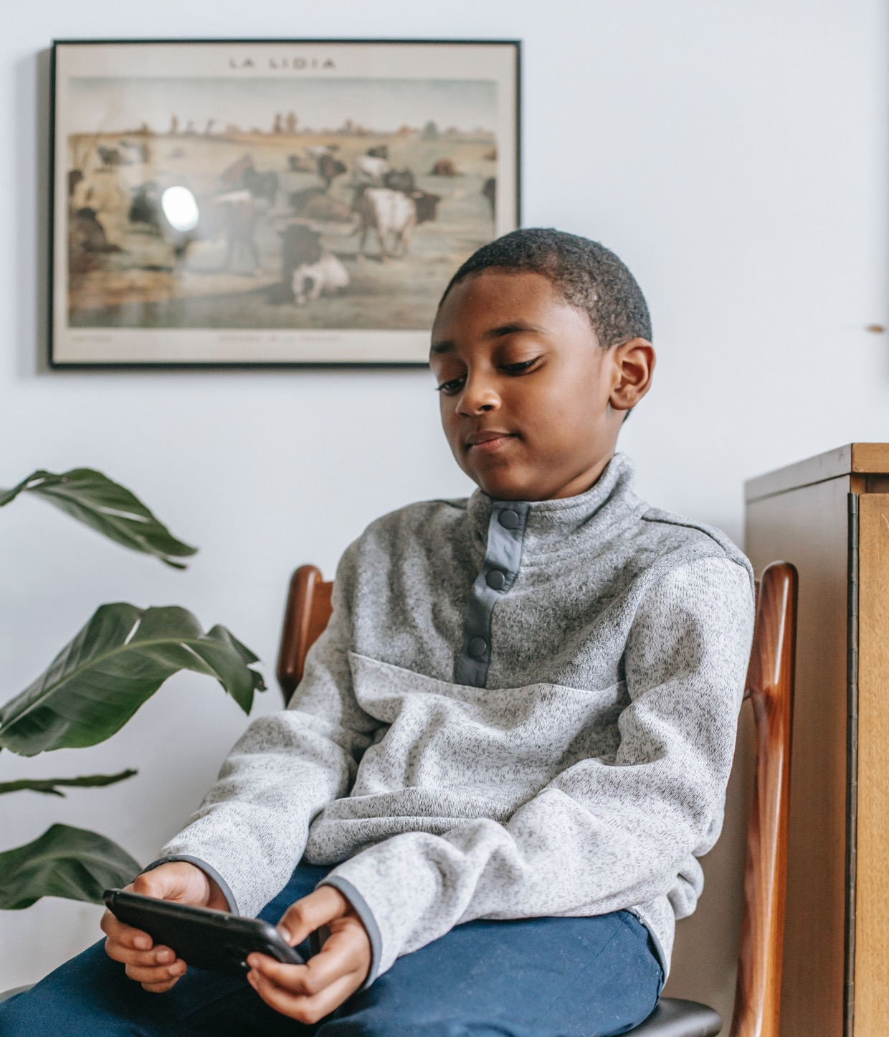
The Terms we use
As you have probably figured, we pay a lot of attention to the words we’re using. Words, even if used as synonyms in daily conversations, often evoke different histories, politics and ideologies. In this part we will clarify some of the terms we rely on in our work and explain how they differ from other similar terms you are likely to encounter.

Slide 50
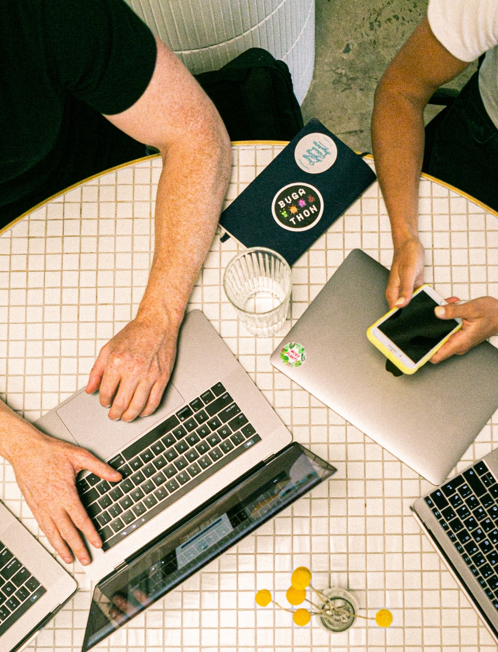

Contribution
Participation
S
To us, contribution is a more radical type of participation. As proposed by Sherry Arnstien in her ladder of participation, participation can be used to indicate many different processes, from tokenism to real citizen power. Participation at its most rudimentary could be understood as simply ‘being there’. Often, participation in research implies adding new data to processes that have been determined in advance by other people.
With Contribution we hear something entirely different. Contributory research is not determined in advance. It means that you, as a contributor, are expected to help setting the direction of the research. This includes coming up with research questions and deciding on a method that will help you answer them. As such, all participants hold a very active role in the process – implied too in the verb ‘to contribute’, which unlike ‘to participate’ always means to add something.
We believe that the equal investment in the process is the surest way of guaranteeing that the outcome of the research process will be of interest to all participants.

Slide 51
Skills, Training, & empowerment
Capacitation
S
When we talk about what we hope to bring about through contributory research, we often speak about capacitation.
Referencing the work of Amartya Sen (see above) capacitation can be described as the process through which people acquire capabilities, knowledge allowing them to act on the(ir) world.
This is very different from teaching people skills, which are often predefined according to the demand of a given structure or logic, like the job market. Caricaturizing slightly, you might say that whereas capacitation is about acting on the world, skills is about adapting to the world. That is also why we differentiate contributory research from training programs, which are often explicitly geared towards skill-development. Sometimes, we try to combine the two logics, like what is the case for our nine sessions capacitation process Reason our screens (see in chapter 5).
We also prefer to use capacitation rather than the term empowerment. One reason is that empowerment has been used so frequently and in so many different contexts that it, just like participation, has come to indicate a plethora of different dynamics and processes. Scientist and activist Max Liboiron writes how the word to ‘empower’ often implies ‘granting’ power to a group of people, ‘like passing a baton’, without acknowledging the structural problems that are causing power to be unequally distributed in the first place.
Capacitation, on the contrary, is not something you can ‘give’ or ‘pass on’. You can, at most, favor the conditions of capacitation by creating a space where knowledge can be exchanged and experimentation supported. What follows from capacitation is not ‘power’ in a traditional sense, but rather the capacity to perform informed acts, which, to paraphrase the philosopher Hannah Nussbaum who’s also worked on the question of capacitation, favors a person’s psychical, psychic, or ethical integrity. Such acts could take the form of traditional acts against dominant forms of power – but not only that. The whole point of capacitation is that it isn’t up to us to determine the outcomes. Each capacative process will run according to the individuals embodying it.

Slide 52
Horizontal
Diagonal
S
Many collective projects today advocate horizontal decision making processes. In its most radical form, horizontality implies that everyone’s voice is equal at any given moment and that no one holds a privileged position in relation to a given field or expertise.
In contributory research, we prefer to talk about a diagonal approach. While everyone is equal when it comes to making big decisions, like determining the direction of the research, some voices will count more than others in specific contexts. E.g, if wanting to understand the different developmental stages of the child, we would tend to privilege the knowledge of a biologist, a developmental psychologist, or a psychoanalyst; if wanting to understand the barriers for changing screen habits, we would tend to consult a parent. With contributory research, we don’t seek to level people’s knowledge. The idea is to mobilise different types of knowledge in order to reach conclusions that no one could have arrived at by themselves. To us, acknowledging the limits of certain types of knowledge in some contexts is the flip-side of acknowledging their particular value in others.

Slide 53
Bifurcations & long-term change
Impact
S
The first meaning of impact in English is ‘to collide into something’. Even in other uses of the term, the idea of producing a visible result, and producing it fast, will often persist. It is what institutions most commonly intimate when looking to support actions considered impactful. Institutional demands of impactfulness will frequently be accompanied by impact measurements. It indicates that, from an institutional perspective, impact isn't just expected to be fast and visible, but quantifiable too.
There is, of course, nothing wrong about wanting to bring about fast, visible and quantifiable results. What seems important though, is to distinguish between impact and long-term, sustainable change. The two aren’t mutually exclusive. However, one doesn’t necessarily guarantee the other either. In a report from 2020 on energy precarity, the philosopher Camille Lizop writes that while the COVID crisis had a significant impact on global energy consumption, it never led to a sustainable change in our consumption levels. In his book To Solve Everything Click Here, Evgeny Morozov speculates as to how paying people to vote would have an immediate impact on voters' attendance, but without addressing the underlying causes for why people abstain from voting today. In fact, paying people to vote could further undermine a sense of citizenship. As this latter example shows, an exclusive focus on impact might end up further aggravating the problem you’re trying to address in the long term.
That is why we are less interested in talking about impact than the sustainability and long-term prospects of the processes advocated. We also want to shift the focus from instant and significant effects because we know that sustainable change rarely happens overnight. When you’re working, as we often are, to question deep seated habits, generate new types of work and employment, and search for generalisable solutions in the local, you will likely have to work for a very long time. As we write in chapter four, the experimentation of the Contributory Clinic, and other contributory research projects launched at the same time, was originally envisioned to last for minimally ten years: the time it would take to see a change in the trajectories of the the children affected by the problems we hope to address.
Another idea that is often implicit in impact is that we already know what is needed. When operating within a technical system that is new to us, we cannot always rely on solutions that have worked in the past. In general, if relying on what you already know, you will often end up producing more of the same. Sometimes, it makes sense to apply a specific strategy that has already worked in a different situation, especially when facing urgent issues. However, in contributory research, the focus is slightly different. Here, we work to produce openings – openings towards radically new ways of being together. We also sometimes call these openings, which will always be impossible to predict in advance, for bifurcations.

Slide 54
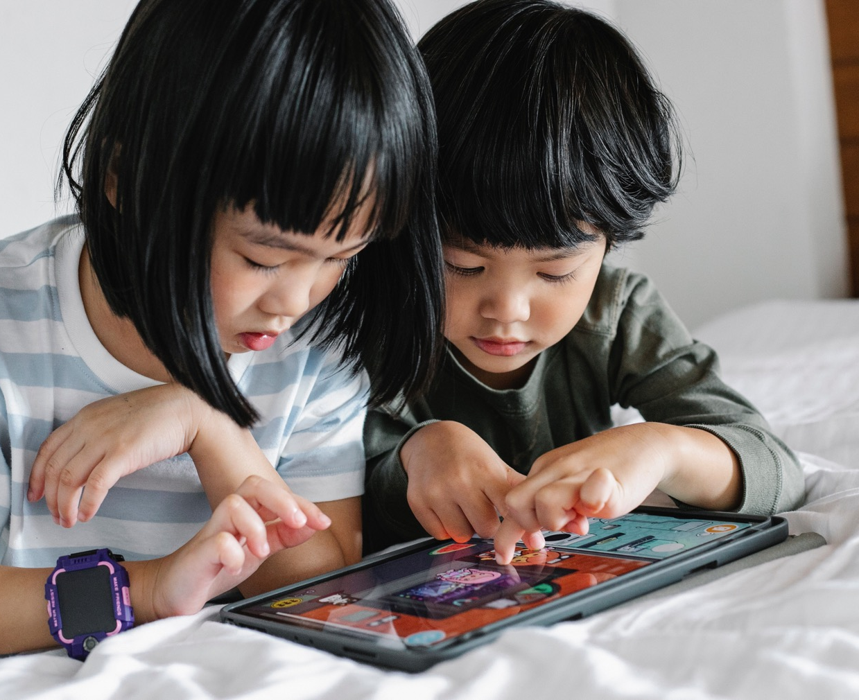
The Difficulties Associated With the Overexposure to Screens and how Contributory Research Responds to them
Based on the interviews from Project Result 1, we have identified some of the problems professionals face when trying to address the question of overexposure. Below, indications for how Contributory Research responds to them.

Slide 55
‘Overexposure of screens to young children is a relatively new problem and so there are still a lot of different and sometimes antagonistic views on its causes and effects. It can be difficult for professional and parents to know what to believe.‘
Contributory research engages with these different antagonistic views, analyzing and discussing the arguments on both sides. This allows participants to develop their own position on the topic, which they can since defend to others.
‘If children are overexposed to screens, it is because parents are addicted to screens themselves.’
Very young children will not pick up a smartphone or tablet on their own initiative. In a contributory research on screens, we acknowledge that the overexposure to screens is often the product of adults’ own screen addiction. Through our work, we try to address this addiction, not as someone looking in on people with a problem, but by working from the observation that everyone is deeply affected by the technology that surrounds us. As a group, we work to come up with strategies that can help us regain control of our screen usage.
Two of the first observations we make when beginning contributory research work is that 1) we are all affected by screens and 2) that screens are (most likely) here to stay. This isn’t necessarily a bad thing. In fact, there are countless benefits to modern digital technologies. That is why we never set out to get rid of screens. Instead, we take the time to identify which digital practices led to joy and learning, and which ones encroach on other important activities, and which should be limited, if not abandoned entirely.
‘Unlike other addictogenic substances, it is nearly impossible in today's society to rid ourselves of screens.’

Slide 56
‘Fighting the omnipresence of screens demands resources and time. Today, there’s a rift between parents who already limit screens at home and parents who depend on screens to get through their everyday life. The latter group is often the hardest to reach.’
We know that a lot of the parents we work with are parents that are already worried about the effects of screens and that have the time and energy to participate in a long-term process to ‘reason’ their screen behavior. Similarly, we know that we only rarely enter into direct contact with families who live in precarious situations, who are often all the more vulnerable to the effects of overexposure. To compensate for this, we count on the parents and professionals we work with to transmit the knowledge they acquire through our collective work. The parents who form part of our research are granted the title of Parent-ambassador as a way of encouraging them to embrace their role as actors of reasoned screen usage in their community. With our short-term capacitation process (see chapter 5), the goal is to create a large network of actors who can instigate discussions around screens in their territory.

Slide 57
‘It is difficult transmitting knowledge about the overexposure to screens without coming across as being judgemental.’
We are all concerned by the problem of screens. This is the attitude we hope to transmit to those participating in the research. We believe treating the question of overexposure in-debt will open up for more nuanced dialogues around the topic that highlight the special skills of the parents (see chapter 1 part 2) instead of focusing exclusively on what parents ought not to do. Sometimes, avoiding sounding judgemental comes down to seemingly small gestures, like the words used to evoke a problem. One tip shared by a psychologist who forms part of our research is to replace typical interrogations about screen hours with the open, non-judgmental question: “so, how do you go about dealing with screens at home?”
‘Knowing not to use screens with your children is not the same thing as coming up with new practices that can replace them.’
In Contributory Research we always look for practices that can replace screens, greatly aided by parents and professionals. Turning cooking or cleaning into a shared moment, turning ordinary objects into toys, or participating in activities proposed by organisations in the area: the alternatives to screens are often closer and simpler than what you would think. Many parents have already come up with different strategies to regulate their screen usage. Through a process of contributory research these strategies are put in common.

Slide 58

‘Changing screen habits does not happen overnight. It requires sustained effort on the part of the parent.’
Contributory research takes time. Our shortest program is structured over nine sessions, which means that we follow a group for at least a couple of months. To us, a couple of months is the minimum time necessary to accompany participants – parents, professionals, and researchers alike – to new screen habits. Most often, we’ll be able to observe noticeable changes in how people think about and practice screens during this period.
However, just because you manage to ‘reason’ your screen time for a period of time, doesn’t mean that it’ll stay that way. That is why we, following a process of contributory research, continue to meet with those who have participated every couple of months, to check in and plan for new actions they can undertake, whether in their private or professional life.

Slide 59
04
How to Launch a Process of Contributory Research?

Slide 60

Introduction
In the previous chapter, we’ve given an overview of the method we’re working from in Seine-Saint-Denis, its concepts and orientations. But how do you go about launching your own process of contributory research on the overexposure of screens concretely speaking? As you’ve probably been able to gather, there isn’t one recipe to follow. Because contributory research depends on the investment of local actors, the research process will unfold according to their availability, interests, and knowledge, as well as the budget made available to you.
That being said, there are a number of things you might want to consider as you begin to develop your project. Based on our experience from working in the Contributory Clinic, we’ve tried to identify the different steps to move through if wanting to begin a collective experimentation on the overexposure to screens.
First thing to know is that there within the Contributory Clinic are different levels of engagement. Put simply, you can divide our contributors into a core group and an extended group. The core group is made up of people who are invested in the long-term and who participate in the activities on a regular basis.
Most often, it is the core group that will set the direction of the research. Made up of researchers, health care professionals, and one parent, the core group is itself quite fluid, with members alternating depending on the specific activity undertaken.
The extended group – that we also sometimes refer to as the public – is constituted of those who participate punctually in the activities of the Contributory Clinic. This group is primarily composed of parents affected by overexposure together with health and childcare professionals.

Slide 61

The first part of this chapter looks at how the core group of the Contributory Clinic came into being. For the purpose of this guide, we’ve divided this process into steps: finding key-partners for your project, anchoring your work locally, constituting an interdisciplinary team, conceiving of the group’s references and dreams, deciding on the rules and conventions, and identifying tools of collaboration. For the group to be able to work sustainably, it is also important to consider how people will be remunerated for their contributions.
The second part focuses on how the Contributory Clinic opened their activities to the public. We’ll describe the format of our public workshop and seminars and how we’ve communicated these activities to the public. We’ll also reflect on how we try to accompany those who wish to launch new initiatives against the overexposure to screen. We say ‘accompany’ here to indicate that it isn't us that will decide on the kinds of initiatives participants from our workshops go on to instigate. Quite on the contrary. We consider a process of capacitation most successful when participants end up coming up with their own actions, which can exist, develop, and grow independently of us.
Logically, you will want to create a core group before opening this group up to a public. Besides from this order, the different phases described below should not necessarily be followed consecutively. In the Contributory Clinic, we often find ourselves jumping between the different steps, revisiting references, research goals, collaborative tools, and ways of working together as we go along. Sometimes people from the extended group will join the core group, which will require us to rethink some of the initial decisions. Ultimately, the longevity of the project will depend on your capacity to ensure that a Contributory Clinic reflects, and continues to reflect, the desires of those who contribute to it.
In general, we want to stress that the below guide should not be thought of as a ‘tried and tested’ method. It isn’t just that it doesn’t fit the logic of contributory research, which should always be developed in relation to a particular locality; at the time of writing, we are only half-way through our own experimentation. When launching the Contributory Clinic, we gave ourselves ten years to work. Ten years was the time we estimated necessary to become an authority on the question of screens, develop a method for working together, gain legitimacy in the territory, and see the initial capacitation work multiply into new and unforeseen initiatives. It means that a lot of our doing is still in the process of being figured out; we are, in other words, still learning.
A lot of this learning happens quite intuitively by responding to opportunities that arise and finding solutions to problems as they emerge. In this guide, we will reflect on what has worked well (and less well) for us, but in order to develop more formalised ‘rules’ or ‘stages’, you would have to analyse a number of different experimentations, to get a better sense of what works across different localities and territories. Being the only Contributory Clinic so far, this kind of cross-analysis isn’t possible at this stage. However, we hope is that it won’t stay this way! If you are reading this text now, it means that we’re already a little closer to seeing Contributory Clinics multiply across the continent. Do let us know if you venture your own contributory research project. Learning about your successes and failures could help us refine the stages as proposed below, for an ever more tested, applicable, and comprehensive guide-to-action.
Because we’re basing the texts on the knowledge obtained through the particular experience of the Contributory Clinic, the steps below are conceived specifically for someone who hopes to conduct contributory research on the overexposure to screen. If you want to do contributory research on a different topic, or if you don’t know exactly what you want to work on, there are a couple of additional stages to follow when launching your work. We invite you to read more on these in the book Bifurcate (here). Especially chapter 3 and 4 are useful.
e
CLICK
TO VIEW

Slide 62
Creating a Core Group
You are someone who is worried about the overexposure of screens to young children. Maybe you’re a healthcare professional who’s meeting a lot of overexposed children through your job, a researcher who would like to develop care practices, or a parent who worries about the place screens have taken in our lives. You want to start a collective action to fight against the overexposure to screens. Where to start? Here’s how we did it.
XS
01.
02.
Aggregating Desires
Finding and Constituting a Locality
04.
03.
Retentions and Protentions (The Group’s Memory and Dreams)
Bringing together Theoretical, Practical, and Experiential Knowledge
05.
06.
Rules and Conventions
Contribution Tools
07.
Remuneration and Valorisation

Slide 63
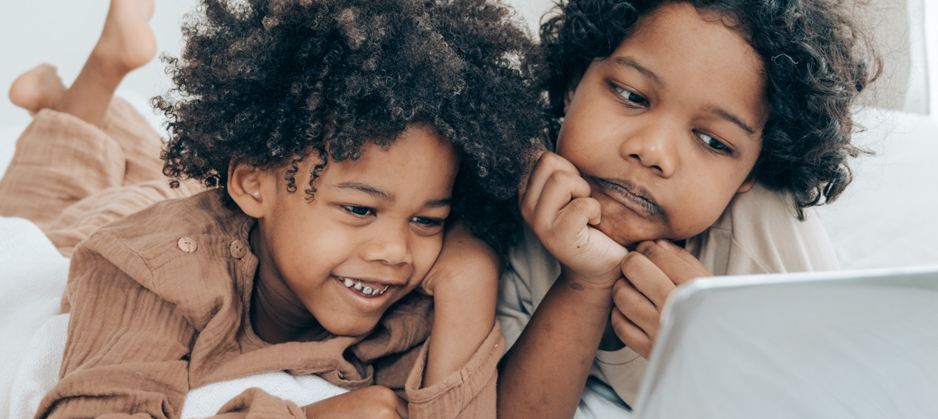
01.
Aggregating Desires
No one can undertake a contributory research project by themselves. The first thing to do if wanting to do contributory research is to find people to work with. Unlike for some research or health care projects, stakeholders and partners are not external to the project: they define it. Every major decision (like the topic treated, the place of the research, or the financing) should be taken together as a group.
To start with, you’ll need at least two or three allies that are ready to carry the project with you. It is important that they share your motivation and approach to collective work. For this initial part, you don’t want to tire yourself out by convincing people about the necessity of your activities (there’ll be plenty of chances to practice your persuasion skills when securing financing later).
In 2017, the child psychiatrist Marie-Claude Bossière addressed a letter to the philosopher Bernard Stiegler, stating her concern with what she considered a worrying phenomenon: through her work she was meeting a growing number of children showing severe delays in language acquisition and motor skills, and behavioral problems, as manifest in aggression, hyperactivity, or isolation. Together with other child doctors and psychologists at the time, she suspected screens to be the cause of the problem. She had previously read Stiegler’s book Taking Care of the Youth and Generations, which talks about the responsibility of adults in children’s education and how digital technologies come to circumvent intergenerational knowledge-transfers, which leads to a general loss of knowledge in favour of commercial interests. At the time of receiving the letter, Bernard Stiegler was, together with the team at the Institute of Research and Innovation, preparing a large-scale action in the northern suburbs of Paris. Together with inhabitants of the territory, they wanted to invent new non-toxic ways of practicing technologies through a method of contributory research. Marie-Claude Bossière saw a potential match between her concern about overexposure and the work foreseen by the institute. So did Bernard Stiegler. He put her in contact with the rest of the team at the Institute of Research and Innovation, and, together with another philosopher and a theoretical biologist, soon joined what was to be named the Contributory Clinic.

Slide 64
02.
Finding and Constituting a Locality
It was decided that the Contributory Clinic would form part of the activities IRI was about to launch in Seine-Saint-Denis, a department in France known for its young population (50% is younger than 30 years old), its multidiversity (more than 135 nationalities are represented) and its relative economic poverty (17,7% lives under the poverty line).
It is worth mentioning that no one from the initial group of the Contributory Clinic had previously lived or worked in this particular department. In hindsight, it might have been easier to situate the project in a territory familiar to the members of the group. It is something you’ll want to consider when launching your project. There are clear advantages to working in a place or institution you already know, as you’ll have a better understanding of how to insert your project into a pre-existing ecosystem of actors, institutions, and initiatives.
Without this prior knowledge, you’ll have to dedicate some time to familiarizing yourself with the place and the people living there, presenting your intentions to interest groups, collectives, networks, organisations, and to public and elected officials. Doing this ground-work isn’t only necessary to further the project, it is also the only way to make sure that you are not encroaching on other people’s work or going up against their interests, which is a risk you’ll have to constantly mitigate when you’re arriving in a new territory. Ultimately, there is no way of creating a sustainable project without local support.
In order to find local collaborators, Marie-Claude Bossière contacted the coordinator of The Local Advisory Board on Mental Health (in French: Conseil local de santé mentale), which groups elected officials and professionals from psychiatry. They directed her to the head of the department overseeing the Infantile and Maternal Protection centres (in French: Protection Infantile Maternelles, PMI) in Saint-Denis, who transferred a note of intent to all of the local teams. At this stage, the project was presented very openly, as a general proposal to work collectively in order to find strategies against the overexposure to screens. It is important that your proposition reads as a genuine invitation to contribute, and not as a call for participation in a project that has already been defined in advance. The PMI centre in the neighborhood Pierre Semard responded positively to the proposition. From 2018 and onwards, its team and the clinic would become the ‘home’ of the Contributory Clinic, grounding the project locally and providing a physical space to meet.
Disposing of a space for regular meetings has been indispensable to our process. Unlike research conducted by one person, Contributory Research relies on a geographically situated location where people can come together and exchange. This place ought to be accessible, both practically and symbolically speaking. For each potential location, ask yourself if it is near the homes of the participants, if it is disabled-friendly, if everyone would feel comfortable inside of it. Even if universities and research labs are open to the public, some might feel uneasy in academic spaces. People can have similar apprehensions about institutional spaces, like municipal meeting rooms. Ask yourself where people already go.
Maternal and Infantile Protection centres have a particular history in France: launched after the second world war, they seek to protect all mothers and children residing in France regardless of their status and nationality. It means that before beginning our project, parents from the neighborhood were already in the habit of going to the PMI to seek guidance concerning their young children, which has been a clear advantage in our work.

Slide 65
03.
Bringing together Theoretical, Practical, and Experiential Knowledge
With the PMI Pierre Semard onboard, the Contributory Clinic had successfully grouped researchers and a diverse group of professionals (a child psychologist, child nurses, health care workers, a director). The only thing missing at this point were parents who could join the research work. Depending on who you are, and the position you are working from, you might have trouble recruiting either researchers, professionals, or parents. Be patient! Do not start your research before you have managed to put together a group that unites theoretical, practical, and experiential knowledge about the topic you want to investigate.
Regardless of the people you’re trying to recruit, we recommend that you seek out actors locally, relying on the people you have already met, and who’ve taken an interest in what you do. In our case, the parents who joined the initial discussions had been identified by Marie-Claude Bossière through her work, and by the professional team of the PMI centre. All in all, two mothers joined the initial discussions on a regular basis, making for a core group of around ten people, counting researchers, professionals, and parents.
04.
Retentions and Protentions
(The Group’s Memory and Dreams)
For the first year, the initial group met once every month to discuss texts selected by the group members. Especially Bernard Stiegler insisted on the importance of creating a common pool of knowledge on screens before opening the group to the public. In 2018, the topic of overexposure was still relatively unexplored. While scientific studies began to show the correlation between screen time and development delays, there was little theoretical work situating this issue within broader concerns about the way human beings — as individuals and as a species — come into being.
Today, you’ll find more analyses on screens and their effects. That doesn’t mean, however, that you can skip this initial phase of theoretical groundwork. Regardless of the amount of work done on the topic, it is important that your group takes a position on the interpretations of screens and their ramifications, which are still divergent – sometimes contradictory.
Furthermore, we believe this process of reading and analysing texts to be instrumental in constituting a group. Constituting a group is not the same thing as having found people to work with. Groups are quite nebulous, but usually they are bound by something shared, be it specific activities, convictions, a history, or a project. While not formulated in these exact terms at the time, the initial meetings allowed the members of the Contributory Clinic to develop what we with the language of the Institute of Research and Innovation would refer to as shared retentions and protentions, or, in simpler terms, shared memories and dreams.
The retentions of a group are manifest in the references that underpin and facilitate discussions. One thing that helped us constitute this common base of references was the creation of a shared bibliography. Creating a bibliography is not the same thing as simply making a list of books to read. It implies reading and analysing documents to subsequently decide which ones are the most relevant for the work you’re hoping to conduct. Creating a bibliography as a way of solidifying a group is not a new idea (just see the reading list of the Black Panther Movement). As an exercise, it quite naturally probes the participants of the group to situate an issue in a wider theoretical context. A bibliography is also a useful trace of the original intellectual work, which can be consulted by people who join the group later in the process. Bearing this in mind, it is a good idea to prepare a diverse set of references, so there’s an entry point for everyone regardless of their scholarly background. For inspiration, you can access the bibliography of the Contributory Clinic here.

Slide 66

04.
Retentions and Protentions
(The Group’s Memory and Dreams)
As for Protentions, or dreams, they were formulated quite naturally. In the beginning, the Contributory Clinic’s dreams were broad. There was a desire to form a group that could welcome parents suffering from an overexposure to screens. To valorise the kinds of knowledge that could serve as a counterweight to screens, like cooking and gardening. And that certain of these parents would eventually set in motion new actions against the overexposure to screens, under the status of parent-ambassadors.
How was the Contributory Clinic to achieve these dreams? At first, there was no clear road-map. In fact, as long as people stayed within the realm of the possible, they were encouraged to formulate the ambitions without getting too hung up on specific constraints; to entertain what Bernard Stiegler elsewhere has called realisable dreams. As we’ve gotten a better understanding of the different obstacles and possibilities in the territory, some of the objectives have become more precise. In project management terms, you could say that a number of sub-goals have been defined. Today, the group often directs their effort towards the production of a specific result, be it an educational program, a presentation, an archive, an art piece, or a text. The guide you’re currently reading is an example of such a sub-goal: as the project has evolved, we’ve felt it important to take stock of our experience in order to fuel similar adventures in different contexts.
Still, even as you advance in the process, it is important not to lose sight of these greater ambitions that will ultimately fill the smaller, quotidian tasks with meaning. It is also important to stress that contributory research isn’t goal-oriented in a traditional sense. If we talk of ‘desire’ or ‘dreams’ rather than ‘goals’ or ‘objectives’, it is because the latter two words sometimes overemphasize the end-product over the process. To turn things on its head, you could say that the production of desire is in itself a goal of the Contributory Clinic. A desire to learn, to learn from one another, to analyse the relations between humans and technology, to use technology intelligently. When faced with an issue like the overexposure to screens, this kind of desire is key. That is because overexposure cannot be ‘solved’ in a traditional sense: there is no quick fix that will magically resolve the issue. Using screens thoughtfully requires continuous negotiation, the kind of critical mindset we try to promote during our workshops. That is also why we describe the critical work as therapeutic. At least we can observe how participants, through ingenuity, new knowledge, and new-found confidence, slowly regain control over an aspect that was previously causing harm in their life.

Slide 67
05.
Rules and Conventions
Besides agreeing on references and dreams, you’ll need to construct a framework that will allow people to collaborate. Just like bringing people together doesn’t automatically create a group, it doesn’t necessarily lead everyone to contribute either, not even if you have good intentions. To create the right conditions for collaboration given your particular context, you will have to make the question of groups and contribution a subject of your research. The focus of your contributory research is in this sense always double: there’s a concern with producing new knowledge on screens and a concern with how this knowledge is produced.
To develop a collective approach to group work, the Contributory Clinic has been especially influenced by texts written by actors from Institutional Psychoanalysis, like François Tosquelles and Jean Oury, and by Greogry Bateson, whose theories ground the methods of Alcoholic Anonymous. Besides the more theoretical work, some ground rules have been established. Rules serve to counter the entropic tendencies that will necessarily prevail within any group work, like people getting hung up on certain questions, discussions derailing excessively, and people coming to dominate over others. In the Contributory Clinic we work according to the following principles:
Respecting meeting times. Respecting meeting times is the same thing as respecting other people’s time. People you work with will usually have other commitments, so try to stay within the hours decided on in advance.
Respecting the agenda. As mentioned in the introduction, there will often be different levels of engagement in a contributory research project. Further yet, as the project evolves, you are likely to have different people working on slightly different tasks (like preparing a grant application, planning a workshop, writing an article, or testing a new digital tool). It means that deviating from a set agenda can create confusion, or lead to some people feeling excluded, even if it is to talk about something that technically forms part of the project.
Taking all important decisions collectively. This is perhaps one of the most important rules of the contributory clinic. No one from the group should take a decision on behalf of the group without consulting the other members. This is all the more important if the decision entails new commitments for the other participants.
In our case, these ‘rules’ have never been written down. Instead, people will remind one another of the principles, should they be transgressed. It’s been possible to enforce the rules in this manner, because they’ve come into being through a long and organic process of working together. If you, on the other hand, have a short period to develop working rules, or if there’s going to be a significant flux of participants, it might be a good idea to externalize the rules in writing.
Regardless of whether you write the rules down or not, you probably want to designate one or two people who can guarantee that people respect them. Similarly, there are other responsibilities that need to be ensured to warrant the well-being of the group. Roles like that of a coordinator, an animator, and a spokes-person: someone who can present your work in public settings. Recently, Marie-Claude Bossière evoked the idea of having someone who preserves the dreams of the group, reminding people of the original ambitions, should people get too hung up on the everyday execution of tasks. Similarly, you might want to invent other specific roles that serve to counterbalance the specific negative trends in your contribution work.
In the Contributory Clinic, one coordinator works full-time on the project. The animation of the group has been ensured by Maire-Claude Bossière, who has done both practical and theoretical work around groups; and whenever she’s been absent, by Marie Duverger, a psychologist, who has been implicated in the Contributory Clinic since its onset. Whenever presenting the project (to a public or potential donors) we try to assemble a team that represents the diversity of our group, mobilising at least one researcher, one professional, and one parent.
As activities multiply, we’ve come to realise that there’s some use in creating formal conventions with those contributing, which outline the responsibilities of each person. Externally, it eases the relationship with partner institutions, in stating exactly how much time their employees are expected to work with us. Within the group, it helps clarify how much each group member can be expected to contribute, protecting them from doing more work than what is reasonable or feasible given their other responsibilities.

Slide 68
06.
Contribution Tools
Intrinsic to any contributory research, is a reflection on how digital tools come to define the limits of your collective thinking-process. Today, there exist quite a few technologies that help facilitate contributory work. When choosing the tools to support your collaboration, you should consider the kinds of practices they encourage. There are many different ways of staying in touch between meetings, documenting your process, sharing references between you, or working on texts, videos, or other research outcomes collectively, each of which tends to crystallize or promote certain group dynamics (that can be more or less determined, open, vertical, and horizontal).
Minimally, you want to ensure that everyone knows how to use your collaboration-tools, in order to avoid an undesired divide between those who have already acquired certain digital competences and those who have not. To be coherent with the work you’re doing on screens, you might also want to consider if the tools solicit participants through notifications, or in other ways incite addictive behaviours. It is quite interesting to use open source tools, which participants can appropriate and eventually modify to make them better aligned with their research objectives, method, and ethics, critiquing hereby the dangers of screens all the while developing digital practices that nurture the collective fabric. If you are interested in exploring these kinds of tools, you’ll find an overview of open-source alternatives to proprietary platforms here.
We promote open software; we also know that using open software often requires greater technological know-how, which you, or other members of your group, might not possess as of yet. From our experience, it is important to balance technological idealism and user-friendliness. In the case of the Contributory Clinic, we also rely on proprietary platforms like Zoom, the Office Package, and our respective email addresses that, most often, are supported by big platforms. We try to balance these choices with open source alternatives, where we can. Assisted by the Institute of Research and Innovation, our documents and archive are stored on NextCloud, an open source alternative to a service like Google Drive. Additionally, we are always looking for possibilities of testing new contributory tools.
In the past, we’ve developed project proposals around augmented reality technologies, geolocated networks, and participatory science platforms; with a parent representative association, we have already contributed to the conception of a new social network. Currently, we’re searching for the means to pursue some of these leads. The dream is that the Contributory Clinic can eventually assist in the conception of tools that can bolster the network of actors which, through our different activities, is starting to form on the territory of Seine-Saint-Denis.

Slide 69
07.
Remuneration and Valorisation
Coming up with solutions to fight against a major health issue is real work and we don’t believe that anyone should work for free. With a group and program starting to form, it’s time to think about how to finance your activities. Originally, the Contributory Research was meant to be financed through what was called a Contributory Economy, a model providing a salary to everyone contributing to a project, whether in the form of theoretical knowledge, lived knowledge, or know-how.
In the end, the Contributory Economy was never realised as imagined. As a consequence we’ve moved towards a mixed financing model, consisting of donations from private foundations, funding from public institutions (municipal and regional offices and research bodies), and payments for punctual events (presentations, seminars, workshops). Some of this money is given to the project unconditionally, while some is bound up on the production of specific results. One of the challenges we face today is making sure that all of these diverse productions come together in a clear direction that can bring the group closer to the dreams as they’ve emerged through the collective work.
Ensuring financing to run the project is only one aspect of remunerating people. You’ll also have to consider how to distribute this money. The Contributory Economy is a proposition for how a territory might work collectively to decide on the conditions of this distribution. The aim of this model is to counterbalance the biases of traditional economic structures that tend to overlook the value of actions that do not lead to a commercial product or of public institutions that often fund actions according to predefined categories (making it difficult to valorise roles that cross different categories like ‘a parent-researcher’ or ‘a researcher invested in social actions’).
Recently, we’ve returned to the principles of a Contributory Economy to see how to adapt it to the current context in which we work. Despite our initial intentions, we have relied on voluntary work for the upstart phase of the Contributory Clinic. As the activities proposed to parents and professionals multiply, this model, which was never desirable, is no longer fair or realisable. Already in 2020, the Institute of Research and Innovation employed one of the parents under the title of parent-ambassador to compensate her for her contribution. However, this solution is also far from ideal: it does not offer a real chance to deliberate on the value of her work (or the work of other people from the Contributory Clinic), reproducing instead a traditional salarial model.
To move beyond this model, and reconsider the proposition of The Contributory Economy, we’ve launched a series of seminars, which are meant to interrogate the feasibility of instigating a structure that can administer and remunerate the work of the parents – and which will be run by the parents themselves. The exact form and governance of such a structure is to be decided on in a deliberative process to be carried out in 2023 with members from the Institute of Research and Innovation, implicated parents, and researchers from relevant fields.

Slide 70
Opening the Group to the Public
A group has been formed. You have developed a framework that allows everyone to contribute in a meaningful way. You’ve found funding to ensure your activities. At this point, it’s time to think about how to open the group to a larger public.
What are the things to think about? Below is what we did.
XS
01.
Organising the workshop and the seminar
03.
02.
Seeing your activities expand and grow
Communicating
on your activities

Slide 71
01.
Organising the workshop and the seminar
The goal of the Contributory Clinic is to create a space where parents can come and develop strategies to reduce the screen time of their children. When opening the group to the public, the first thing to decide is how to organize this time. How will you welcome people and introduce them to the project? How will you organise the space? Will you rely on any content to instigate the discussion? How to make the link between different sessions? How do you conclude meetings?
The original format of the Contributory Clinic was organized around two structures: a workshop taking place every second week in the PMI centre and a theoretical seminar happening every second month, which was firstly held at the Institute of Research and Innovation, since on Zoom during the COVID-19 pandemic, and finally in a hybrid format with a physical anchoring in Saint-Denis.
The workshop was conceived of as the main activity bringing together the core group with parents from the neighborhood. It is open and long-term, meaning that parents can drop in for one session or follow the discussion for several weeks. It’s important that the space feels open and friendly. This is ensured through strategies like arranging the chairs in an open circle without tables in the middle, preparing tea and coffee, and inviting people to introduce themselves at length. Seeing that you’re targeting parents with young children, you also want to make sure that someone can take care of the children during discussions.
It is important that you stay in the same place and work during the same hours so people know where and when to find you. In the Contributory Clinic, we work every second Friday (with the exception of holidays) from 09:30 to 12:00. The first hour and a half is open to parents. The last hour is reserved for the core group. During this time, we evaluate the day’s session, plan for the following, and discuss other potential projects or opportunities we want to respond to together.
As for the content, we’ve found it very useful to start off sessions by showing a small video on the effects screens have on children. It can be overwhelming for new parents to feel all the attention on them when they arrive, and so the video helps direct it towards an exterior object which can incite responses from everyone present. In general, it’s important that the animator sees that the workshop does not turn into a collective consultation session. The objective is to create a dialogue between different kinds of knowledge by complementing lived experience with theoretical knowledge and know-how, which is difficult to do if you get lost in one person’s experience. To create a more balanced discussion where all of the attention does not gravitate towards a single person, it’s a good idea to have at least a couple of parents present for each session.
The seminar is an extension of the reading session that structured the first year of activities in the Contributory Clinic. We use them to go into debt with some of the issues that have been identified during the workshop and which merit further discussion. At first, the seminars took place at the Institute of Research and Innovation. The content would since be relayed to the parents and professionals during the workshops. During COVID, the seminar, like most other activities, moved online; during this same moment, the rest of the group was invited to take part. After the pandemic, on the request of the professionals, we moved the seminar to the PMI Centre. As we’ve worked with more people in the territory, we’ve opened the seminar up to a larger public. It isn’t just reserved for those who participate in the workshop, but more generally for people who are interested in the topic, and who would like to reserve a moment every second month to dive deeper into subjects related to the question of overexposure. The seminars are theoretical in nature. Sometimes researchers from the core group will prepare a topic to discuss; other times we invite other academics or professionals to prepare a presentation. Previous interventions have treated topics such as addiction, play, autism, the capacity to be alone, disruption, human language, negation, and frustration. The seminar lasts two hours: one hour is reserved for the presentation and one hour for the discussion.
You might decide to structure your activities differently, but we have found a lot of value in this intermittent model, where you move between looking for alternatives to screens and more theoretical discussions, which shed light on the problems you run up against and provide conceptual tools for imagining new forms of action.

Slide 72
02.
Communicating on your activities
After deciding on the format of your activities, it’s time to recruit people for your workshops.
For recruitment, you can use classic communication tools, like posters or flyers that you distribute in the neighborhood or share online via pre-existing organisations and networks. However, from our experience, the most efficient way to recruit parents is to transmit the information directly to people. This can be done by the professionals of your group, who are in regular contact with parents, and who are in a good position to judge whether someone might benefit from participating in a discussion on screens. Another strategy is to go meet parents in places they already frequent. In the Contributory Clinic, we have participated in many open days and workshops in kindergartens and schools, and other activities in the territory that mobilise parents, like cooking or a gardening workshop.
Still, even when applying all of these diverse strategies, finding parents who can invest themselves in the project on a regular basis is not a given. Starting with a handful of parents in 2018 for our early workshops, we were in 2020 short-cutted by the pandemic, where the PMI centre, like most places, had to close all collective activities for months. While we are no longer confined, this long interruption of activities seems to have definitely changed the way people use public spaces. Many organizations in Seine-Saint-Denis report a decrease in public engagement. As for the Contributory Clinic, we haven’t since succeeded in attracting a consistent gathering of parents for our bi-weekly workshop.
Instead, much of our direct parent engagement happens through the program Reason our screens, which we launched in 2022 and will pursue until 2024. We’ll describe this program in more details in the following chapter, but it might be worth noting two differences compared to the Friday workshop that seems to have had a positive effect on parent engagement:
For Reason our screens we ask parents to commit to a minimum of nine sessions. We’ve realised that participating in a single session isn’t enough if wanting to address the complexities of screen usage in the home. Nine sessions seems like a good amount of time to transmit the most important knowledge on screens, overexposure, and addiction, and allow for parents to appropriate this knowledge to develop better, less toxic screen practices – what we also refer to as capacitation.
The other difference is an indirect benefit of this commitment. Because the participants of Reason our screens follow the same program for months, it leads to a bond between participants, which makes them want to come back and continue the collective work. Incidentally, it is also often this social bond that will help them sustain the good practices developed during the capacitation process, even after the training sessions are over.

Slide 73
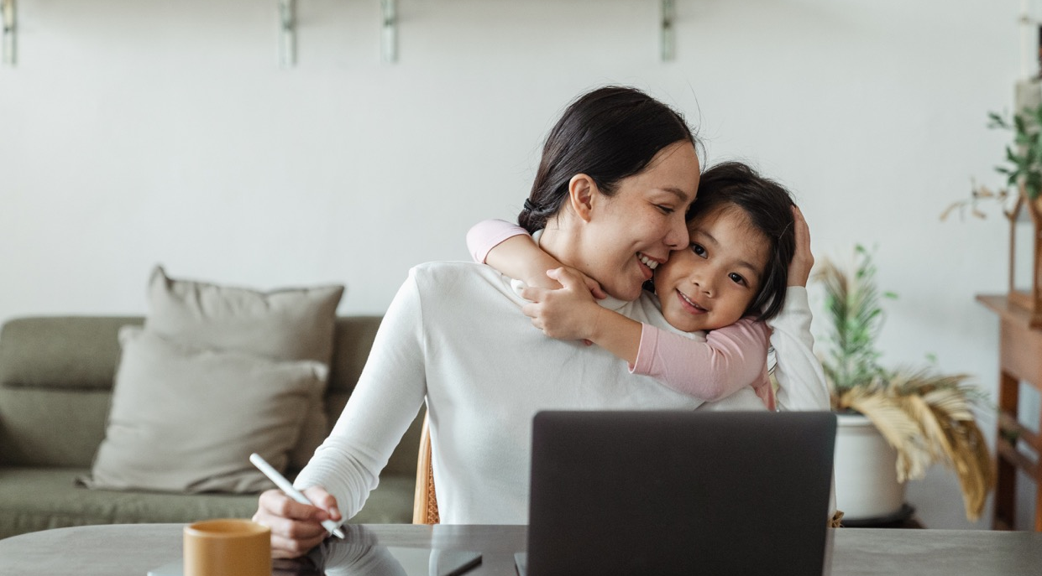
03.
Seeing your activities expand and grow
It would be antithetical to capacitation to instruct people what to do with the knowledge they've developed from participating in a process of Contributory Research. Quite on the contrary, the program ought to be stirred so it fits and supports the desires of those who wish to contribute.
Sometimes that means setting your own ambitions to a side. As evoked previously, one of the initial dreams was that the program of the Contributory Clinic would lead to what we’ve referred to as ‘Parent-ambassadors of a reasoned screen usage’: parents who could initiate their own activities against overexposure in their neighborhood. However, we did not want to impose this ambition on the parents we worked with, for whom the main concern was often to find solutions to tackle the question of screens in their personal life. In fact, we only brought it up much later when certain parents we worked with began to express a desire to pursue activities on screens outside of the framework we could offer. As a response to their request, we have since 2023 been working to constitute a new group made up of parents who have participated in our program Reason our screens and the core group who’s been working in the PMI centre, which will work to see what kind of structure – institutional, financial, technical, and social – might accommodate and render the work of parent-ambassadors sustainable.
In similar ways, you might want to facilitate discussions on other topics as they emerge alongside your regular activities. Being open to new alterations of your program forms part of a process of Contributory Research, which can also be described as a way of working against automated work – this, at least on two levels. The Contributory Economy is often presented as a way of fighting the unemployment that follows from the automation of labor, whereas Contributory Research on many occasions has been described as a de-automation of the spirit.

Slide 74
05
One Example of a Capacitation Process: Reason our Screens

Slide 75
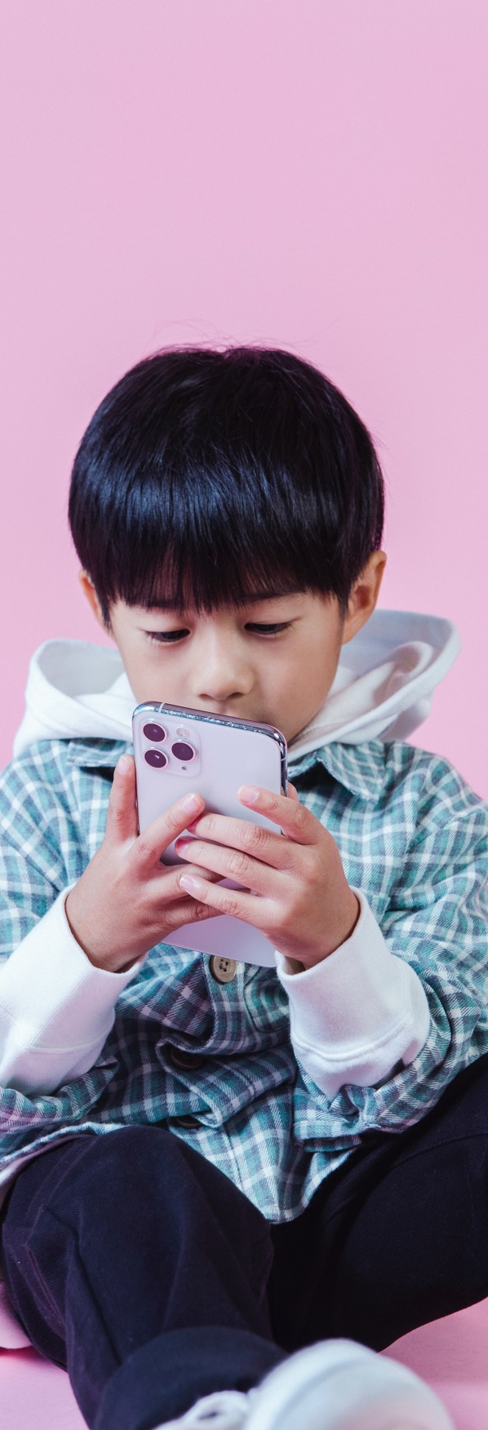
If there’s one thing we’ve hoped that you’ve taken with you from the previous pages, it’s that no group of Contributory Research will look or act the same. We sometimes say that Contributory Research always takes place within a locality, with which we mean to describe a unique organisation of actors with a particular history, whether this locality is a family, a group online, a community, a territory, or some other constellation.
Introduction
That being said, it is sometimes really helpful to see how other people have gone about structuring contributory research (on screens or on other topics). Just because contributory research is always developed locally, that doesn’t mean you cannot look towards different localities for inspiration. On the pages to follow, we will share the structure of a nine-session capacitation-process named Reason our screens, developed by the Institute of Research and Innovation with the support of the City of Saint-Denis and the French Interministerial Mission Against Drugs and Addictive Behaviors.
This particular capacitation process is based on a much longer process of contributory research initiated in 2017 (see chapter 4). When starting this work, the consequences of overexposure to screens were still a relatively unknown to most people. During the initial years of working together, our group, constituted of researchers, professionals from a maternal and child health centre, and parents, brought together the relevant scientific studies available at the time, together with theories from biology, psychology, and philosophy, and experience from the ground, to form a common pool of knowledge on the subject. It is this pool of knowledge that led to the identification of the themes we now cover during Reason our screens.

Slide 76
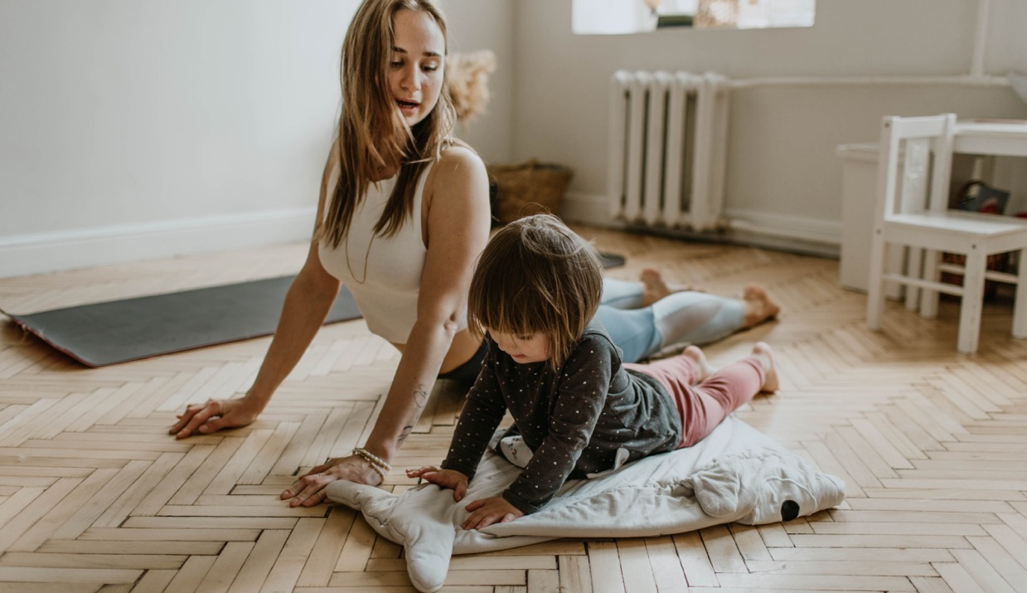
Compared to the initial phase, which required a smaller group working consistently over a long period of time, the nine-session capacitation allows for the implication of more people in the process. From 2022 to 2024, 60 professionals and 30 parents living in the department of Seine-Saint-Denis will follow the program.
Before diving into the program, one word on the difference between capacitation and training. During a training, you work towards predefined skills. During a process of capacitation, you work to help people develop their own position on a topic which allows them to conceive of new actions or practices. It means that in a process of capacitation you don’t know exactly where you’re going as no one can tell the participants in advance what such actions or practices will look like. Instead, we try to bring different facts, theories, and experiences to the table, relevant to the topic we’re treating, which might incite responses from the participants. Videos are very helpful in instigating a group discussion, and so it's worthwhile creating your own archive of relevant content.
Furthermore, we often invite people to come speak to us. Below, we’ve indicated the kinds of topics we usually cover, but the content of the session will necessarily vary depending on the expertise of the people you’ll be working with. Whether you invite a speaker or not, it’s important to keep a good balance between presenting new knowledge and letting people respond to it. Letting people respond is not just about letting them express their individual point of view. We consider each participant a valuable contributor to the capacitation process. Their ideas and inputs are as valuable as – if not more valuable than – the materials we’ve prepared in advance.
Concretely, each cohort of Reason our screens is constituted of fifteen people (ten professionals and five parents). We organise nine sessions and two follow-up sessions in the six months following the completion of the program. Each session is three hours long. We take a break in the middle of the session (we don’t want to exert people beyond reason). We bring biscuits to our workshops. There’s always coffee and tea. All of these little things matter. While we’re there to tackle a serious issue, we’ve found that one of the best strategies to fight the issue of overexposure is creating new social bonds, new relations, new friendships. Put differently, during our capacitation processes, spending a good time together is taken very seriously.

Slide 77
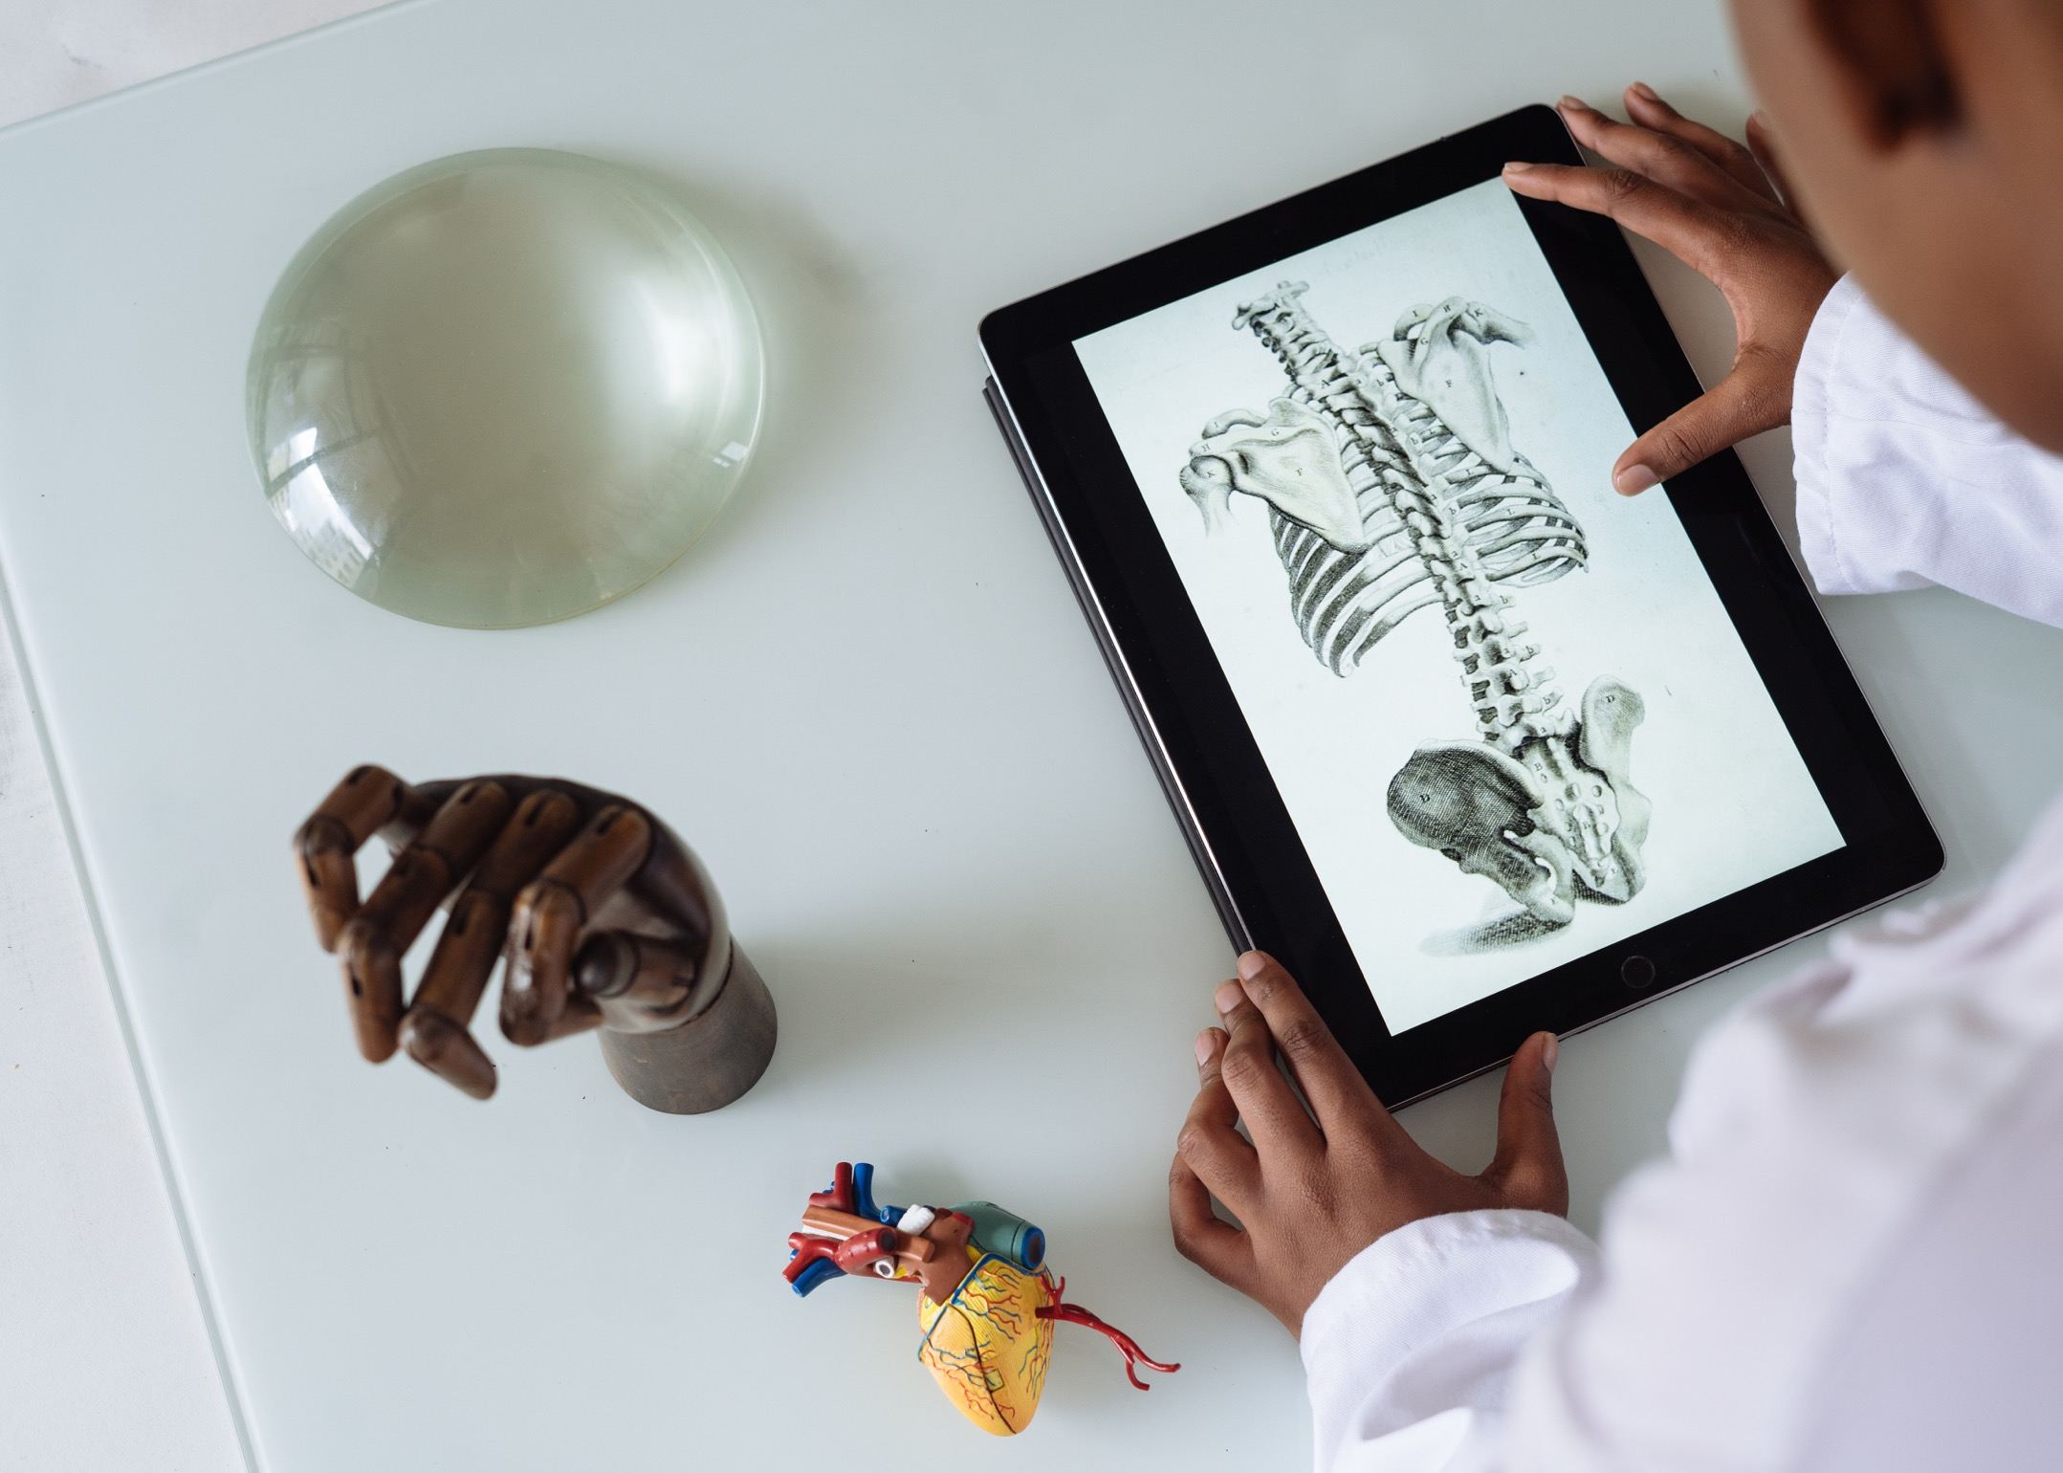
The Nine Capacitation Sessions
01.
All Addicted to Screens 78
What does Science Tell us about the Overexposure to Screen? 78
Why do Screens have a Strong Impact on Young Children? 79
The Attention Economy and Captology: the Strategies of Digital Manufacturers to Capture Attention 79
Addiction 80
To Put Yourself in the Place of… 80
Playing and Games 81
The Institutions: How to Work in your Local Area 81
New knowledge on screens, how to use it to go further 81
`
02.
03.
04.
05.
06.
07.
08.
09.

Slide 78
`
01.
All Addicted to Screens
The research process begins with acknowledging that we’re all “addicted “ to screens. No one is speaking from the ‘outside’. We’re here to invent care strategies and to be taken care of.
We present the basis of the method we’ll be following (contributory research – see chapter 2) and some of the concepts we use to think about the role of technology today (pharmakon, proletarisation – see chapter 2 part 1) and how we might invent new practices to fight overexposure (capacitation, transindividuation – see chapter 2 part 1 and 3). We ask each participant to fill out a questionnaire about their current knowledge about, and practice of, screens.
We spend some time mapping out the different participants, by responding to the following questions:
Are you worried about the impact of screens on young children?
Do you think you are equipped to act as a family on this issue?
Do you think you are equipped to act professionally on this issue?
Do you feel the need to enrich your knowledge on this issue?
Do you think you have a reasoned use of screens?
Does it feel like enough actions are happening on screens around you?
Together, we watch a video of how parents today use smartphones with their children (see in our archive here). What does the video evoke? Have any of the participants witnessed similar situations in their private or professional life? We take a moment to decide how the group will stay in touch. By email or by sms? What are the advantages and disadvantages of each technology?
`
02.
What does Science Tell us about the Overexposure to Screen?
In the last decade, a great number of scientific studies have come out on the overexposure to screens.
We invite an expert to talk to us about these studies. In France, we have worked with the pediatrician and researcher Eric Osika, but other types of profiles could be envisioned, as long as the person is up to date with the newest studies on the topic.
We spend some time discussing the studies: are people surprised by the results? Do the symptoms described correspond to the symptoms people observe in their everyday life?
We watch a video on the plasticity of the brain (see here) and invite a biologist to talk about why babies are captured by screens and what happens to their brains if overexposed (and underexposed to social relations).

Slide 79
`
03.
Why do Screens have a Strong Impact on Young Children?
Even without the studies on screen exposure, we can deduce a lot about the effects screens have on children by applying what we already know about the conditions children rely on to develop.
We invite a biologist to talk about the relation between parents and their offspring in the animal kingdom, and the particularity of the relation between the parent and human baby.
We watch a video about the monkeys Rhesus and Harlow (see here), which shows that the need for social relations is present even in primates.
We invite a psychologist to talk about how the child develops. During our workshops, we have focused on attachment theories, the different developmental stages, and the concept of the transitory object, and covered psychologists and psychoanalysts such as D.W Winnicott. Mélanie Klein, John Bowlby, T Berry Brazelton, Daniel Stern (read chapter 2), but the exact material will depend on the expertise of the speaker.
We watch a video of the still face experiment by psychologist Edward Tronick (access here). Each participant talks about an experience where a technology has come to rupture a social relation.
`
04.
The Attention Economy and Captology:
the Strategies of Digital Manufacturers to Capture Attention
If babies are overexposed to screens, it is often because their parents are overexposed. Widespread addiction to technologies did not emerge by chance. It is the result of digital marketing strategies, refined by the scientific discipline captology.
We watch an extract from the Netflix documentary The Social Dilemma (here).
We invite an expert to talk about the Attention Economy. In France, we have worked with Florent Souillet who’s a writer and activist (author of the book The War on Attention), but you could imagine inviting a sociologist, economist, or anyone else who has studied the Attention Economy.
We ask the group: in which situations do they find it difficult to stop using screens? Which applications do they return to? How does it make them feel to spend a lot of time on screens?

Slide 80
`
05.
Addiction
We can only get better from addiction if we acknowledge that we are addicted.
We make a ‘map of vulnerabilities’. Using post-its, we ask everyone to indicate 1) where they use their smartphone the most 2) when they use it the most 3) which applications they use the most 4) which mood they find themselves in when using it.
We ask everyone to do a similar exercise, this time with a mapping over when they are most likely to hand their smartphone to their child.
For each of the most common vulnerable situations, we collectively come up with strategies for how one might avoid relapsing to screens.
We watch one of the episodes of Dopamine by Arte (here). With a child psychologist, we talk about what addiction and dependence means for the baby. What is the difference between being dependent on a parent, dependent on a toy, and dependent on a smartphone?
We invite one of our parent-ambassadors to talk about the smartphone addiction of her child, and the actions she’s put in place to combat it.
`
06.
To Put Yourself in the Place of…
To effectively combat overexposure, or to talk about screens without coming across as judgemental, it is important to know how to ‘put yourself in the place of someone’, whether this someone is a young child, a friend or parent who is struggling to cut down on screen time in the home.
How does the child perceive the world? With a biologist, we talk about how the child might experience the world around it. How is this experience different from that of adults?
Together, we watch one of the automatically generated videos found on Youtube Kids (title: BURIED ALIVE Outdoor Playground Finger Family Song Nursery Rhymes Animation Education Learning Video). How might a child perceive it? Why does it come across as so disturbing to us?
Roleplay: put yourself in the place of your interlocutor. Try to act out the following situations:
In the waiting room before a medical consultation, a parent watches their smartphone.
Someone from your family gives their smartphone to their child.
A parent arrives at kindergarten with their child holding a smartphone in its stroller.

Slide 81
`
07.
Playing and Games
When thinking about alternatives to screen exposure one of the important topics to cover is play.
We invite someone to talk about the importance of free play. What does play entail for the child? How does playing help the child develop? What is the difference between ‘play’ and ‘game’? How do parents best support the child in play?
There exists today many games developed to animate discussions on screens. In groups, we test these different games. What are the advantages of each one? What are the skills required to use them?
`
08.
The Institutions: How to Work in your Local Area
It is almost impossible to fight overexposure to screens by yourself. Knowing who else is acting around will is the first step in creating local alliances and starting initiatives together.
We invite local actors to come present their work on overexposure. What does their approach look like? How does it differ from ours? Is there ground for collaborations?
In groups divided between parents and professionals, we identify actions that can be experimented in the home or at work. What are the potential obstacles from carrying out these actions? One person from each group presents the conclusions to the others.
`
09.
New Knowledge on Screens, How to Use it to go even Further
How do we keep on working against overexposure after the program?
In groups of two, each person defines an action they wish to experiment after Reason our Screens. They present the actions to everyone else in the group.
We ask each participant to fill out a questionnaire about their current knowledge about, and practice of, screens.
Collective evaluation of the program: What worked well? What could have been developed further? What knowledge has been acquired? We respond to other comments and questions.
How do we stay in touch? Choose a tool for sharing resources and ideas following the program.

Slide 82
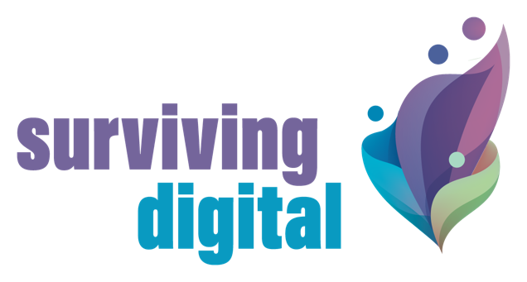

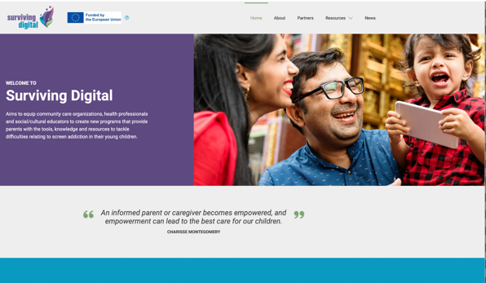








follow our journey
www.survivingdigital.eu
The European Commission support for the production of this publication does not constitute an endorsement of the contents which reflects the views only of the authors, and the Commission cannot be held responsible for any use which may be made of the information contained therein 2021-1-FR01-KA220-ADU-000033578

